Slide 1
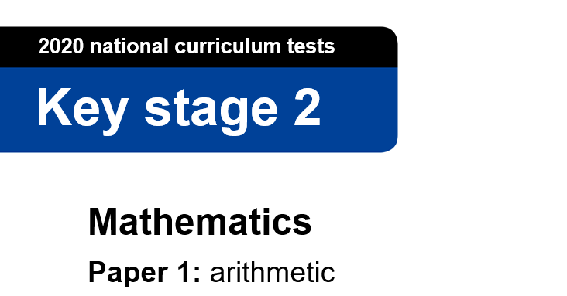
Mrs Batten and Mr Hubbard have made some deliberate(!) mistakes on their arithmetic paper – You are now the teacher! Spot the mistakes and correct them! If you wanted to, you could even leave a comment or two...
Notes:
Notes for teacher: instructions can be posted on your home learning portal or recorded by teacher as a video message and then posted.

Slide 2
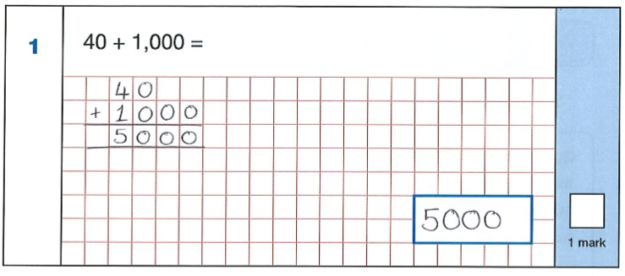
Notes:
Note for teachers: feel free to remove the note at the top if you feel it isn’t needed in your community. Each page is to be printed and laminated and then scattered around the local area for children to find on their daily walk. Alternatively, you can post each question online using your home learning portal.

Slide 3
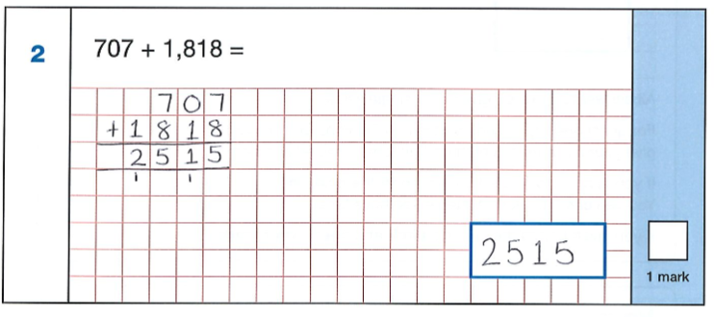
Notes:
Note for teachers: feel free to remove the note at the top if you feel it isn’t needed in your community. Each page is to be printed and laminated and then scattered around the local area for children to find on their daily walk. Alternatively, you can post each question online using your home learning portal.

Slide 4
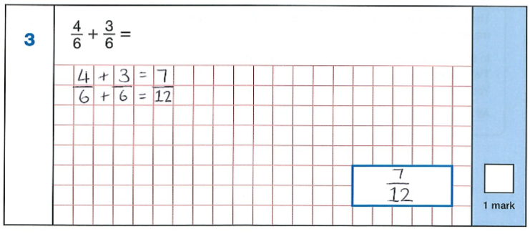
T
Notes:
Note for teachers: feel free to remove the note at the top if you feel it isn’t needed in your community. Each page is to be printed and laminated and then scattered around the local area for children to find on their daily walk. Alternatively, you can post each question online using your home learning portal.

Slide 5
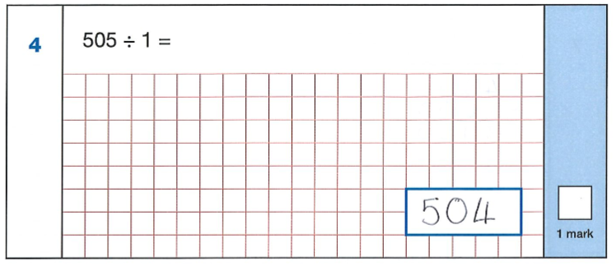
Notes:
Note for teachers: feel free to remove the note at the top if you feel it isn’t needed in your community. Each page is to be printed and laminated and then scattered around the local area for children to find on their daily walk. Alternatively, you can post each question online using your home learning portal.

Slide 6
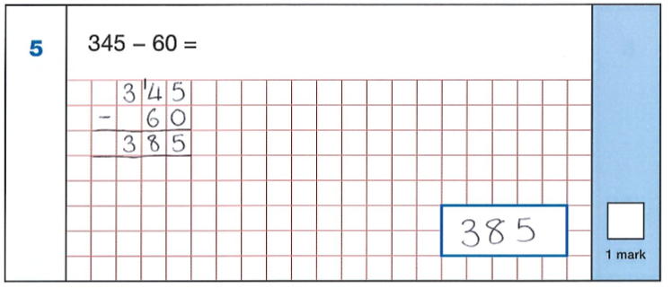
Notes:
Note for teachers: feel free to remove the note at the top if you feel it isn’t needed in your community. Each page is to be printed and laminated and then scattered around the local area for children to find on their daily walk. Alternatively, you can post each question online using your home learning portal.

Slide 7
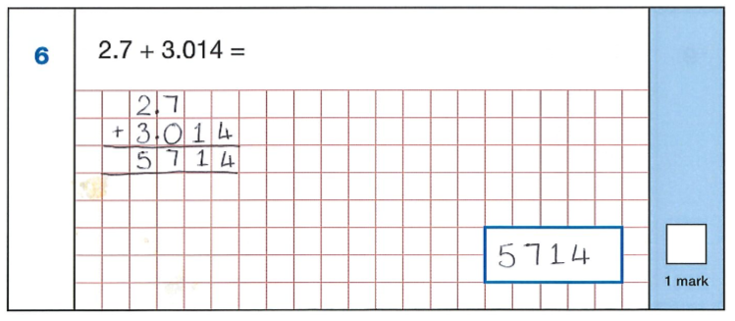
Notes:
Note for teachers: feel free to remove the note at the top if you feel it isn’t needed in your community. Each page is to be printed and laminated and then scattered around the local area for children to find on their daily walk. Alternatively, you can post each question online using your home learning portal.

Slide 8
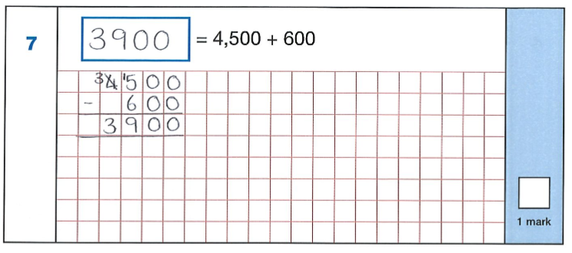
Notes:
Note for teachers: feel free to remove the note at the top if you feel it isn’t needed in your community. Each page is to be printed and laminated and then scattered around the local area for children to find on their daily walk. Alternatively, you can post each question online using your home learning portal.

Slide 9
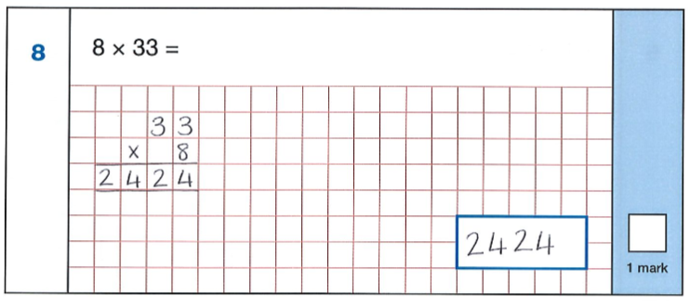
Notes:
Note for teachers: feel free to remove the note at the top if you feel it isn’t needed in your community. Each page is to be printed and laminated and then scattered around the local area for children to find on their daily walk. Alternatively, you can post each question online using your home learning portal.

Slide 10
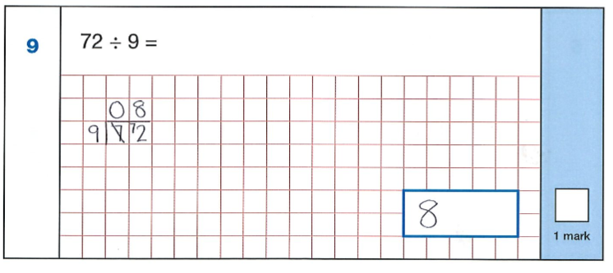
Notes:
Note for teachers: feel free to remove the note at the top if you feel it isn’t needed in your community. Each page is to be printed and laminated and then scattered around the local area for children to find on their daily walk. Alternatively, you can post each question online using your home learning portal.

Slide 11
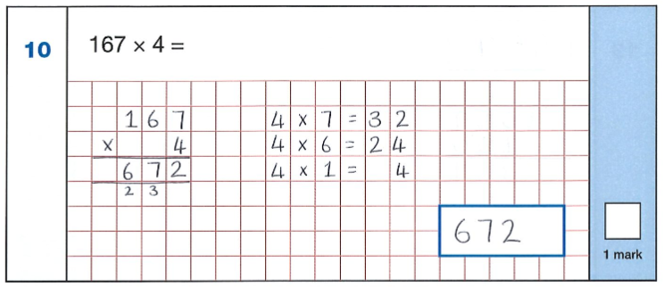
Notes:
Note for teachers: feel free to remove the note at the top if you feel it isn’t needed in your community. Each page is to be printed and laminated and then scattered around the local area for children to find on their daily walk. Alternatively, you can post each question online using your home learning portal.

Slide 12
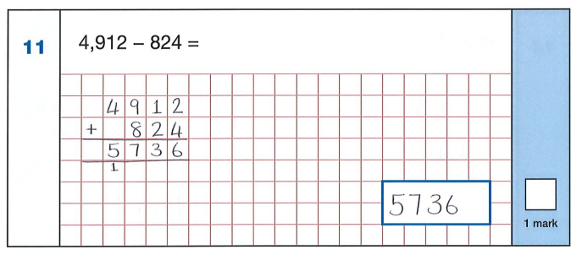
Notes:
Note for teachers: feel free to remove the note at the top if you feel it isn’t needed in your community. Each page is to be printed and laminated and then scattered around the local area for children to find on their daily walk. Alternatively, you can post each question online using your home learning portal.

Slide 13
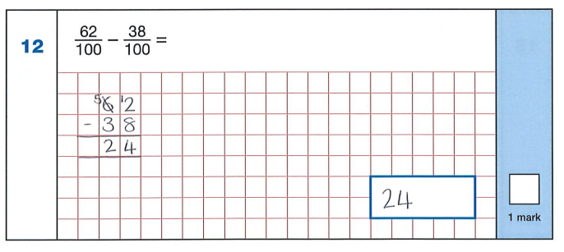
Notes:
Note for teachers: feel free to remove the note at the top if you feel it isn’t needed in your community. Each page is to be printed and laminated and then scattered around the local area for children to find on their daily walk. Alternatively, you can post each question online using your home learning portal.

Slide 14
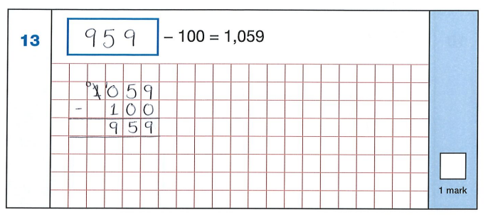
Notes:
Note for teachers: feel free to remove the note at the top if you feel it isn’t needed in your community. Each page is to be printed and laminated and then scattered around the local area for children to find on their daily walk. Alternatively, you can post each question online using your home learning portal.

Slide 15
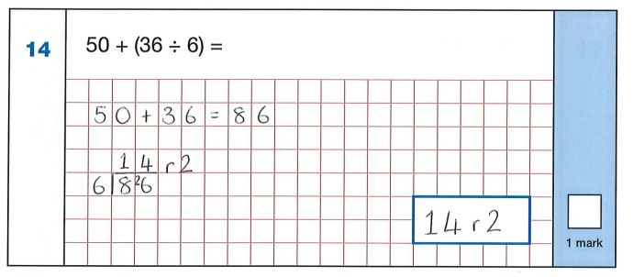
Notes:
Note for teachers: feel free to remove the note at the top if you feel it isn’t needed in your community. Each page is to be printed and laminated and then scattered around the local area for children to find on their daily walk. Alternatively, you can post each question online using your home learning portal.

Slide 16
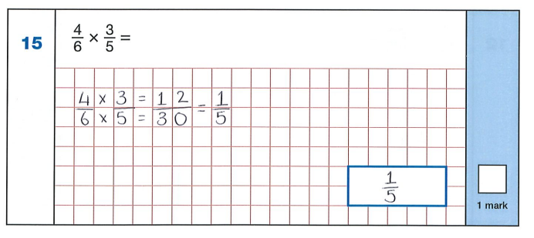
Notes:
Note for teachers: feel free to remove the note at the top if you feel it isn’t needed in your community. Each page is to be printed and laminated and then scattered around the local area for children to find on their daily walk. Alternatively, you can post each question online using your home learning portal.

