Slide 1
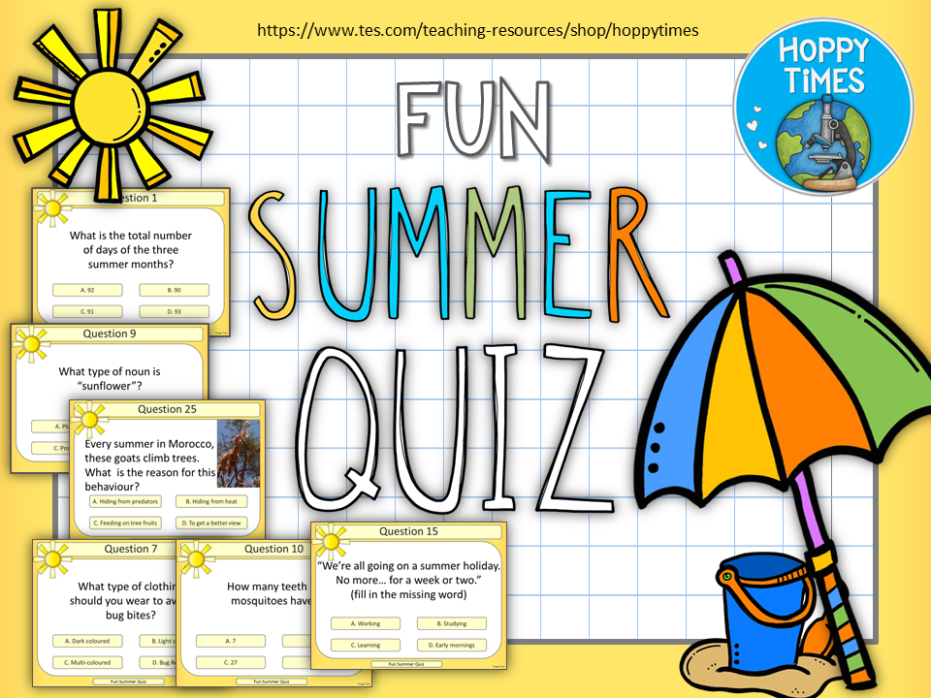

Slide 2

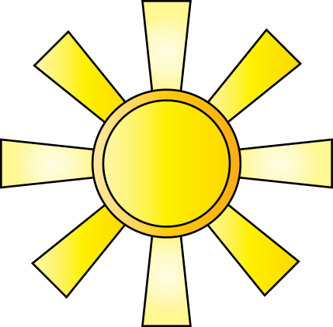
Question 1
What is the total number of days of the three summer months?
A. 92
B. 90
C. 91
D. 93
Fun Summer Quiz

Slide 3
Question 1
What is the total number of days of the three summer months?
A. 92
B. 90
C. 91
D. 93
Fun Summer Quiz

Slide 4
Question 2
Which popular summer treat was once called an Epsicle?
A. Frozen yoghurt
B. A slushy
C. Lemonade
D. Ice lolly
Fun Summer Quiz

Slide 5
Question 2
Which popular summer treat was once called an Epsicle?
A. Frozen yoghurt
B. A slushy
C. Lemonade
D. Ice lolly
Fun Summer Quiz

Slide 6
Question 3
Which of these is celebrated on the 10th of July in America?
A. Sugar Cookie Day
B. Stay Out of the Sun Day
C. Don’t Stand on a Bee Day
D. Tooth Fairy Day
Fun Summer Quiz

Slide 7
Question 3
Which of these is celebrated on the 10th of July in America?
A. Sugar Cookie Day
B. Stay Out of the Sun Day
C. Don’t Stand on a Bee Day
D. Tooth Fairy Day
Fun Summer Quiz

Slide 8
Question 4
The book “Beach Bugs” uses what poetic device in its name?
A. Alliteration
B. Rhyme
C. Onomatopoeia
D. Personification
Fun Summer Quiz

Slide 9
Question 4
The book “Beach Bugs” uses what poetic device in its name?
A. Alliteration
B. Rhyme
C. Onomatopoeia
D. Personification
Fun Summer Quiz

Slide 10
Question 5
Campers’ favourites, “s’mores” are made with biscuits and roasted …
A. Potatoes
B. Marshmallows
C. Pineapples
D. Bananas
Fun Summer Quiz

Slide 11
Question 5
Campers’ favourites, “s’mores” are made with biscuits and roasted …
A. Potatoes
B. Marshmallows
C. Pineapples
D. Bananas
Fun Summer Quiz

Slide 12
Question 6
What season comes after summer?
A. Winter
B. Autumn
C. Spring
D. Holiday season
Fun Summer Quiz

Slide 13
Question 6
What season comes after summer?
A. Winter
B. Autumn
C. Spring
D. Holiday season
Fun Summer Quiz

Slide 14
Question 7
What type of clothing should you wear to avoid bug bites?
A. Dark coloured
B. Light coloured
C. Multi-coloured
D. Bug Repellent
Fun Summer Quiz

Slide 15
Question 7
What type of clothing should you wear to avoid insect bites?
A. Dark coloured
B. Light coloured
C. Multi-coloured
D. Insect Repellent
Fun Summer Quiz

Slide 16
Question 8
Where did the first modern Summer Olympics take place in 1896?
A. Greece
B. USA
C. Germany
D. Spain
Fun Summer Quiz

Slide 17
Question 8
Where did the first modern Summer Olympics take place in 1896?
A. Greece
B. USA
C. Germany
D. Spain
Fun Summer Quiz

Slide 18
Question 9
What type of noun is “sunflower”?
A. Plural
B. Compound
C. Proper
D. Beautiful
Fun Summer Quiz

Slide 19
Question 9
What type of noun is “sunflower”?
A. Plural
B. Compound
C. Proper
D. Beautiful
Fun Summer Quiz

Slide 20
Question 10
How many teeth do mosquitoes have?
A. 7
B. 17
C. 27
D. 47
Fun Summer Quiz

Slide 21
Question 10
How many teeth do mosquitoes have?
A. 7
B. 17
C. 27
D. 47
Fun Summer Quiz

Slide 22
Question 11
Earth has 5 oceans. Which of these is not an ocean?
A. Pacific
B. Southern
C. Mediterranean
D. Indian
Fun Summer Quiz

Slide 23
Question 11
Earth has 5 oceans. Which of these is not an ocean?
A. Pacific
B. Southern
C. Mediterranean
D. Indian
Fun Summer Quiz

Slide 24
Question 12
What popular tourist attraction grows in the heat of the summer?
A. Big Ben
B. Statue of Liberty
C. Stonehenge
D. Eiffel Tower
Fun Summer Quiz

Slide 25
Question 12
What popular tourist attraction grows in the heat of the summer?
A. Big Ben
B. Statue of Liberty
C. Stonehenge
D. Eiffel Tower
Fun Summer Quiz

Slide 26
Question 13
Exposure to sunlight is one of the best ways for the human body to get which vitamin?
A. Vitamin A
B. Vitamin B
C. Vitamin C
D. Vitamin D
Fun Summer Quiz

Slide 27
Question 13
Exposure to sunlight is one of the best ways for the human body to get which vitamin?
A. Vitamin A
B. Vitamin B
C. Vitamin C
D. Vitamin D
Fun Summer Quiz

Slide 28
Question 14
Which of these were originally designed as pie plates?
A. Bottle caps
B. Vinyl records
C. Frisbees
D. Frying pans
Fun Summer Quiz

Slide 29
Question 14
Which of these were originally designed as pie plates?
A. Bottle caps
B. Vinyl records
C. Frisbees
D. Frying pans
Fun Summer Quiz

Slide 30
Question 15
“We’re all going on a summer holiday.
No more… for a week or two.”
(fill in the missing word)
A. Working
B. Studying
C. Learning
D. Early mornings
Fun Summer Quiz

Slide 31
Question 15
“We’re all going on a summer holiday.
No more… for a week or two.”
(fill in the missing word)
A. Working
B. Studying
C. Learning
D. Early mornings
Fun Summer Quiz

Slide 32
Question 16
Seen on all sunscreen bottles, what does the SPF stand for?
A. Skin pollution factor
B. Sun protection factor
C. Sun production factor
D. Skin product family
Fun Summer Quiz

Slide 33
Question 16
Seen on all sunscreen bottles, what does the SPF stand for?
A. Skin pollution factor
B. Sun protection factor
C. Sun production factor
D. Skin product family
Fun Summer Quiz

Slide 34
Question 17
What fraction of a year is summer?
A. 1/12
B. 3/4
C. 1/3
D. 1/4
Fun Summer Quiz

Slide 35
Question 17
What fraction of a year is summer?
A. 1/12
B. 3/4
C. 1/3
D. 1/4
Fun Summer Quiz

Slide 36
Question 18
Kumbaya is a traditional campfire song, but what does “kumbaya” actually mean?
A. Come and buy
B. Coming by
C. Come by here
D. Calming bay
Fun Summer Quiz

Slide 37
Question 18
Kumbaya is a traditional campfire song, but what does “kumbaya” actually mean?
A. Come and buy
B. Coming by
C. Come by here
D. Calming bay
Fun Summer Quiz

Slide 38
Question 19
Summer solstice is the ______ day of the year.
A. Shortest
B. Hottest
C. Longest
D. Sunniest
Fun Summer Quiz

Slide 39
Question 19
Summer solstice is the ______ day of the year.
A. Shortest
B. Hottest
C. Longest
D. Sunniest
Fun Summer Quiz

Slide 40
Question 20
On the 4th of July, people in America celebrate…
A. Labour Day
B. Columbus Day
C. Thanksgiving
D. Independence Day
Fun Summer Quiz

Slide 41
Question 20
On the 4th of July, people in America celebrate…
A. Labour Day
B. Columbus Day
C. Thanksgiving
D. Independence Day
Fun Summer Quiz

Slide 42
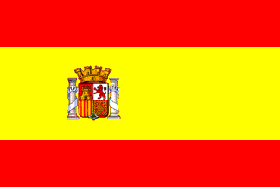
Question 21
Which popular summer tourist destination does this flag belong to?
A. Egypt
B. France
C. Spain
D. Turkey
Fun Summer Quiz

Slide 43
Question 21
Which popular summer tourist destination does this flag belong to?
A. Egypt
B. France
C. Spain
D. Turkey
Fun Summer Quiz

Slide 44
Question 22
Ants are rarely welcomed guests at a summer picnic. But do you know how long some can live for?
A. 5 days
B. 5 weeks
C. 5 years
D. 5 decades
Fun Summer Quiz

Slide 45
Question 22
Ants are rarely welcomed guests at a summer picnic. But do you know how long some can live for?
A. 5 days
B. 5 weeks
C. 5 years
D. 5 decades
Fun Summer Quiz

Slide 46
Question 23
Every 4 years, the World Cup is held in the summer. What sport does it represent?
A. Baseball
B. Football
C. Basketball
D. Snowball
Fun Summer Quiz

Slide 47
Question 23
Every 4 years, the World Cup is held in the summer. What sport does it represent?
A. Baseball
B. Football
C. Basketball
D. Snowball
Fun Summer Quiz

Slide 48
Question 24
Which planet is closest to the Sun?
A. Mercury
B. Venus
C. Jupiter
D. Mars
Fun Summer Quiz

Slide 49
Question 24
Which planet is closest to the Sun?
A. Mercury
B. Venus
C. Jupiter
D. Mars
Fun Summer Quiz

Slide 50
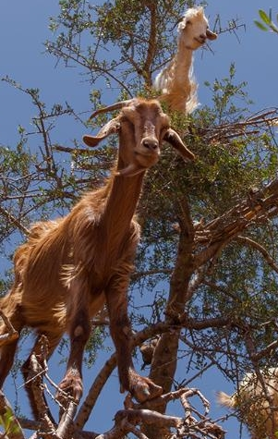
Question 25
Every summer in Morocco,
these goats climb trees.
What is the reason for this behaviour?
A. Hiding from predators
B. Hiding from heat
C. Feeding on tree fruits
D. To get a better view
Fun Summer Quiz

Slide 51
Question 25
Every summer in Morocco,
these goats climb trees.
What is the reason for this behaviour?
A. Hiding from predators
B. Hiding from heat
C. Feeding on tree fruits
D. To get a better view
Fun Summer Quiz

Slide 52
End of quiz
Did you know?
When a mosquito bites, it does not use its teeth but a special tube called proboscis, that pierces the skin and sucks out blood.
Each sunflower with its yellow petals and fuzzy brown centres consists of thousands of tiny flowers.
27th of July is Take Your Plant For A Walk Day in America.
A year in Mercury is 88 days, yet a Mercury day is 176 Earth days.
Fun Summer Quiz

