Slide 1
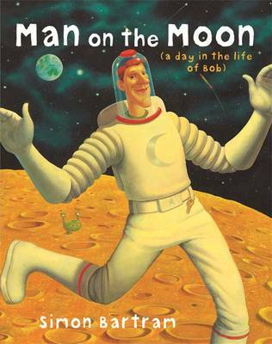
ENGLISH 20/21/22 July Focus text Man on the moon – A day in the life of Bob
20.07.21 LO: identify and write contractions
Watch the video of the story!
https://www.youtube.com/watch?v=rt5zq1uo6re

Slide 2
20.07.21 LO: identify and write contractions
What is a contraction?
Why are they useful?
Can you think of some examples of words that join together to form contractions?

Slide 3
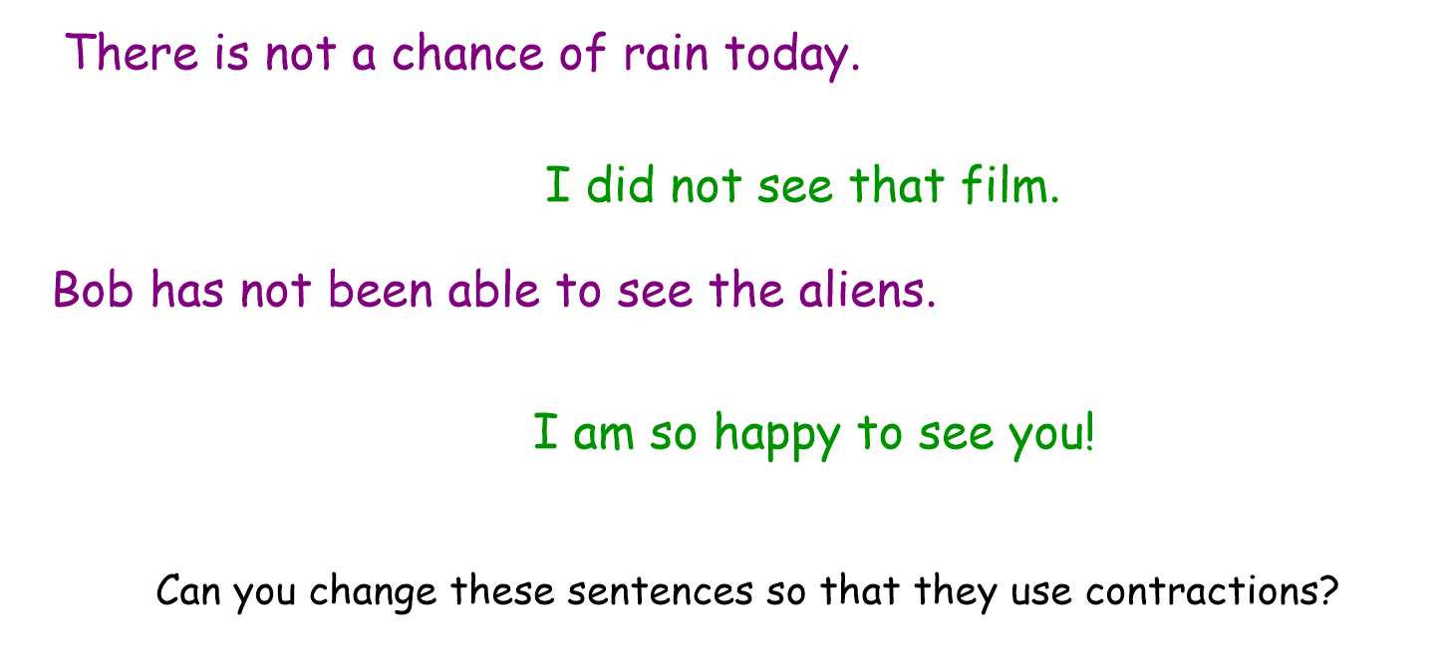

Slide 4
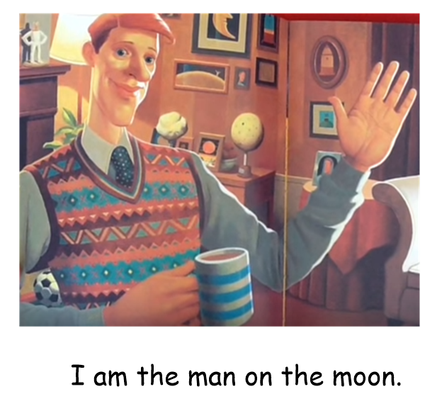
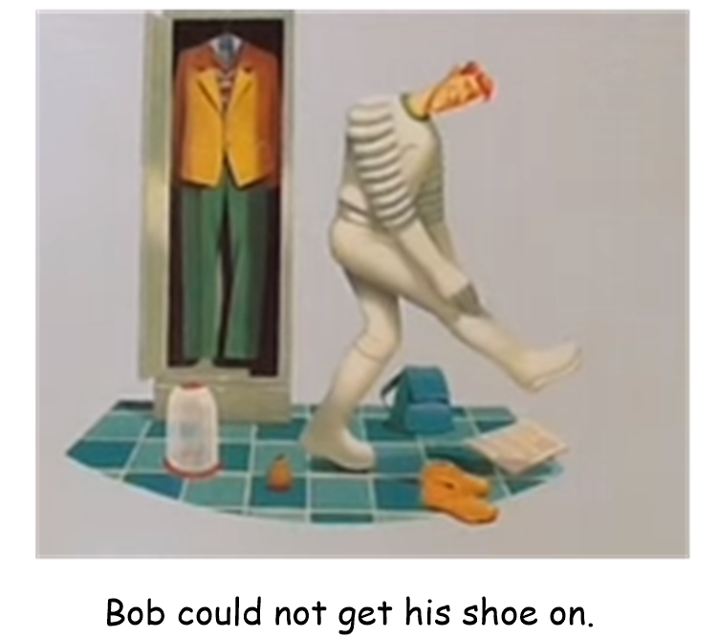
Write these as contractions on your white boards/ paper!

Slide 5
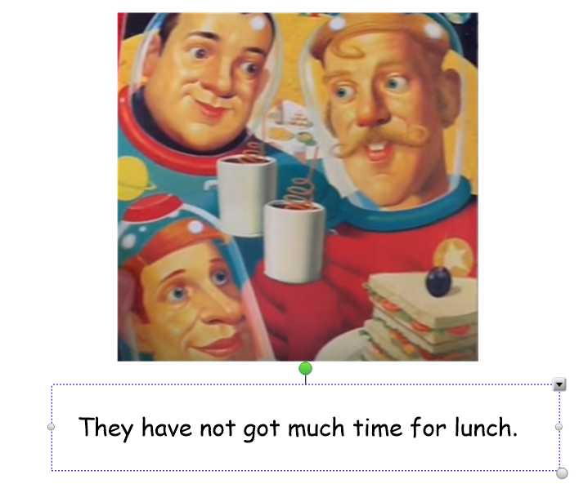
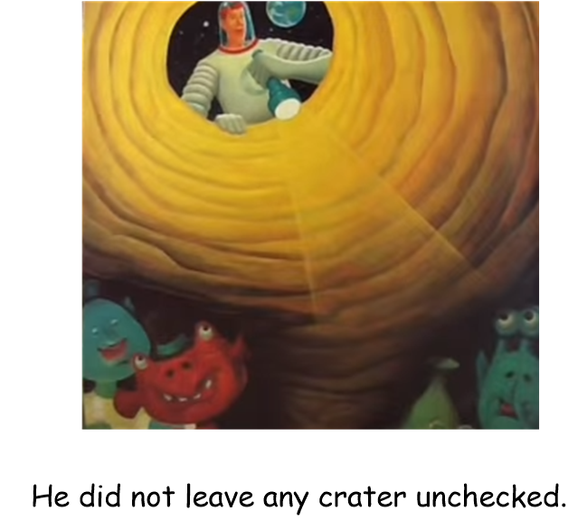

Slide 6
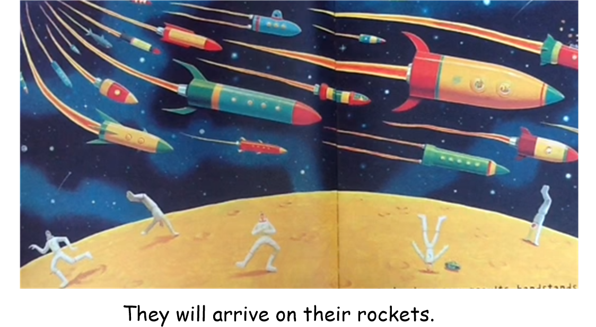

Slide 7
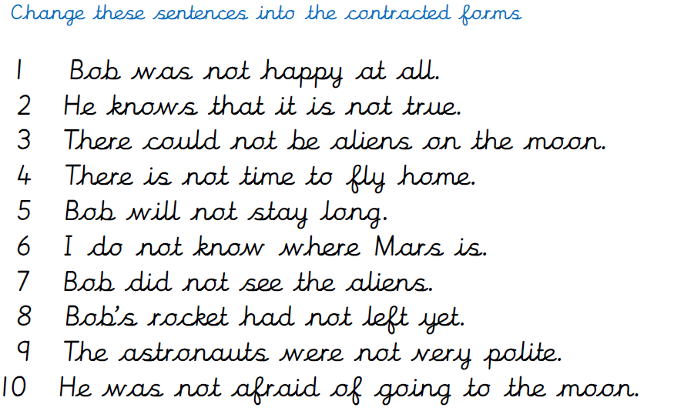
Your task:
Change the sentences on the sheet into their contracted forms

Slide 8
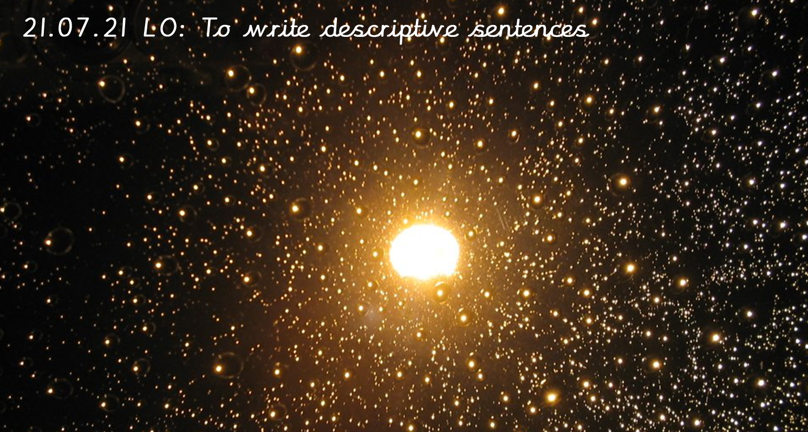
Let’s find out a bit more about space!
Look carefully at the images you will be writing some super sentences in a bit!
https://www.youtube.com/watch?v=Qd6nLM2QlWw

Slide 9
We are going to practise our amazing sentence writing skills using expanded noun phrases and fantastic description!
Song to remember expanded noun phrases! https://www.youtube.com/watch?v=WhEoRVNJfDs&t=25s
Can you think of some sentences for these pictures….

Slide 10
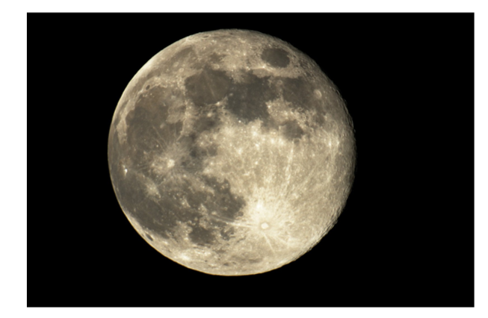
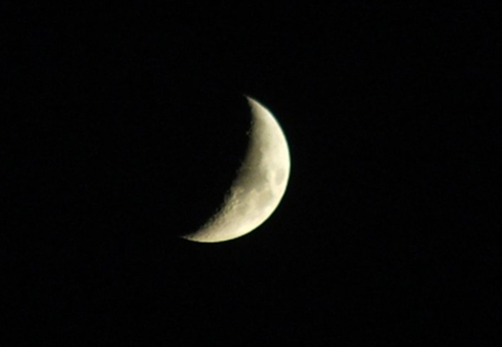

Slide 11
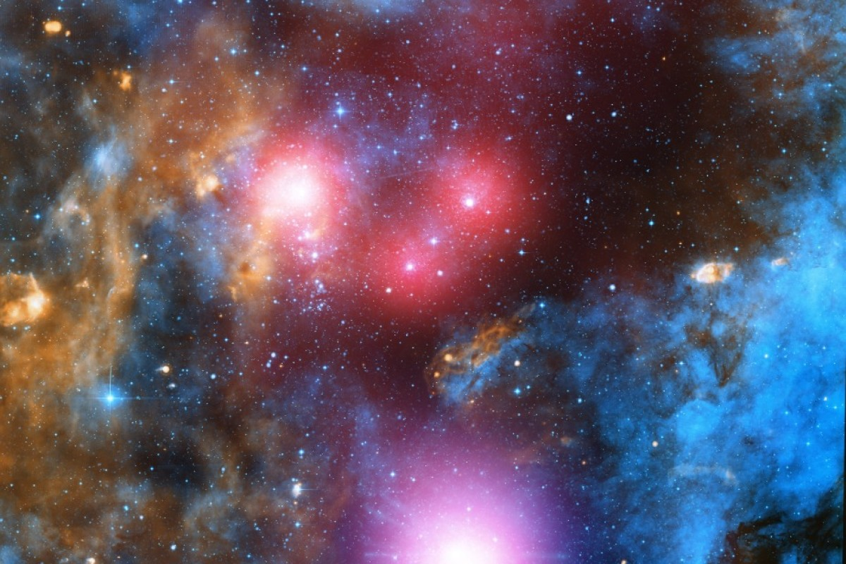

Slide 12
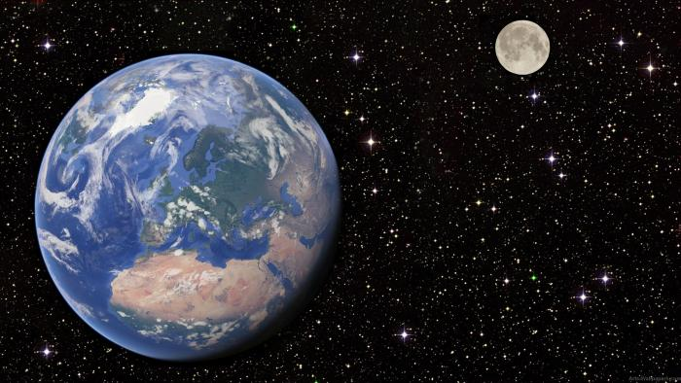

Slide 13
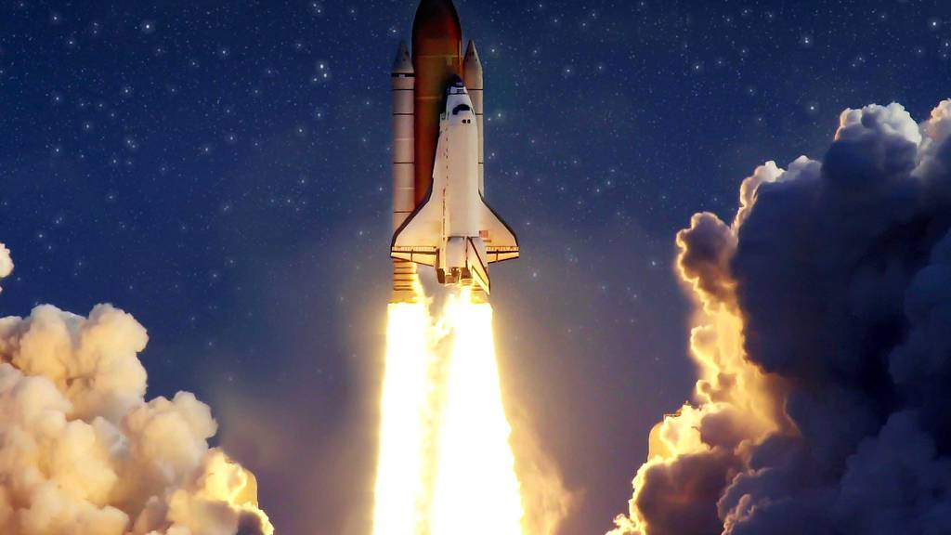

Slide 14
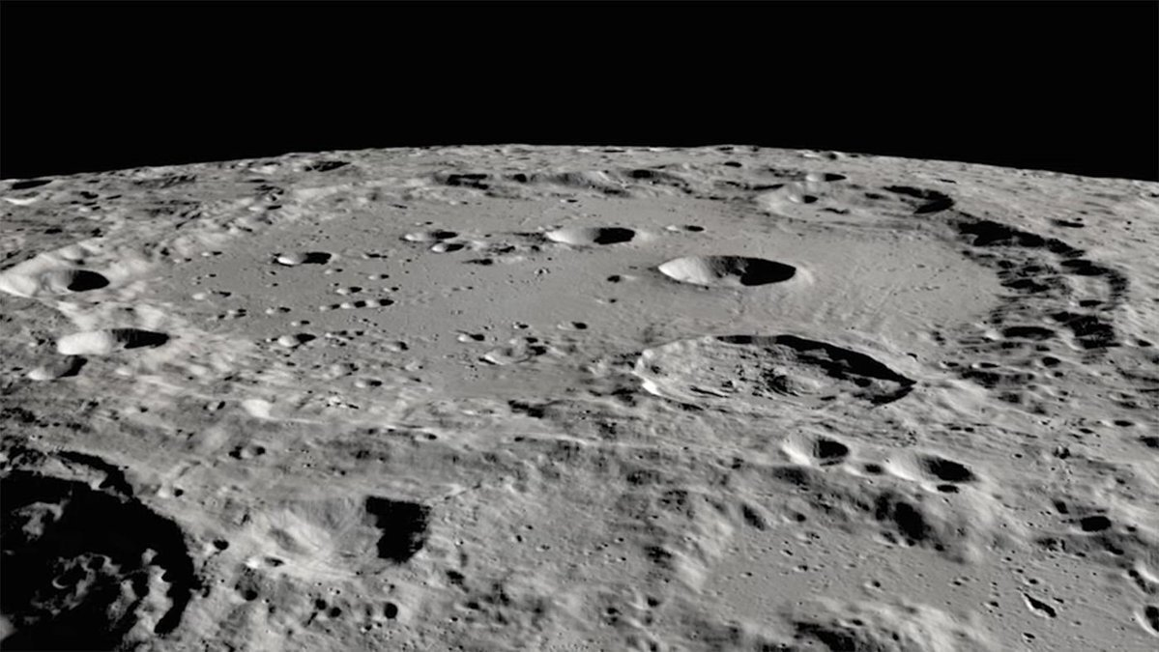

Slide 15
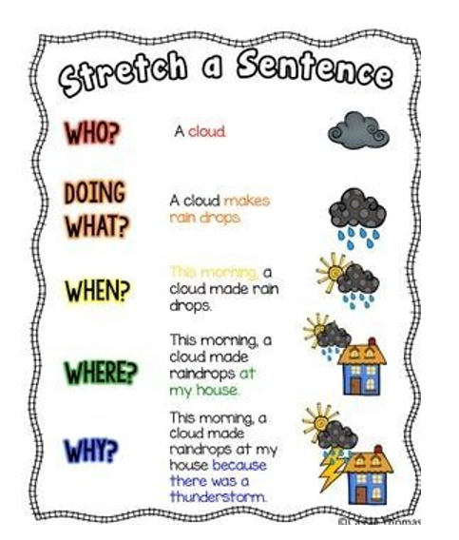
Your task ! Now write some super sentences for the pictures on the sheet!
Remember these questions ……

Slide 16
22.07.21 LO: Recall facts and detail from text
Watch video of story again
https://www.youtube.com/watch?v=Rt5zQ1UO6rE
Remind to listen carefully and look for details ready for a quiz!!
Tasks: Children complete the quiz sheet then the sequencing pictures task

Slide 17


