Slide 1


exclamation
statement
Guess the
sentence type
command
question

Slide 2



Slide 3


Slide 4



Slide 5

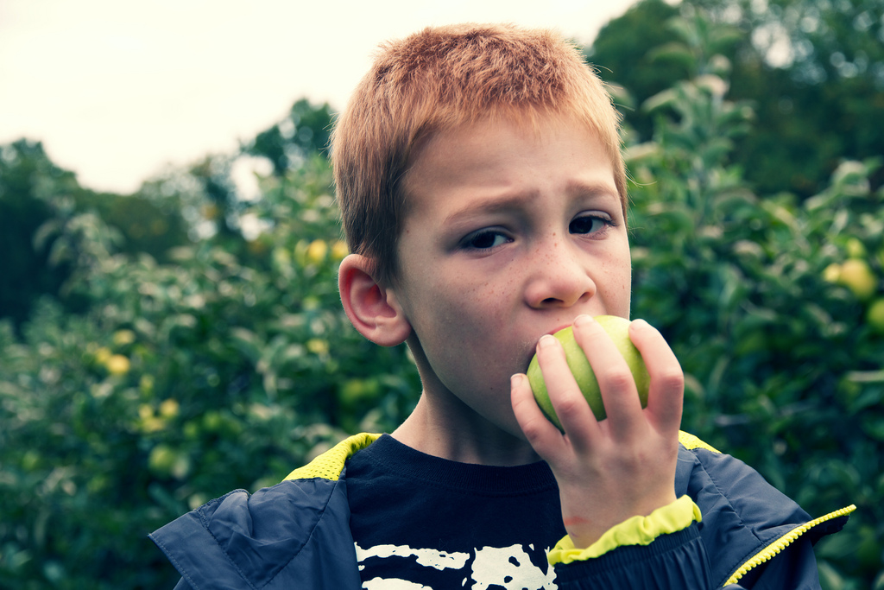

Slide 6

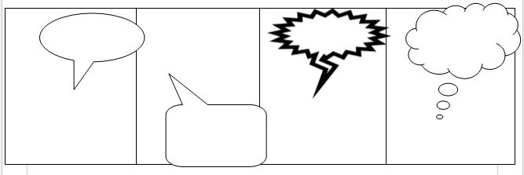
exclamation
statement
Now it’s
your turn!
command
question
Create your
own
comic strip
sentences

