Slide 1
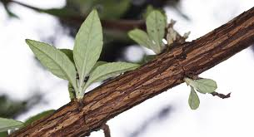
Create a continuous line drawing of this branch
Continuous line- a line that has no breaks in, so the pencil doesn’t come off the page until you finish. This means there is only one start and finish.
Aim higher- include the texture of the bark and draw the leaves with your continuous line as well

Slide 2
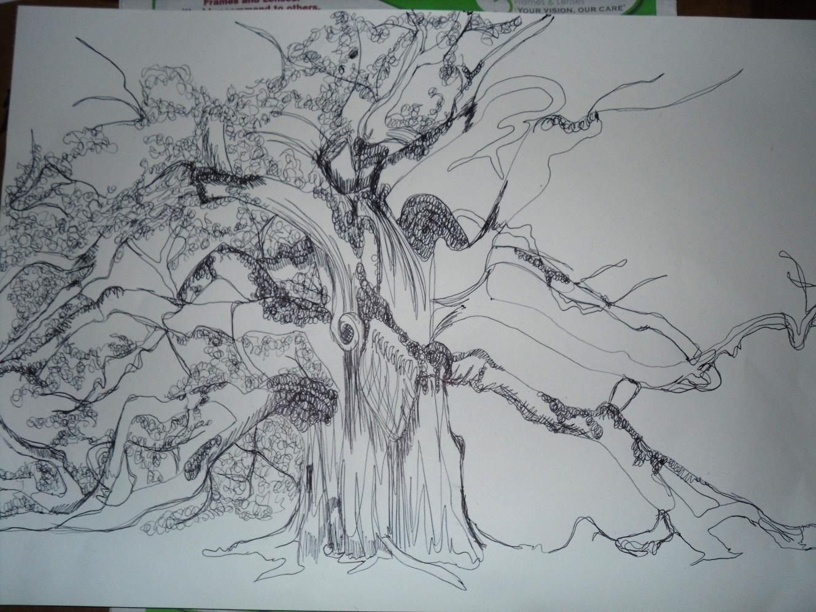
Continuous line of a tree
Start with simple shapes and lines.
Always keep your pencil on the page
Later add texture and detail using different shading techniques.
Aim higher- use shading techniques to add accurate detail and texture to the bark and leaves.

