Slide 1
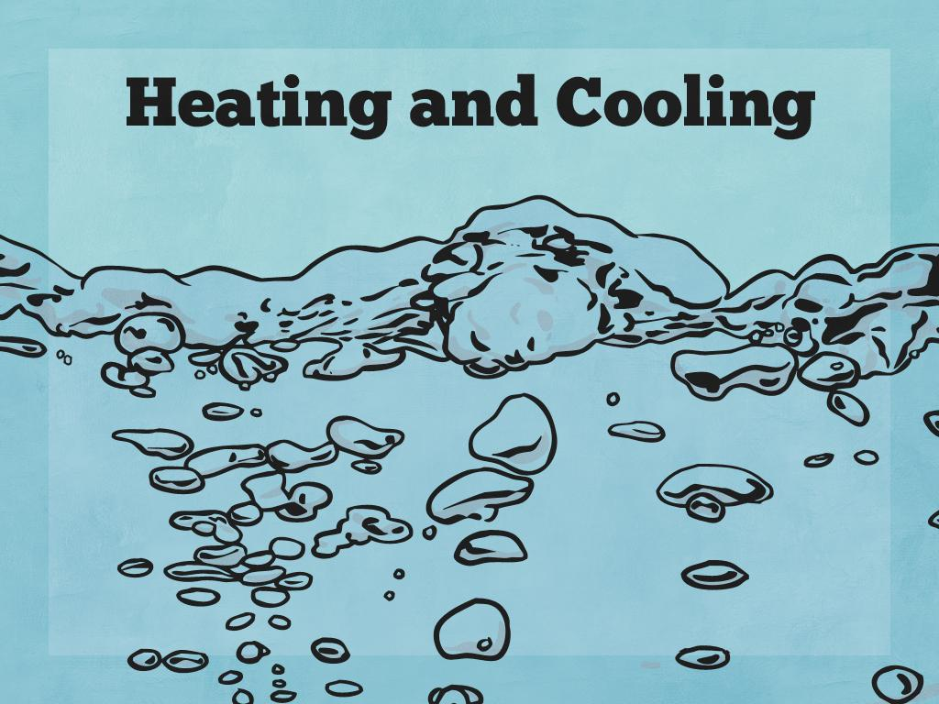


Slide 2

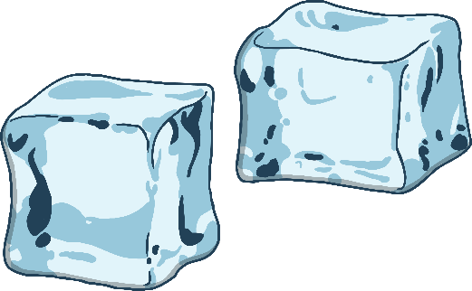
What Makes
Materials Change State?
Materials can be in three different states: solid, liquid or gas.
But how do materials change state?
Have a look at the diagram opposite and choose the correct labels for each arrow.
liquid
solid
freezing
melting

Slide 3
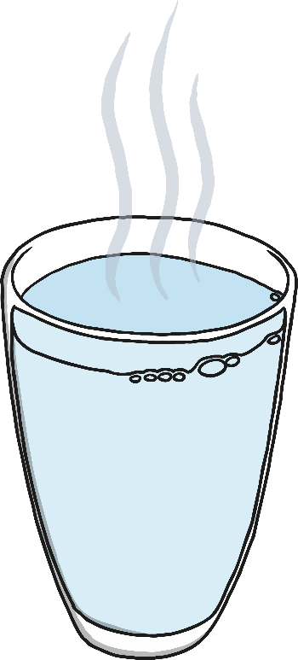
What Makes
Materials Change State?
When a solid turns into a liquid it is called melting.
The temperature at which a solid material melts is called its
melting point. Different materials have different melting points.
If a solid material is heated to its melting point, it will start to
melt and will change state from a solid to a liquid.
In a solid, the particles are closely packed together and are vibrating
on the spot. When a solid is heated, the particles start to move faster and faster. If enough heat is applied, the particles will have enough energy to move about. They are still close together, but can move over and around each other. At this point, the solid has melted to form a liquid.

Slide 4

What Makes
Materials Change State?
When a liquid turns into a solid it is called freezing.
The temperature at which a liquid material freezes is called its
freezing point. Different materials have different freezing points.
It is important to remember that some materials have freezing
points above 0°C. For example, the freezing point of iron is
around 1550°C! Interestingly, this means its melting point is also
its freezing point, just in reverse! Above this temperature, it will be
liquid iron. Below this temperature, it will be solid iron.
If a liquid material is cooled to its freezing point, it will turn from a
liquid to a solid.
The particles in a liquid are close together, but can move quite quickly around and over each other. As it is cooled, the particles start to slow down. Eventually, they slow down so much that they only move gently on the spot, and a solid structure is formed. The material has frozen.

Slide 5

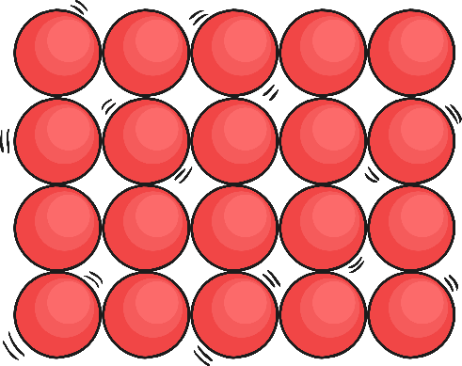

What Makes
Materials Change State?

Slide 6

Melting Chocolate
This is Maya. She is getting the food ready for her birthday party, and wants to make some chocolate crispy cakes.
Her party is only a few hours away, so she needs to make them fast! She needs to know the best temperature for melting chocolate.
When she has melted the chocolate, she can then add the cereal, shape the mixture into cakes and leave them to freeze in time for her party!
Can you help her find the best temperature for melting chocolate?

Slide 7
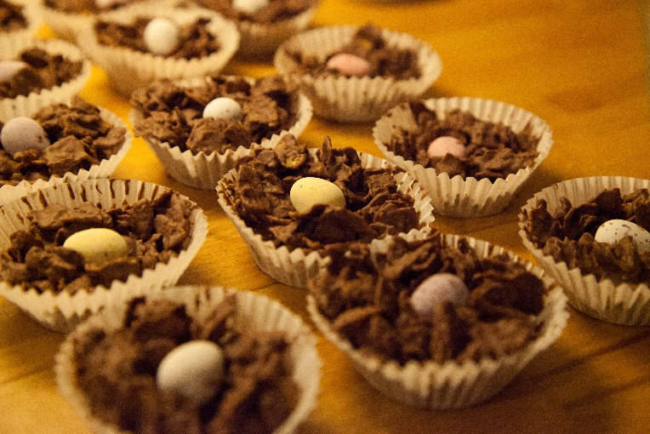
Melting Chocolate
You will place a piece of chocolate in a foil tin and float each tin on a different temperature of water.
You will see how long it takes for the pieces of chocolate to melt at the different temperatures.
Complete your Melting Chocolate Investigation Activity Sheet with your ideas about the equipment you will need, how you will carry out the investigation and your prediction.
Then carry out your investigation

Slide 8


Freezing Chocolate
I want to make sure the
chocolate crispy cakes are solid before my party guests arrive!
I am going to put them outside so the chocolate freezes and changes into a solid quicker.
Do you think Maya's idea is a good one?

