Slide 1
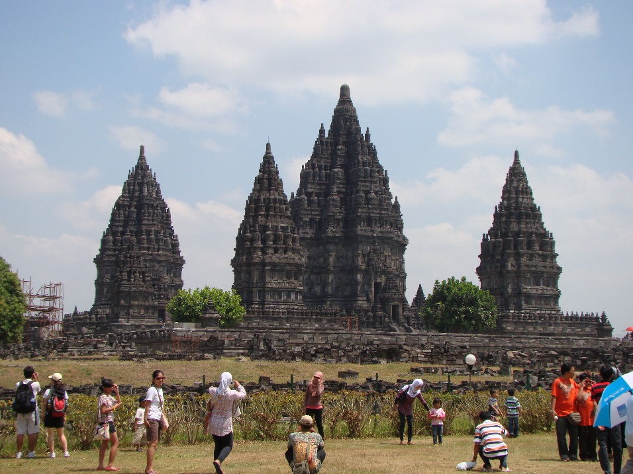
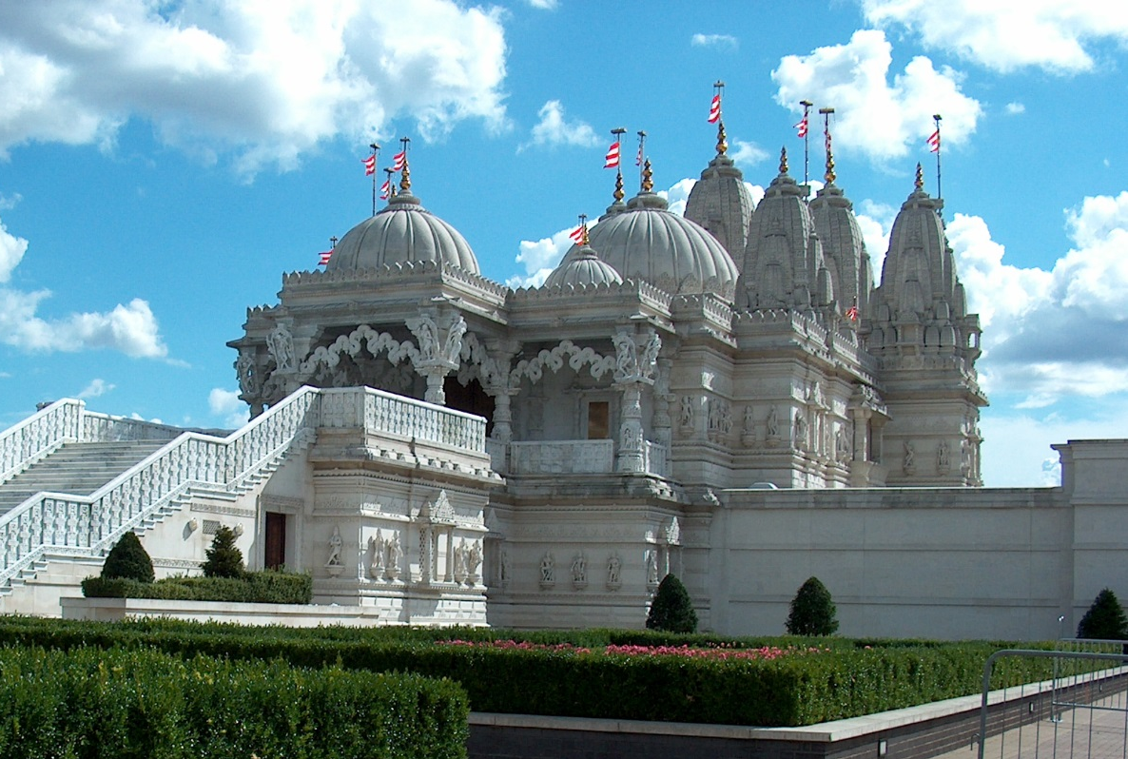
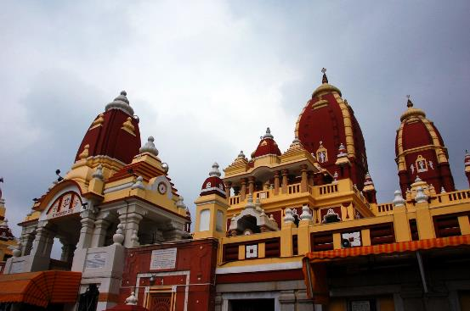
Starter Activities
All of these buildings look different, but what do they all have in common?
Who might visit them?
What might happen there?
Photos courtesy of VasenkaPhotography, Fulvio's photos and RussBowling @flickr.com - granted under creative commons licence - attribution

Slide 2


Slide 3
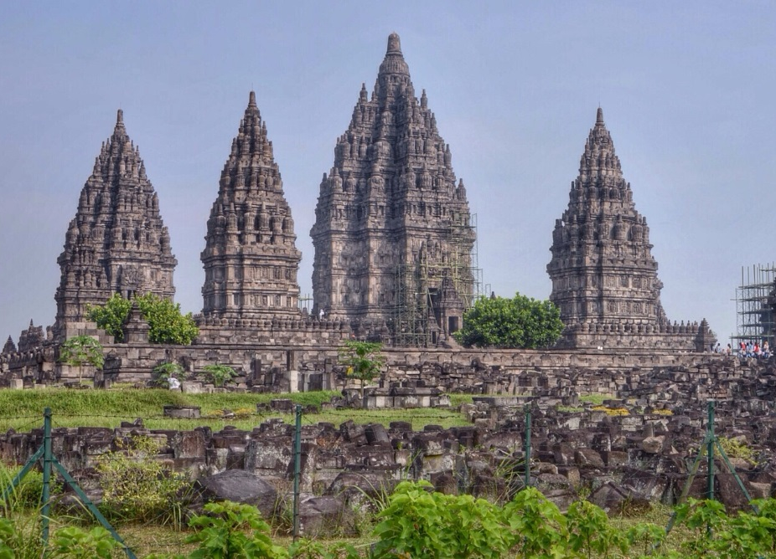
Hindu Mandirs Around the World
Prambanan is the largest temple in Indonesia.
Photos courtesy of claudechauvin.com (@flickr.com) - granted under creative commons licence - attribution

Slide 4
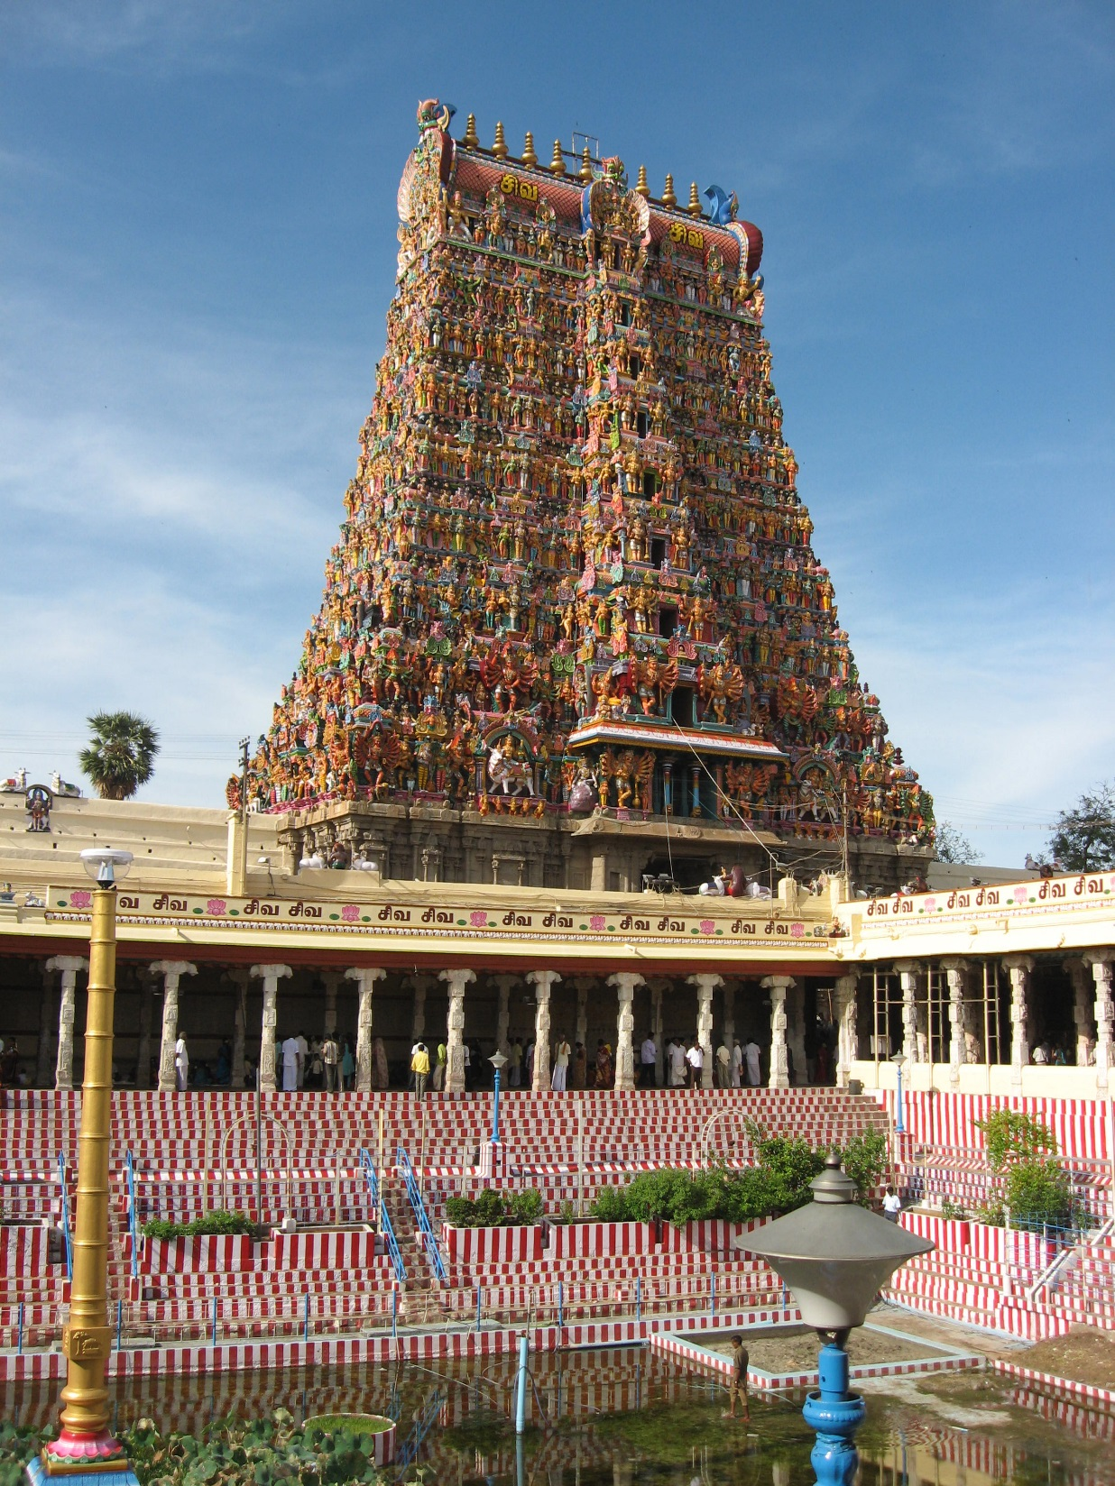
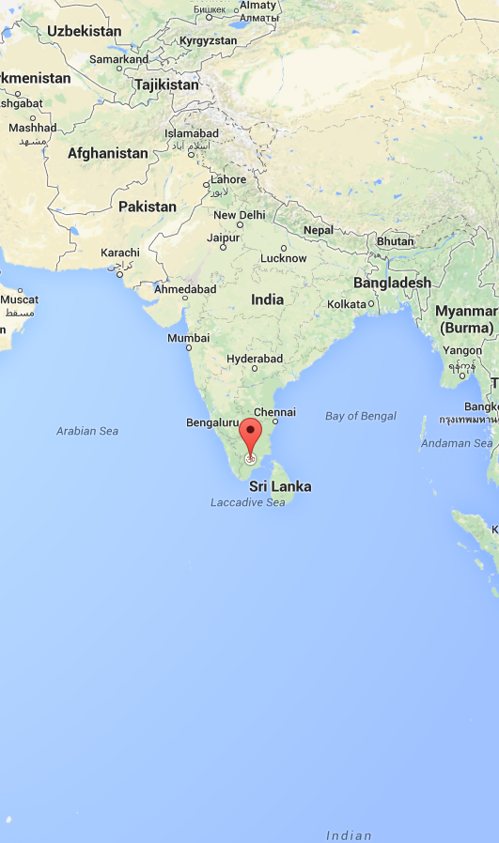
The Meenakshi Amman Temple is one of the most important Indian Hindu temples with 14 towers!
Photos courtesy of Ashok666 (@flickr.com) - granted under creative commons licence - attribution
Map Source: 2014 Basarsoft, Google, ORION-ME, SK planet, ZENRIN

Slide 5
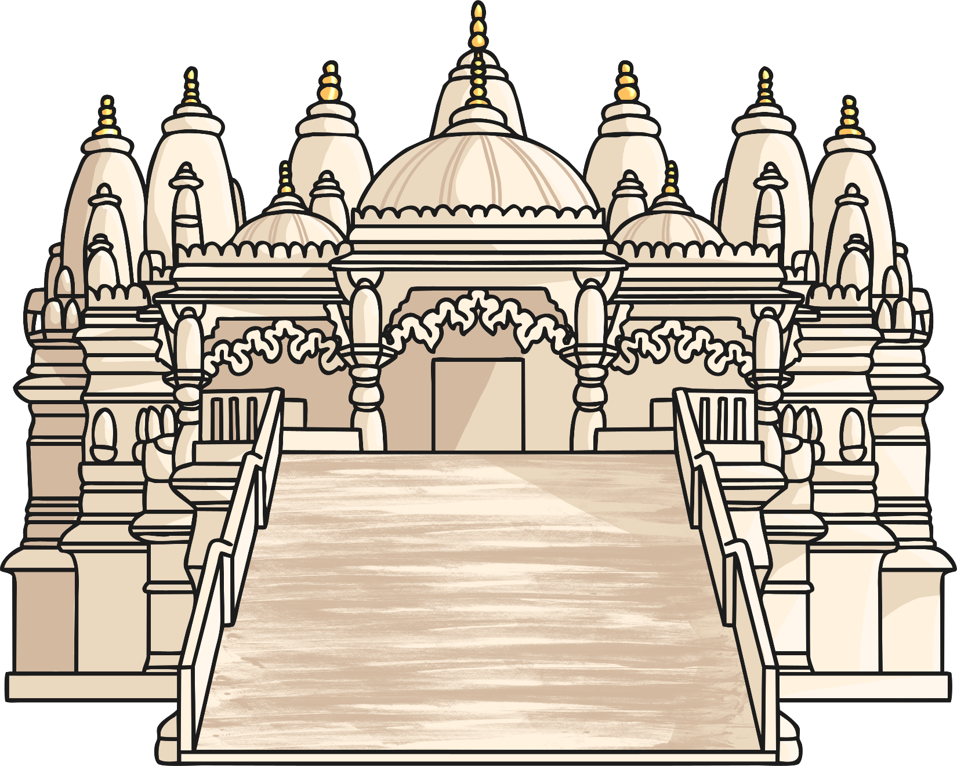
The Sree Ganapathy Temple, in London, is a busy and exciting place. As well as being used for worship, birth, wedding and death ceremonies, it is also a place where visitors can go and discuss and strengthen their faith, take part in meditation classes and yoga.
At a Hindu temple, different parts of the building have a special meaning, for example, the central shrine inside the mandir represents the heart of the Hindu worshipper, and if the temple has a tower this symbolises a connection with heaven.

Slide 6
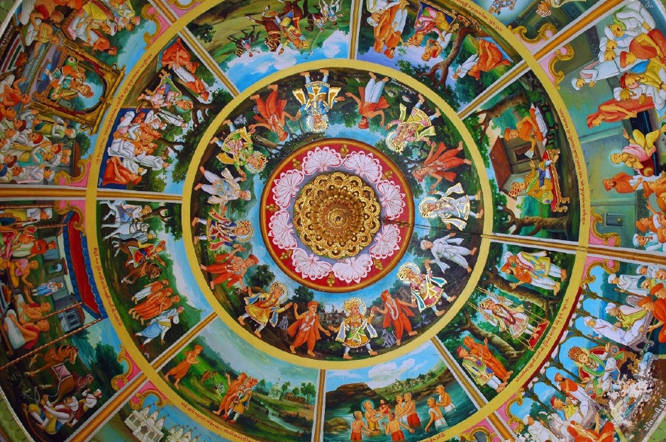
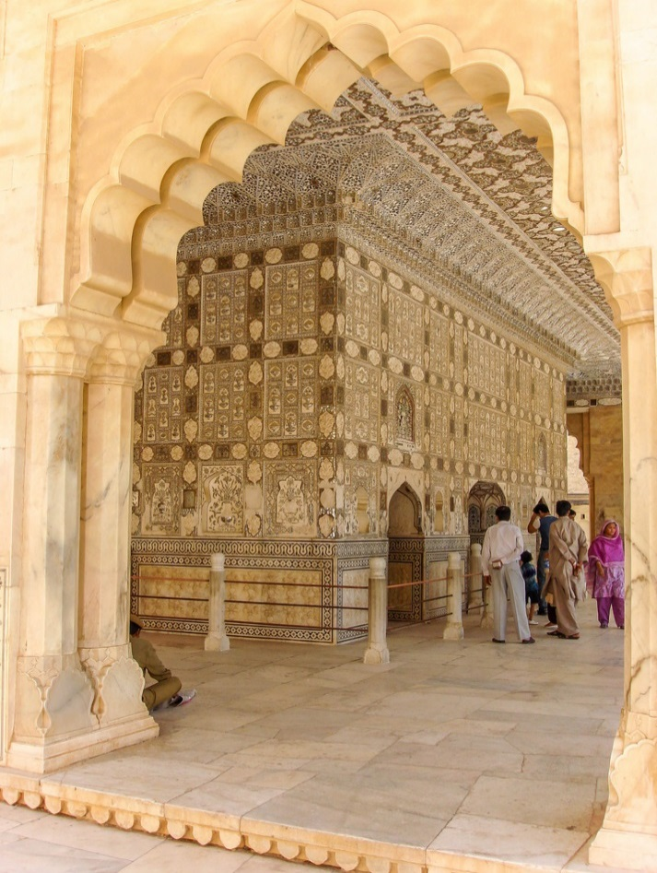
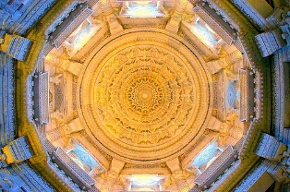
Do they all look the same on the inside?
Photos courtesy of Gadhada07 <DEEPAK GUPTA> and Fulvio's photos (@flickr.com) - granted under creative commons licence - attribution

Slide 7

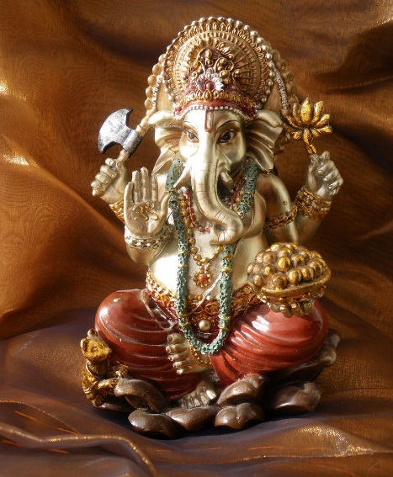
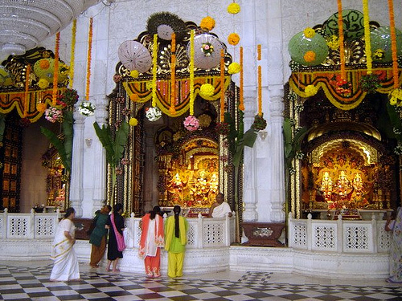
Murti
A murti is a statue of God, or a god or goddess.
Shoe Rack
A place to store shoes before entering the mandir.
Important Features of a Hindu Mandir
Main Shrine
This is the heart of the temple to represent the heart of the worshipper. It is usually at the front of the temple.
Photo courtesy of Os Rúpias and justfluff (@flickr.com) - granted under creative commons licence - attribution

Slide 8

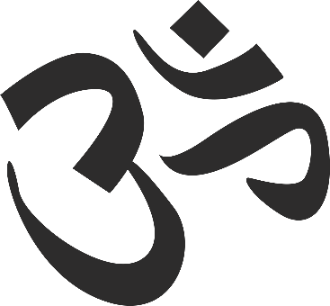
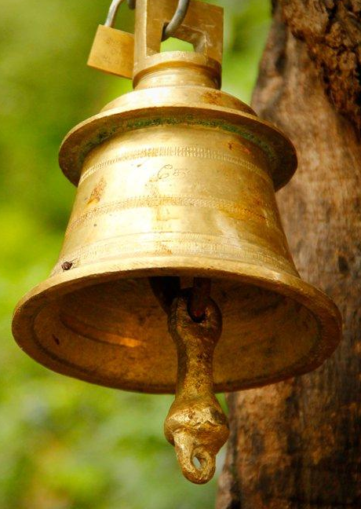
Aum
This is the Hindu symbol. You may see this if you are ever visiting a Hindu temple.
Vedas
These are the ancient Hindu texts. They are kept safe in a special case.
Important Features of a Hindu Mandir
Bell
Worshippers ring the bell before entering to let God know they have arrived.
Photo courtesy Natesh Ramasamy (@flickr.com) - granted under creative commons licence - attribution

Slide 9
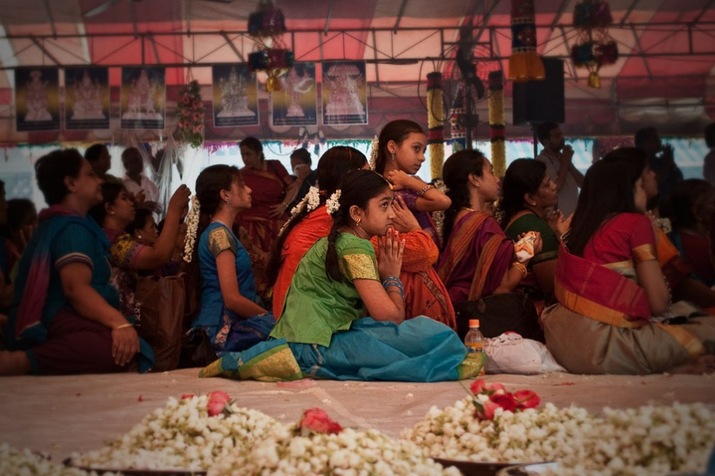
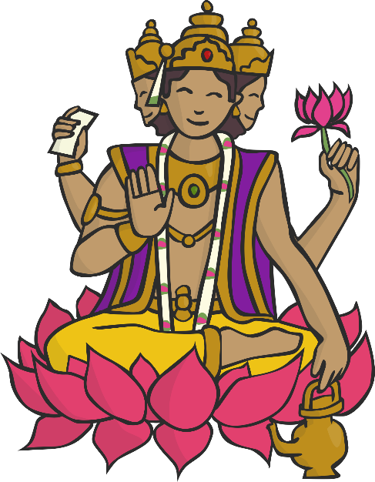


Why do people go to a Hindu Mandir?
Worship, or ‘puja’, takes place here. Hindus can come at any time to be peaceful, pray and sing religious songs.
Each mandir is dedicated to a god and inside will be a shrine to that god. Offerings or ‘prasad’ such as flowers, fruit, water, milk, nuts or sweets are made. Incense is burned to make the temple feel special and during worship, Hindus chant the names of their favourite gods and goddesses.
Photo courtesy of williamcho and oldandsolo (@flickr.com) - granted under creative commons licence - attribution

Slide 10
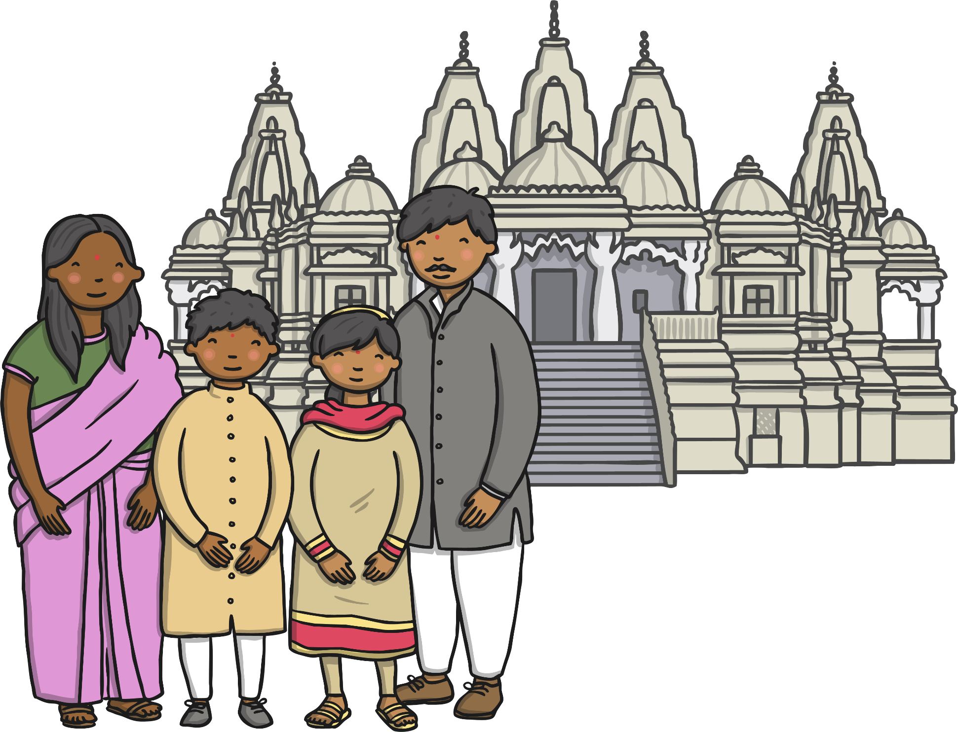
Worshipping at the mandir is a special time to be together with other Hindus.
Mandirs are seen as a place where heaven meets the earth so many mandirs are tall buildings, like mountains reaching up into the sky.

Slide 11
Activity
Watch the video about going to the mandir to worship.
Make a list of things that happen.
http://www.bbc.co.uk/learningzone/clips/worship-in-a-hindu-shrine/3619.html

Slide 12
Showing Respect
Before entering the mandir you must have a wash, make sure you are wearing clean clothes and remove your shoes.
You must make offerings to the gods.
Bow to show respect to the gods.

