Slide 1

Calculating Angles 1
Use angle facts to calculate missing angles at a point and on a line
Solve problems involving right angle notation and vertically opposite angles
Set up and solve equations from geometric diagrams with justifications
Key Words
intersect
point
right angle
straight line
vertically opposite
equation
degrees

Slide 2


Calculating Angles 1
Use angle facts to calculate missing angles at a point and on a line
Solve problems involving right angle notation and vertically opposite angles
Set up and solve equations from geometric diagrams with justifications
Starter Task
Question 1
Which is angle is smallest?
Question 2
Find the missing angle y
Question 3
Find the missing angle k
What angle facts have you used to answer these questions?
Key Words
intersect
point
right angle
straight line
vertically opposite
equation
degrees

Slide 3
Calculating Angles 1
Use angle facts to calculate missing angles at a point and on a line
Solve problems involving right angle notation and vertically opposite angles
Set up and solve equations from geometric diagrams with justifications
Answers
Question 1
B
Question 2
$$y=141°$$
𝑦=141°
Question 3
$$k=141°$$
𝑘=141°
What angle facts have you used to answer these questions?
Key Words
intersect
point
right angle
straight line
vertically opposite
equation
degrees

Slide 4

Calculating Angles 1
FACTS
Use angle facts to calculate missing angles at a point and on a line
Solve problems involving right angle notation and vertically opposite angles
Set up and solve equations from geometric diagrams with justifications
There are $360°$ in a full turn at a point.
Key Words
intersect
point
right angle
straight line
vertically opposite
equation
degrees

Slide 5
Calculating Angles 1
FACTS
Use angle facts to calculate missing angles at a point and on a line
Solve problems involving right angle notation and vertically opposite angles
Set up and solve equations from geometric diagrams with justifications
There are $180°$ in a half turn creating a straight line.
Key Words
intersect
point
right angle
straight line
vertically opposite
equation
degrees

Slide 6
Calculating Angles 1
FACTS
Use angle facts to calculate missing angles at a point and on a line
Solve problems involving right angle notation and vertically opposite angles
Set up and solve equations from geometric diagrams with justifications
There are $90°$ in a quarter turn creating a right angle.
Key Words
intersect
point
right angle
straight line
vertically opposite
equation
degrees

Slide 7


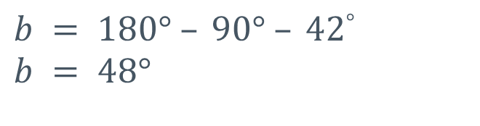



Calculating Angles 1
Use angle facts to calculate missing angles at a point and on a line
Solve problems involving right angle notation and vertically opposite angles
Set up and solve equations from geometric diagrams with justifications
Example 1:
Calculate the size of angle of $b$.
This symbol is
a right angle
Box
It
Up!
$$90°$$
$$b$$
$$42°$$
There are $180°$ on a straight line
$$b = 180° – 90° – 42°$$
$$b = 48°$$
Key Words
intersect
point
right angle
straight line
vertically opposite
equation
degrees

Slide 8




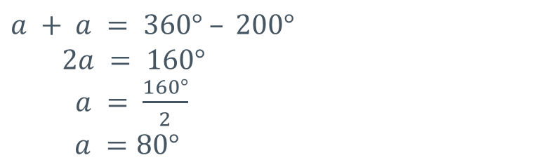

Calculating Angles 1
Use angle facts to calculate missing angles at a point and on a line
Solve problems involving right angle notation and vertically opposite angles
Set up and solve equations from geometric diagrams with justifications
Example 2:
Calculate the value of $a$.
Angles with the
same letter are
the same size.
$$a$$
Box
It
Up!
$$a$$
$$200°$$
There are $360°$ in a full turn at a point
$$a + a = 360° – 200°$$
$$2a = 160°$$
$a = \frac{160°}{2}$
$$a =80°$$
Key Words
intersect
point
right angle
straight line
vertically opposite
equation
degrees

Slide 9
Worksheet
Use angle facts to calculate missing angles at a point and on a line
Solve problems involving right angle notation and vertically opposite angles
Set up and solve equations from geometric diagrams with justifications
Key Words
intersect
point
right angle
straight line
vertically opposite
equation
degrees

Slide 10
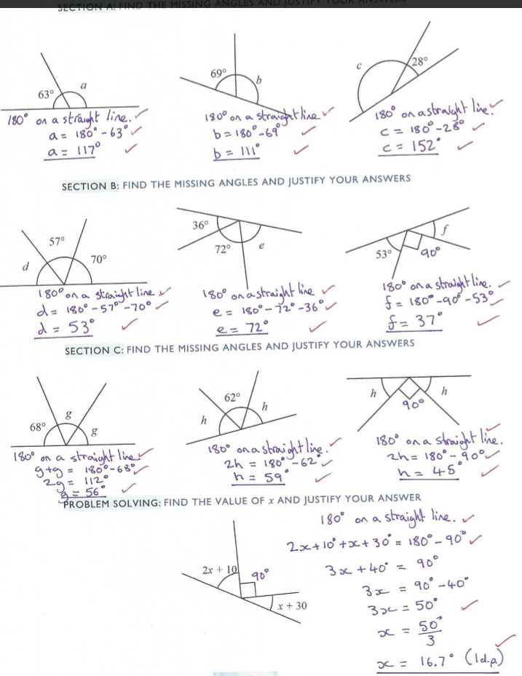
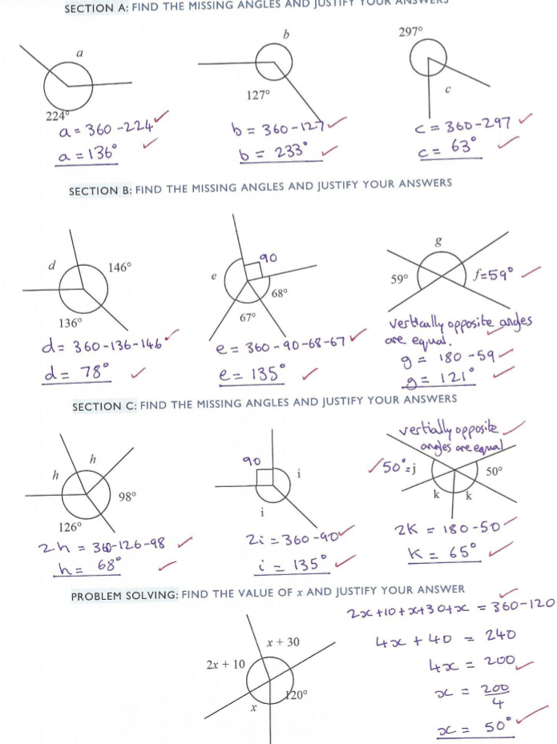
Worksheet Answers
Use angle facts to calculate missing angles at a point and on a line
Solve problems involving right angle notation and vertically opposite angles
Set up and solve equations from geometric diagrams with justifications
Key Words
intersect
point
right angle
straight line
vertically opposite
equation
degrees

Slide 11
Home Research for next time
By cutting out a triangle and ripping the three angles off, can you convince me that the sum of angles in a triangle is $180°$?
Can you use the same idea to demonstrate the sum of the angles in a quadrilateral?
These ideas can be easily researched online if you like. Stick your results in the two boxes and describe in the spaces below.
Use angle facts to calculate missing angles at a point and on a line
Solve problems involving right angle notation and vertically opposite angles
Set up and solve equations from geometric diagrams with justifications
Triangles
Quadrilaterals
Key Words
intersect
point
right angle
straight line
vertically opposite
equation
degrees

Slide 12
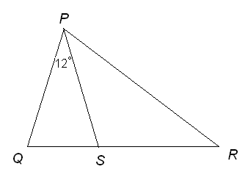
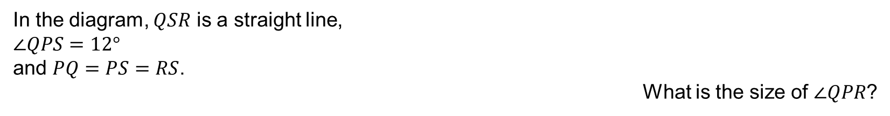
Consider this. . . . .
Use angle facts to calculate missing angles at a point and on a line
Solve problems involving right angle notation and vertically opposite angles
Set up and solve equations from geometric diagrams with justifications
In the diagram, $QSR$ is a straight line,
$∠QPS=12°$
and $PQ=PS=RS$.
What is the size of $∠QPR$?
Key Words
intersect
point
right angle
straight line
vertically opposite
equation
degrees

