Slide 2
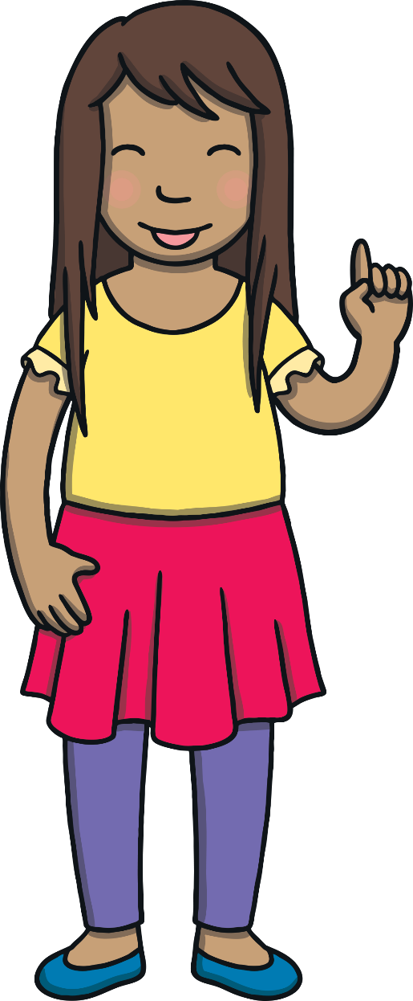
Revisit and Review
Let’s revisit last week’s focus words…
I’ll say them and you write them down!

Slide 3

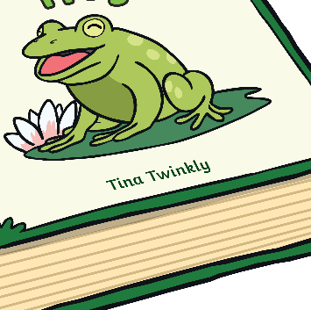
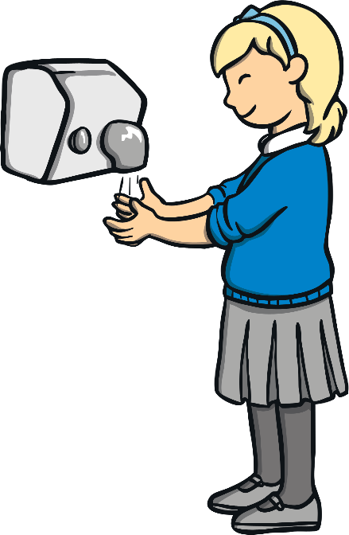
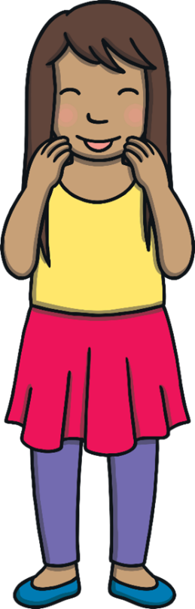
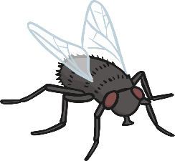

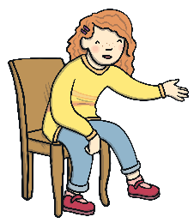
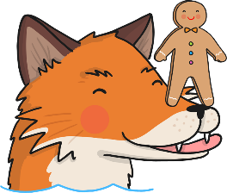


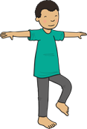

Revisit and Review

Slide 4
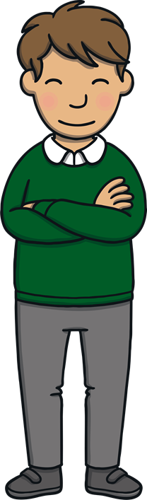
Teach
Today, we are learning to read and spell words containing dge saying /j/.

Slide 5
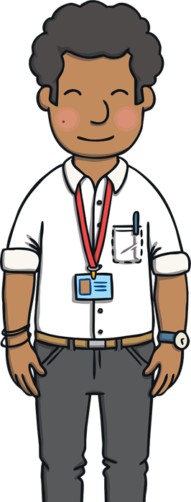

Teach
Mr Philips is writing words with his black pen on the whiteboard for today’s lesson.
All the words have dge saying /j/ in them. Sometimes, dge can make the /j/ sound at the end of a word.
Read the words on the whiteboards.
X
The grapheme ‘dge’ is used for the phoneme /j/ when the word contains a short vowel sound in the middle, e.g. ‘hedge’ or ‘badge’.
Click me for Kit’s teaching tips!

Slide 6


edge

Slide 7
hedge

Slide 8
badge

Slide 9
bridge

Slide 10
fridge

Slide 11
nudge

Slide 12
dodge

Slide 13
sledge

Slide 14
dge Match-Up
Practise
Mr Philips gives the children some word and picture cards. Match each dge word to the correct picture.

Slide 15
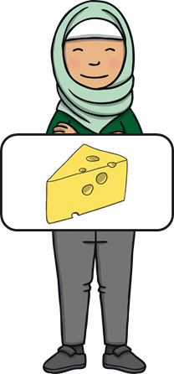
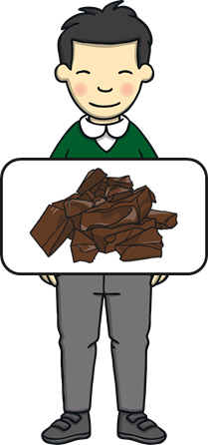
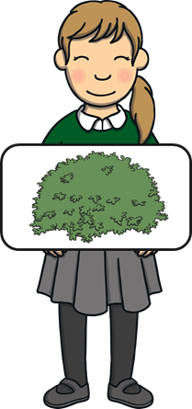
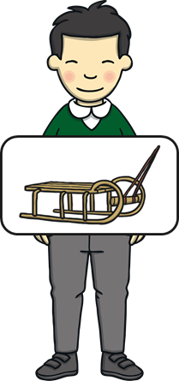
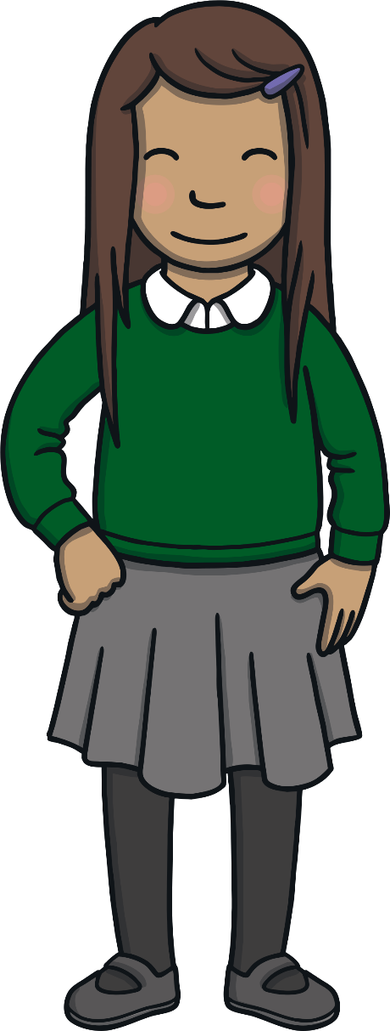
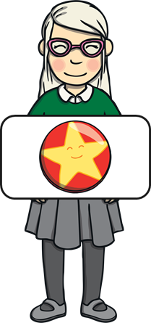
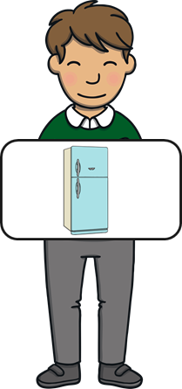
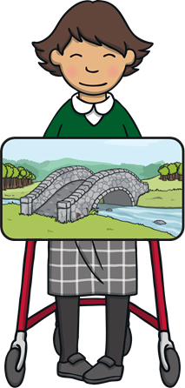
Practise
hedge
hedge

Slide 16
Practise
badge
badge

Slide 17
Practise
bridge
bridge

Slide 18
Practise
fridge
fridge

Slide 19
Practise
sledge
sledge

Slide 20
Practise
fudge
fudge

Slide 21
Practise
wedge
wedge

Slide 22

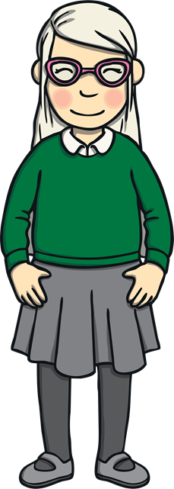
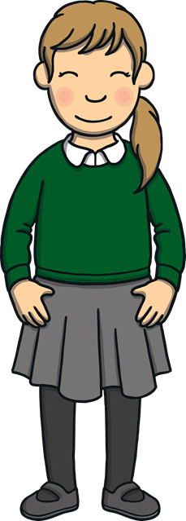

Text Detectives
Apply
Read the words on the sign and spot any dge saying /j/ words.
Read the words on the sign and spot any dge saying /j/ words.

Slide 23
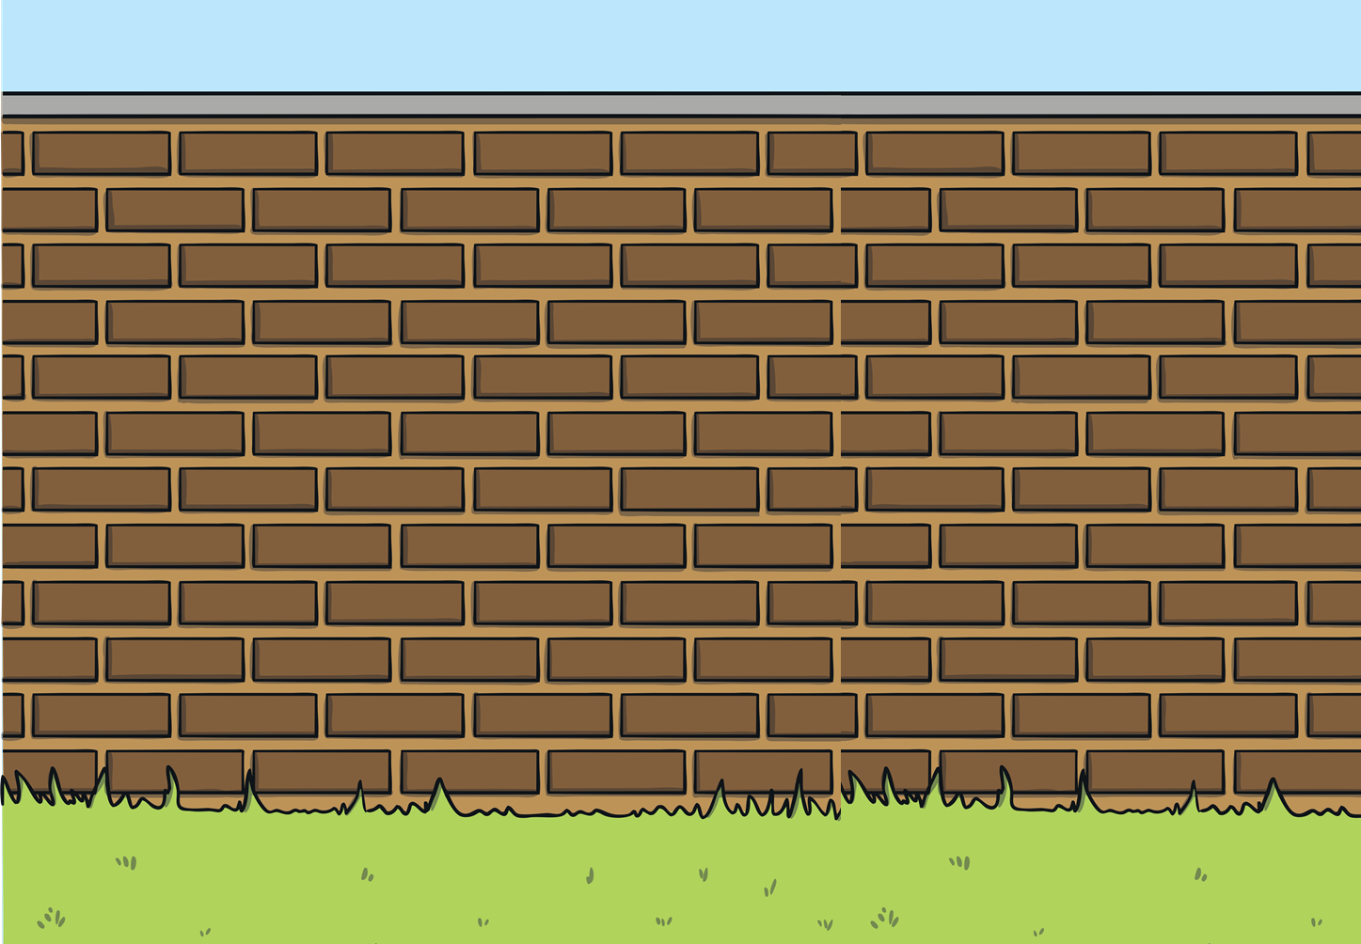


Apply
Monitors who have a badge can cross the
bridge at the edge of the hedge by the lodge.
Remember, children must not eat fudge in school!
Monitors who have a badge can cross the
bridge at the edge of the hedge by the lodge.
Remember, children must not eat fudge in school!
Check

Slide 24
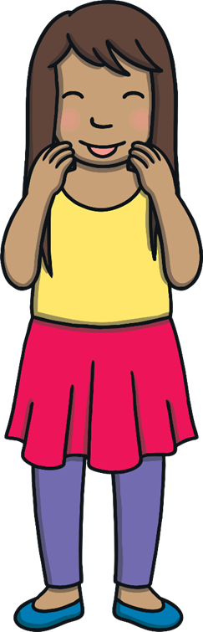
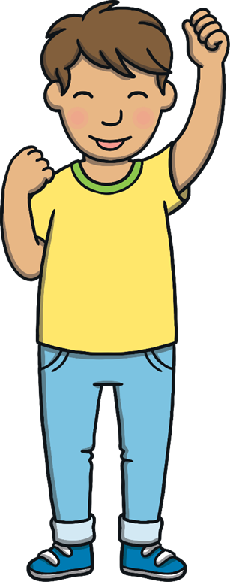
Today, we have learnt…
dge

