Slide 2

Revisit and Review
Let’s practise reading some of this week’s focus words.
largest
finest
nicest
bravest

Slide 3

Teach
Today, we are learning to add -y to words ending in e.

Slide 4
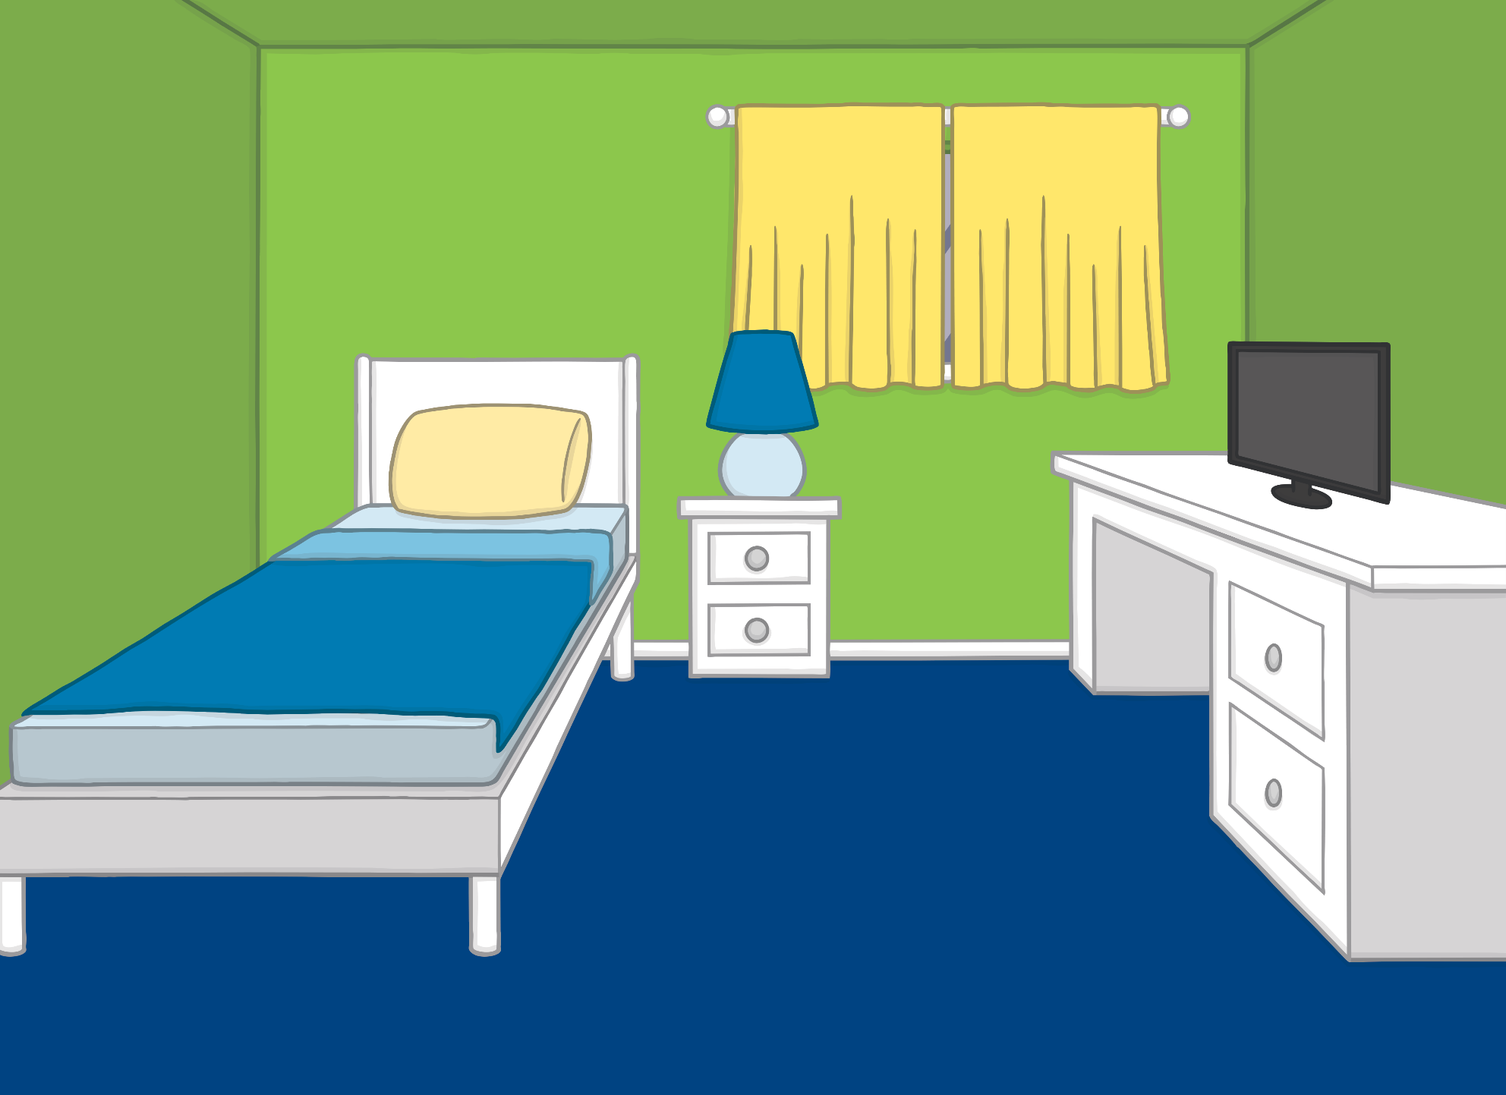
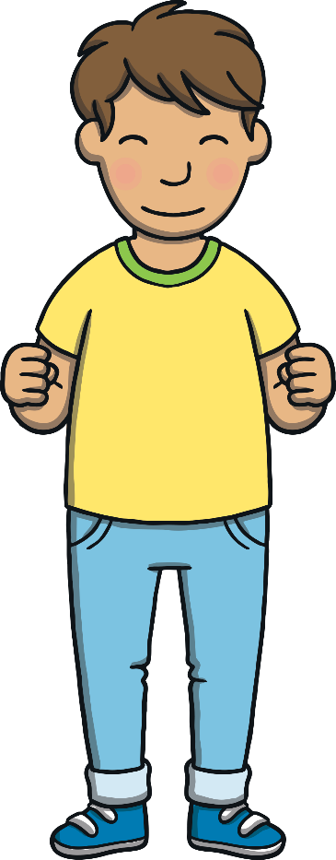
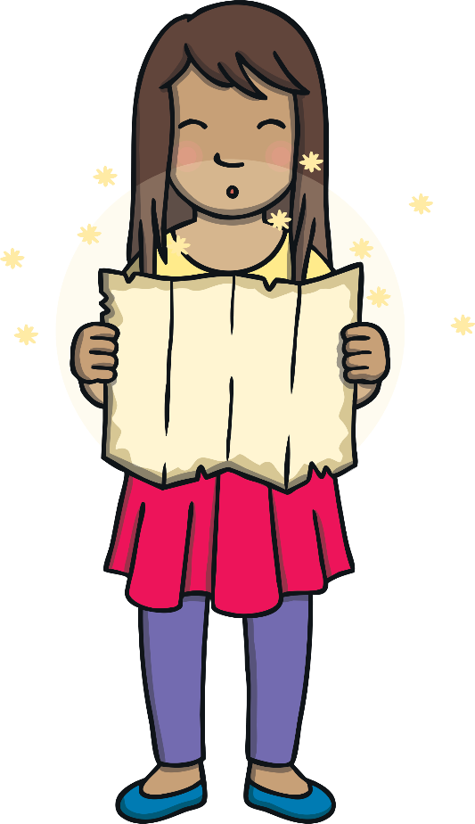
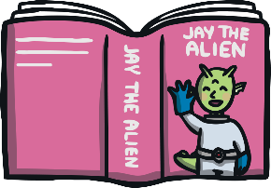
Teach
Kit had found his ‘Jay the Alien’ book while tidying up. He and Sam had decided to go and visit Jay on his planet. Sam pulled out the magic map. As she opened it, she shouted, “Take us to visit Jay, the alien!” Sam’s bedroom began to disappear around them.

Slide 5
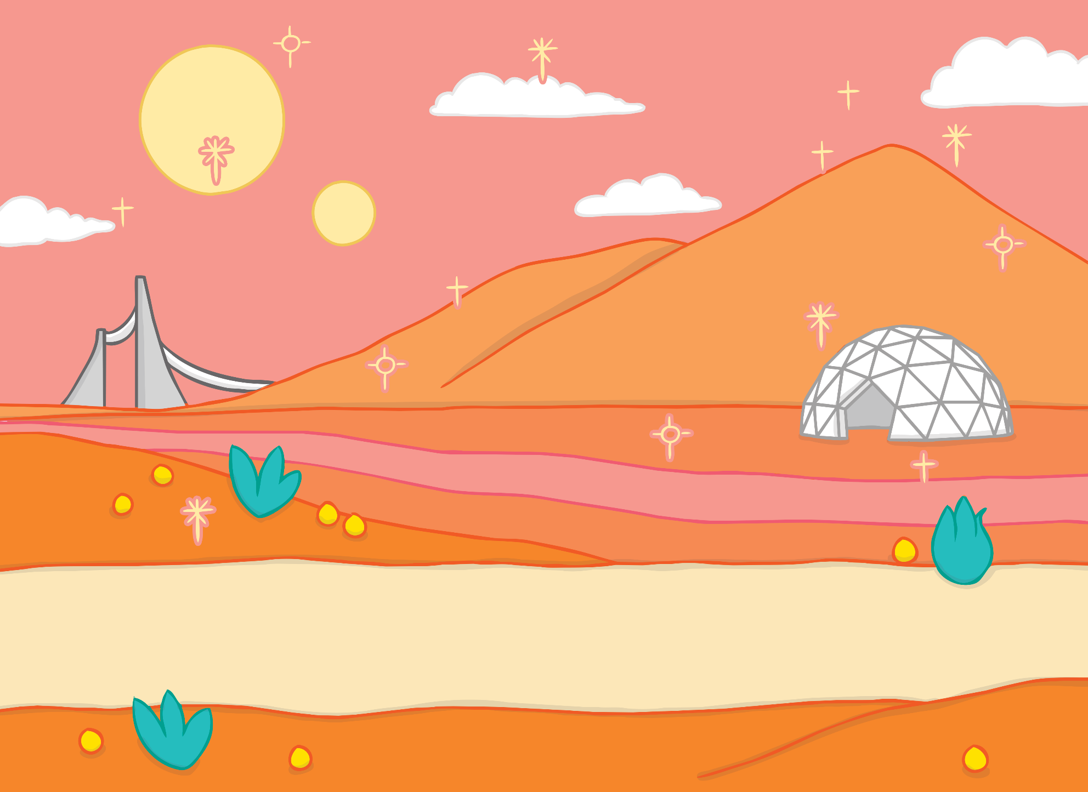
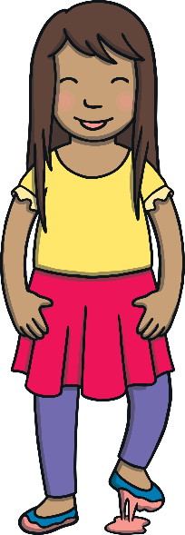


Teach
Kit and Sam found themselves on Jay’s planet! “Wow!” exclaimed Kit as he looked around. “This place is out of this world!”
“It really is,” giggled Sam. “Yuck!” she said, as she moved her feet. “The floor is slimy!”
?
?
X
What was on the floor?

Slide 6

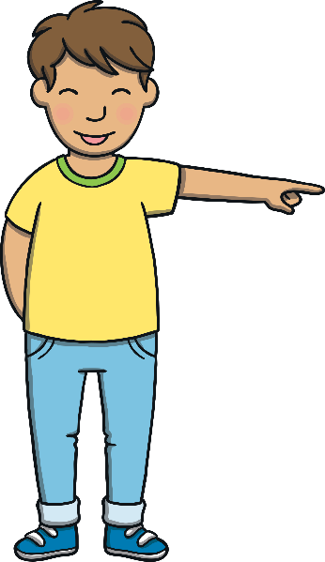
Teach
Kit saw something shiny and sparkly at the bottom of the largest hill in the distance. “Over there!” he shouted. “Jay’s house is over there! I recognise it from my book!” They began to make their way there through the slime.

Slide 7

Teach
When adding –y to words ending in e, the e should first be removed.
For example:
shiny
shine
sparkly
sparkle
X
Adding the suffix –y to a noun or verb creates an adjective. For example, ‘bone’ is a noun but adding the –y suffix creates ‘bony’, which is an adjective.
slimy
slime
Click me for Kit’s teaching tips!

Slide 8
Teach
Can you read the –y words on the alien clouds as Kit and Sam are walking? Click on the slide to begin.

Slide 9
Teach
noisy
slimy
shiny
sparkly

Slide 10
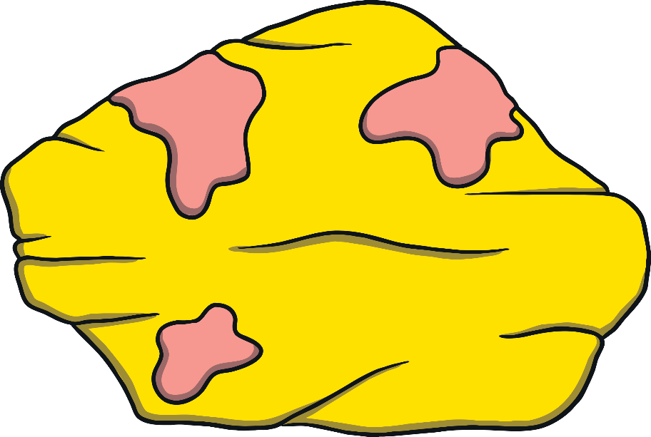
Alien Planet Rocks
Practise
Kit and Sam stop to look at some of the alien rocks. They look like they have –y words written on them but some of the letters are missing. Can you help Kit and Sam to work out what they say?

Slide 11

Practise
shin_
shiny
y
e
ee
i

Slide 12
Practise
slimy
slim_
e
ee
y
i

Slide 13
Practise
icy
ic_
y
ee
e
i

Slide 14
Practise
simpl_
simply
ee
y
e
i

Slide 15


Apply
Jay’s house was much further away than they realised. The noisy wind was blowing at them in icy blasts. “I wish I’d brought my big coat!” shivered Kit.
“Not too far now,” said Sam encouragingly.
?
?
X
Why did Kit wish he’d got his big coat?

Slide 16

A Much Needed Rest
Apply
Kit and Sam decide to stop and have a rest. Sam shelters behind a slimy rock and writes in her diary. Help her to check her spelling of –y words.

Slide 17


Apply
Dear diary,
We have come to visit Jay in his shiny, sparkly
house but we did not expect it to be such a difficult journey.
The ground is slimy and the wind is so noisy. We are both icy cold so we are having a little rest.
Lots of love
Sam
Dear diary,
We have come to visit Jay in his shiney, sparklee house but we did not expect it to be such a difficult journey.
The ground is slimi and the wind is so noisey. We are both icie cold so we are having a little rest.
Lots of love
Sam
Check

Slide 18
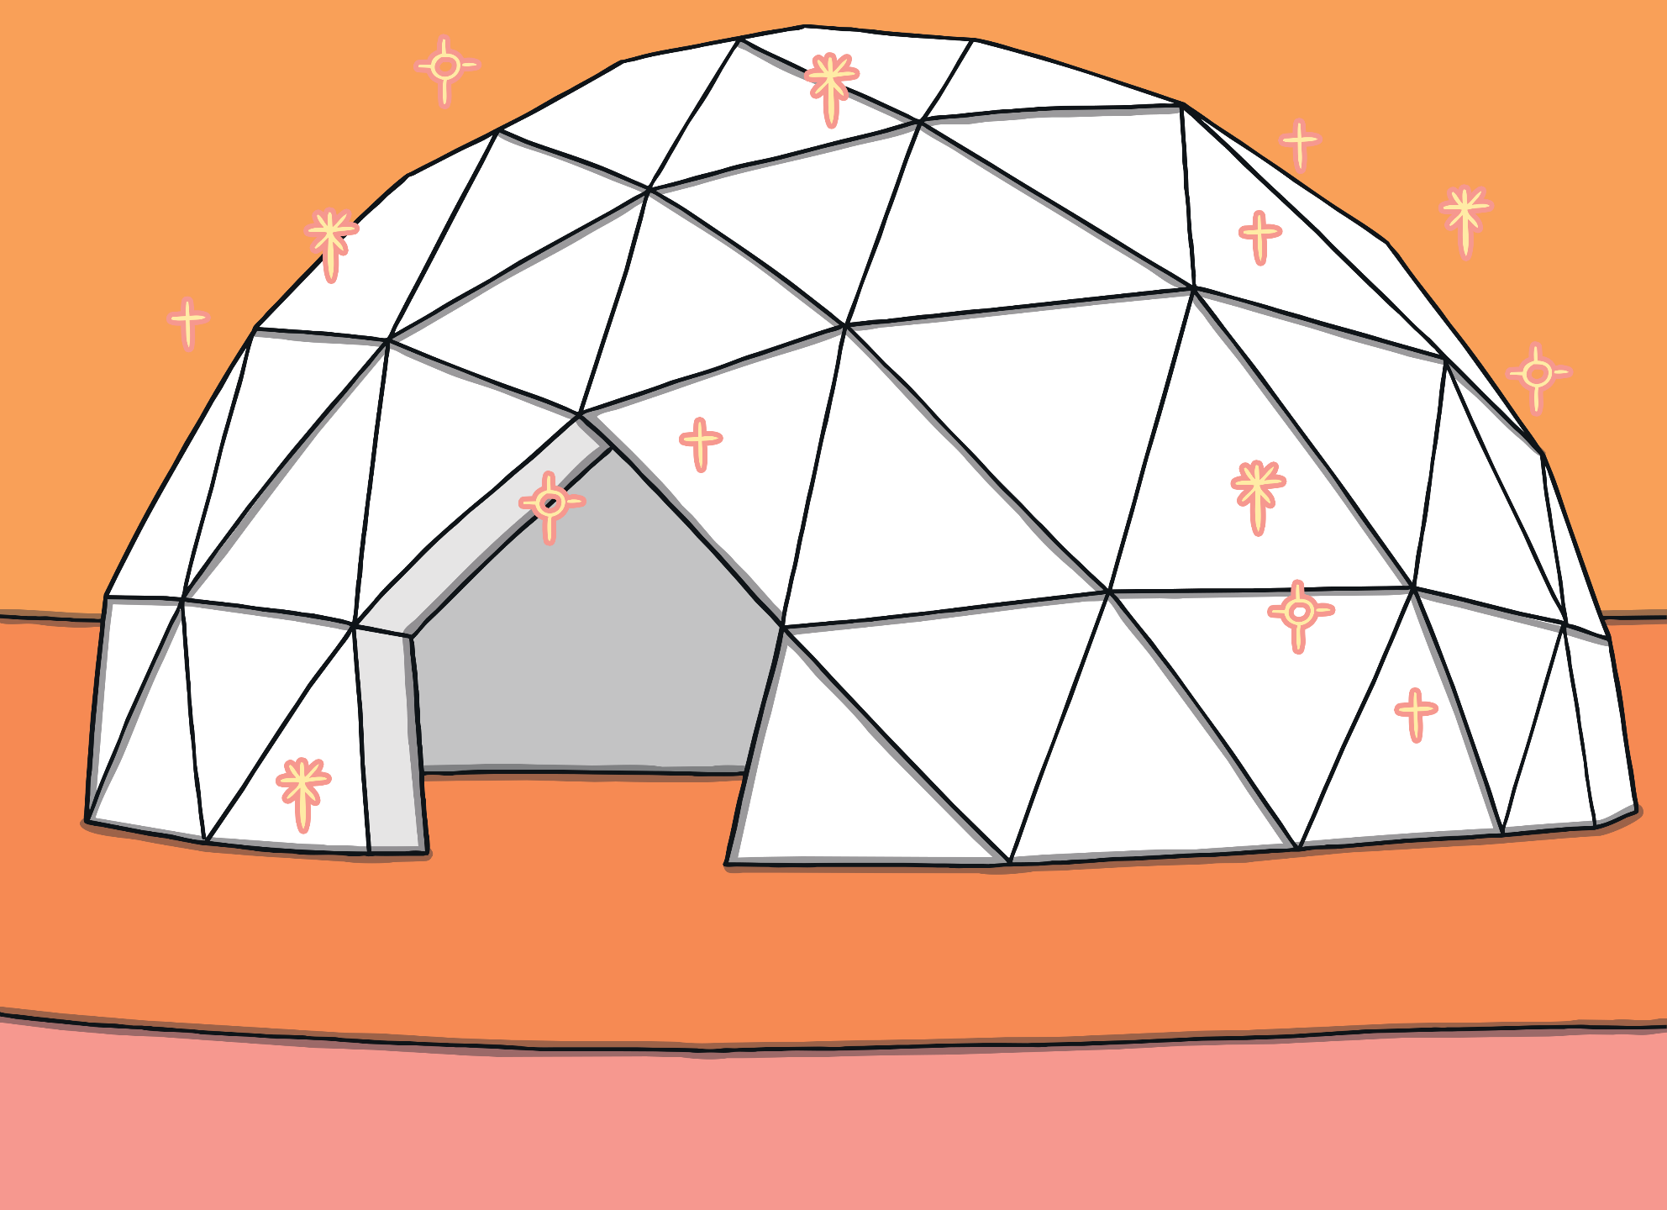


Apply
After they had rested for a little while, Kit and Sam continued on their journey and finally reached Jay’s house. It was even more sparkly and beautiful close up…

Slide 19

Today, we have learnt to add –y to words ending in e.
The adventure continues next lesson!

