Slide 1
LO: Holy week, Palm Sunday

Slide 2
Let's recap
Why do we celebrate Easter in Spring?
A) Because it's nicer weather and not too close to Christmas?
B) Because this is a time of year that new life blossoms and Jesus was reborn on Easter Sunday?

Slide 3
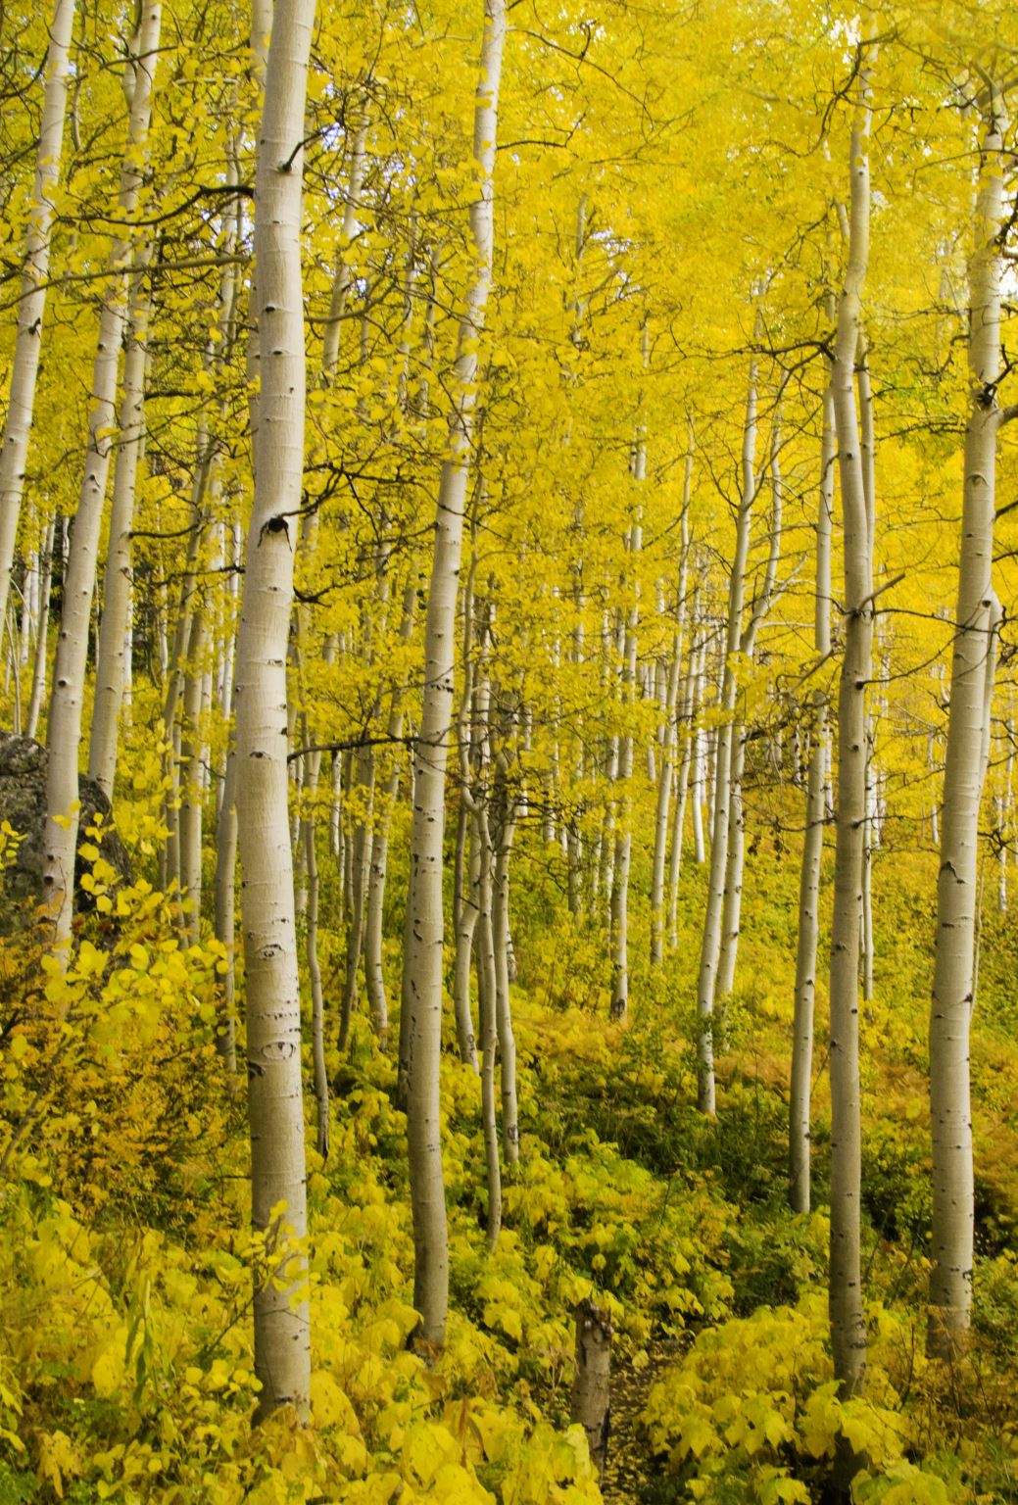
That's right....
A new life
Spring-time
That is why Christians celebrate Easter in Spring, it is a reminder of new life.

Slide 4
Holy Week
Please watch the following videos
https://youtu.be/z-39h0xYqdE
https://youtu.be/lTmbTuutBgg

Slide 5
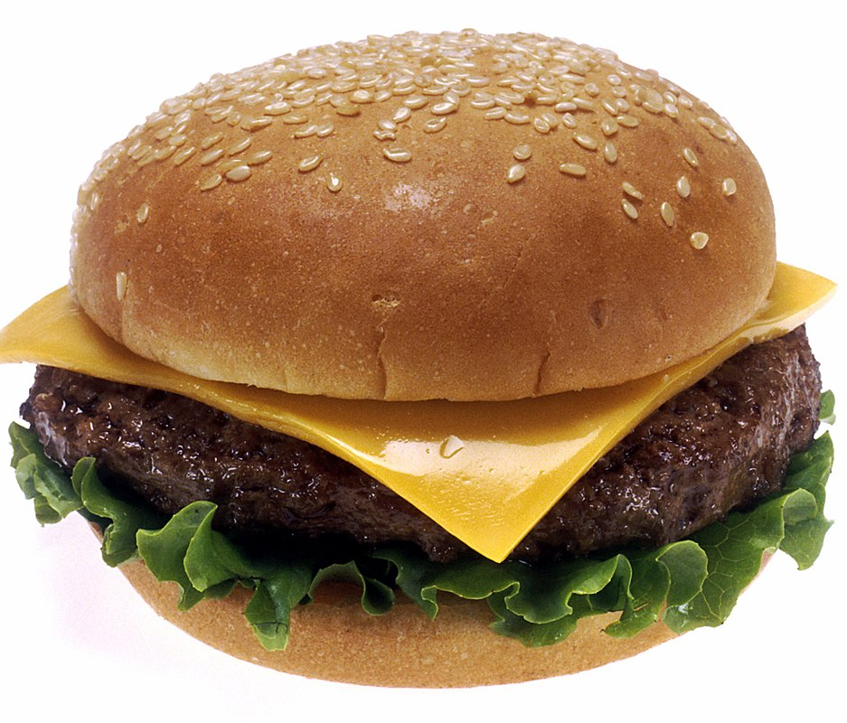
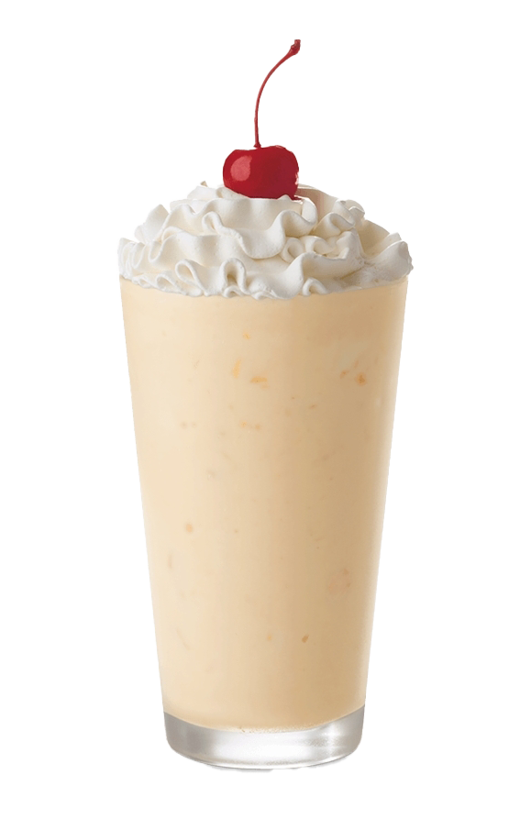
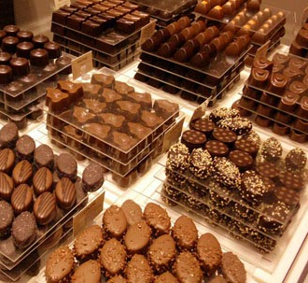


Palm Sunday is the sixth Sunday after lent.
What is Lent?
Pancake day is the start of lent and is known as Shrove Tuesday.
Ash Wednesday
First day of lent and is a reminder that Jesus went without food for 40 days and 40 Nights, and that is why Christians try to give up a luxury such as nice food for lent.

Slide 6
Palm Sunday is the start of Holy Week
Good Friday and Easter Sunday is also part of Holy Week
In your books complete the following sentences.
The day before Ash Wednesday (start of lent) is called Shrove Tuesday, also known as ______________ day.
Jesus went for__________________________with out food, Christians remind themselves of this by doing something called______________.
During lent you give up what?

