Slide 2

Revisit and Review
Let’s practise Sam’s Sounds and Common Exception Words!
e_e
ew
a_e
o_e
oy
ay
au
ea
ue
wh
ow
ou
i_e
aw
ph
ch
u_e
oe
ir
ie
autumn
princess
talk
prince
April
August
February
July
January
Sunday
know
school
mother
walk
another
baby

Slide 3
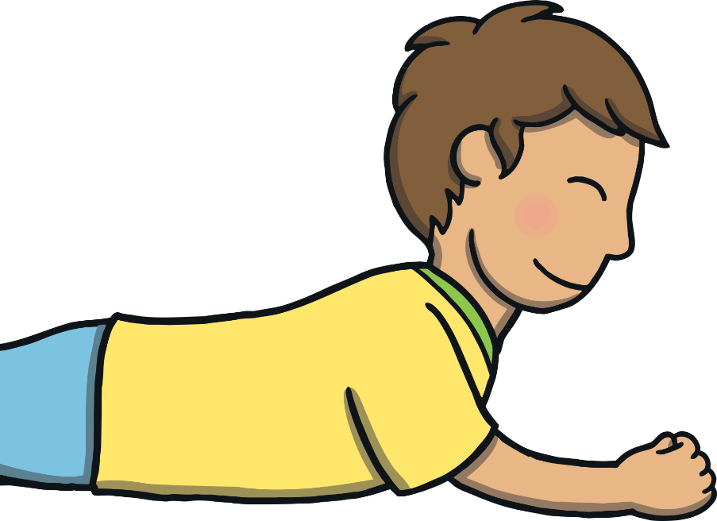

Teach
Today, we are learning to read words containing
y saying /igh/.

Slide 4
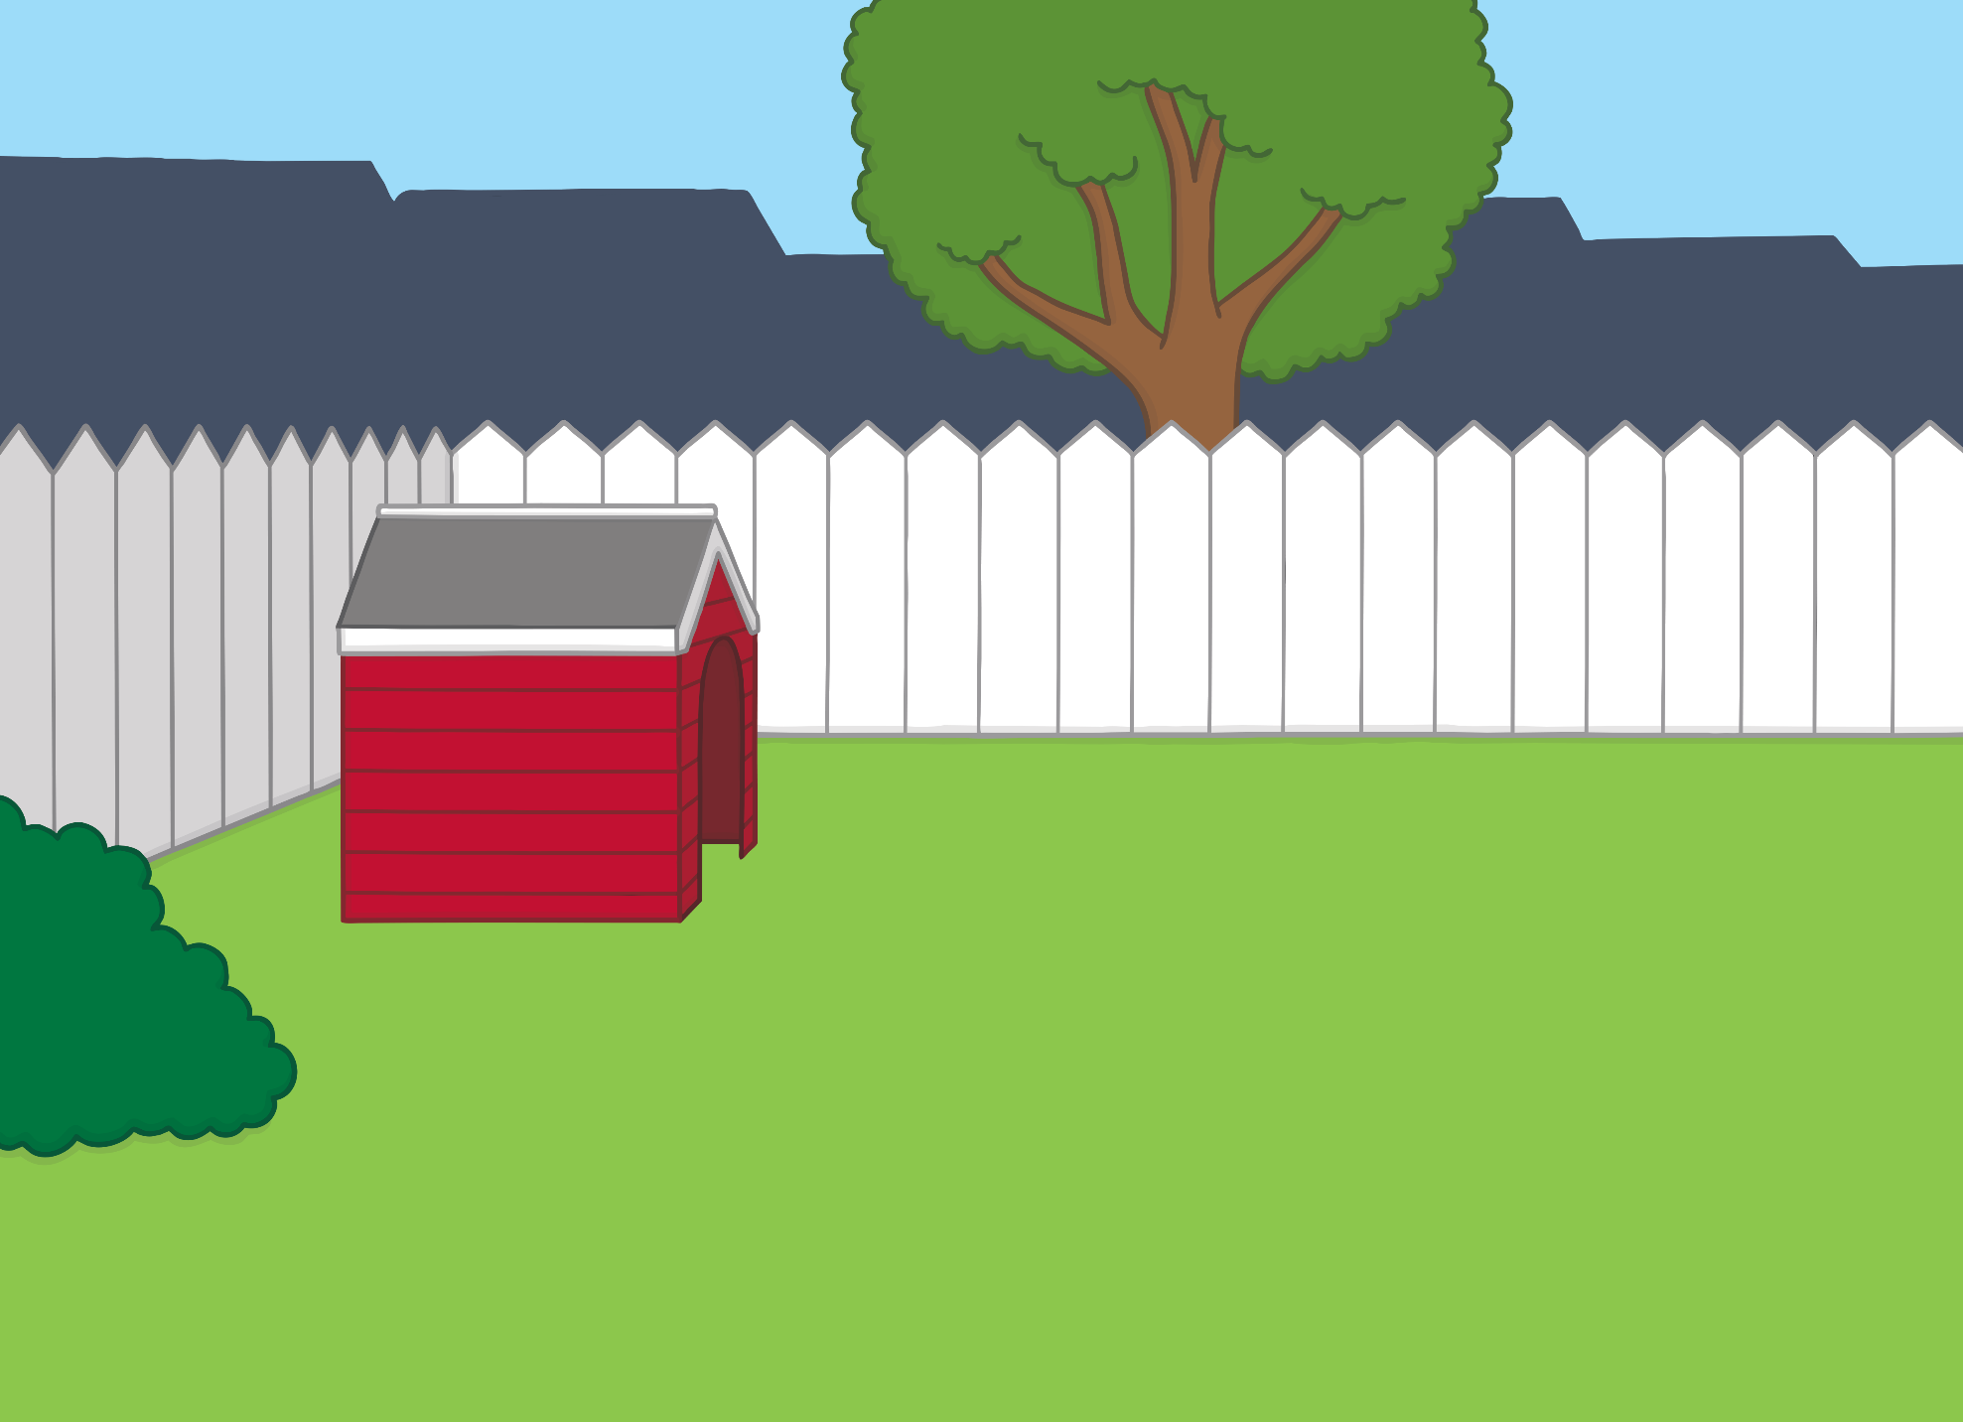


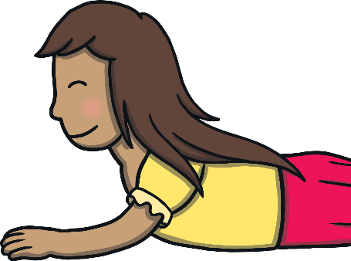
Teach
Click me for Kit’s teaching tips!
X
Now that your children are more confident readers, you could encourage them to read the story along with you! When you see the question mark icon, click for a comprehension question.
It was the last day of the summer holidays and Kit and Sam were playing in the garden. They were lying in the grass, looking for insects.

Slide 5

Teach
“Look at the line of ants,” said Sam. “They are carrying bits of leaves.”
“Yes,” said Kit. “Look, a beetle and a ladybird – they are so tiny!”

Slide 6

Teach
Kit and Sam sat and watched a butterfly flap lazily from flower to flower. “There really are a lot of insects in our garden,” said Sam.

Slide 7
Teach
In lots of short words, the y makes the /igh/ sound.
by
my
try

Slide 8

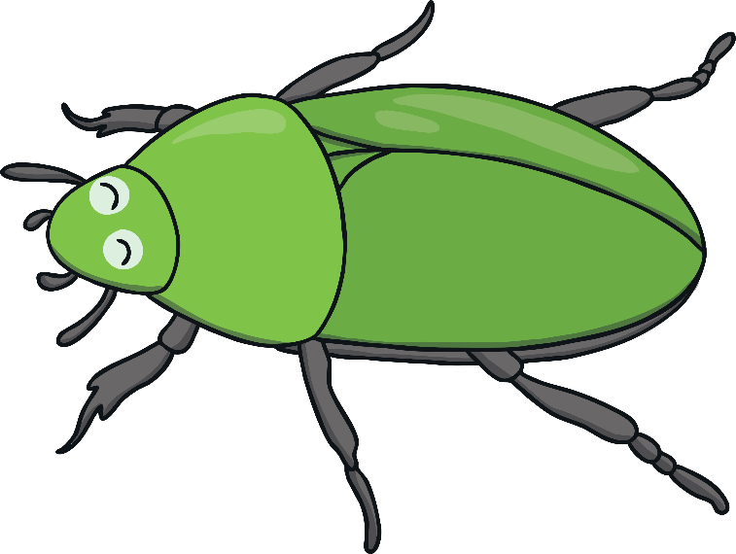
Teach
Kit and Sam are watching insects. Can you read the words containing y saying /igh/? Click on the insects to reveal a word to read.

Slide 9

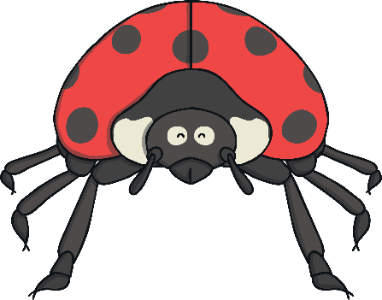

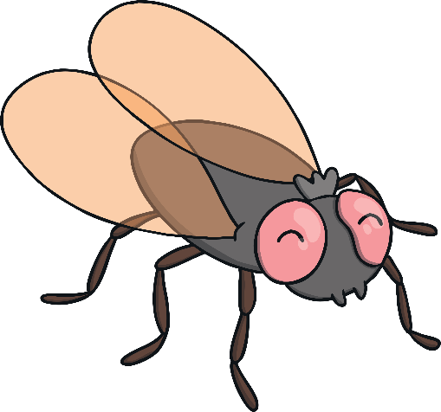
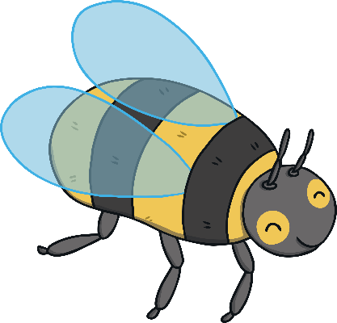


Teach
by
spy
dry
my
fry
why
try
sky

Slide 10
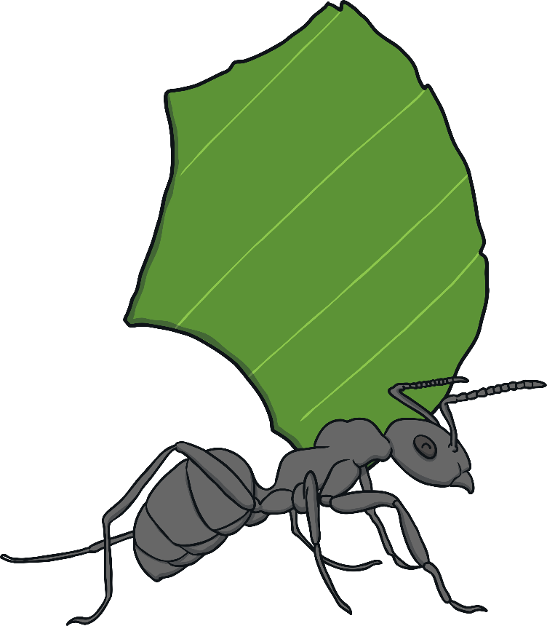
Practise
Ants and Leaves
The ants are collecting leaves. As the ants walk past, click on the leaf with the matching word.

Slide 11
Practise
shy
sky
dry
fly
why

Slide 12
Practise
shy
sky
dry
why

Slide 13
Practise
shy
dry
why

Slide 14
Practise
shy
why
?

Slide 15
Practise
shy
?

Slide 16




Apply
?
?
X
What do you think is behind the tiny door?
Kit and Sam followed the trail of ants as they carried their leaves to a gap in the fence. “Hey Sam, there is a tiny door in the fence!” said Kit.

Slide 17
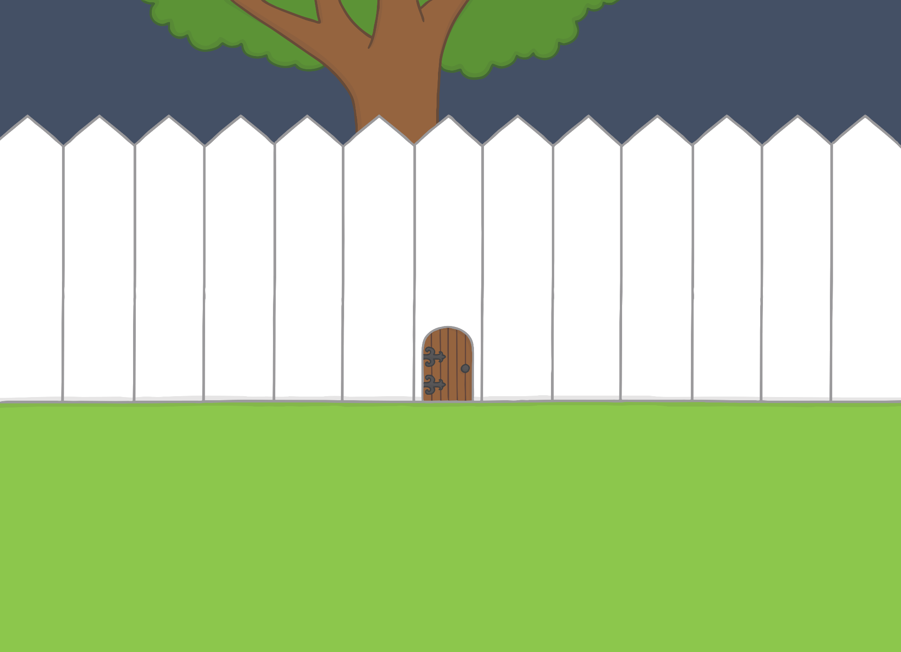

Apply
“You’re right!” said Sam. “I’ve never seen that before. I wonder where it leads?” They bent down.
“There is a sign on the front,” said Kit. “Let’s read it.”

Slide 18



Apply
Text Detectives!
There is a sign on the little secret door. Can you read it and spot any y saying /igh/ words?

Slide 19


Apply
Why
Why not come inside the door
And see what you can spy?
Some of us are on the ground
And some are in the sky.
Some of us are big and brave
And others are quite shy,
But try to spot us where you can,
Perhaps you’ll learn to fly!
spy
sky
shy
try
fly
Check

Slide 20


Apply
“I want to go in!” said Sam, excitedly.
“But we’re too big to fit through the door,” said Kit, thinking hard. “Unless we use…”
“The magic map!” finished Sam.

Slide 21



Today, we have learnt…
y
saying /igh/
The adventure continues next lesson!

