Slide 1


Position and Movement Week 2
LO: Describe movement and turns using mathematical vocabulary

Slide 2

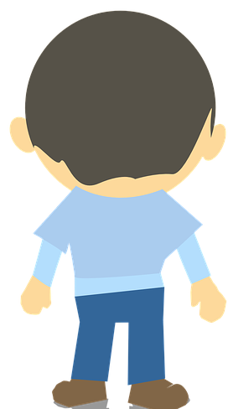
Fluency
RECAP:
Clockwise and anticlockwise:
anticlockwise
clockwise

Slide 3
Fluency
Stand up and show:
A quarter turn anticlockwise.
A half turn clockwise.
A full turn anticlockwise.

Slide 4

Fluency
Complete the sentences.
2
Move forward ______ squares.
X
anticlockwise
Make a quarter turn ___________________.
forwards
2
Move ______________ ______ squares.

Slide 5
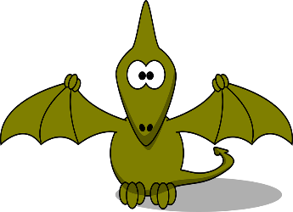
Fluency
Complete the sentences.
forwards
3
X
Move ______________ ______ squares.
clockwise
Make a quarter turn _______________.
forwards
2
Move ______________ ______ squares.
quarter
clockwise
Make a ____________ turn _______________.
forwards
3
Move ______________ ______ squares.

Slide 6
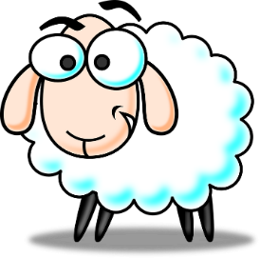
Fluency
Where would the sheep end up if it moved:
2 steps forwards,
Quarter turn clockwise,
1 step forward?

Slide 7

Fluency
Where would the duck end up if it moved:
3 steps forwards,
Quarter turn anticlockwise,
1 step forward,
Quarter turn anticlockwise,
2 steps forwards?

Slide 8

Fluency
Where would the bee end up if it moved:
1 step forward,
Quarter turn clockwise,
3 steps forwards,
Quarter turn anticlockwise,
1 step forward

Slide 9
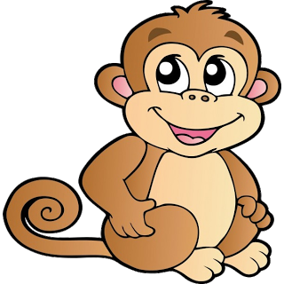

Problem
solving
Write the shortest route from the monkey to the banana?
How many other routes can you find?

Slide 10
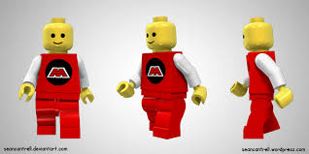
LO: Investigate and explain different routes using mathematical vocabulary

Slide 11
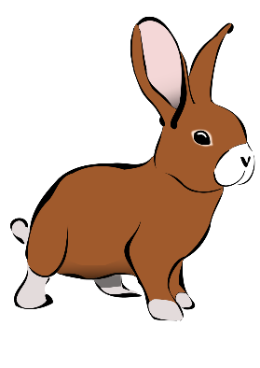
Problem
solving
How many different routes can you find?
X
What is the shortest route?

Slide 12

Problem
solving
How many different routes can you find?
X
What is the shortest route?

Slide 13
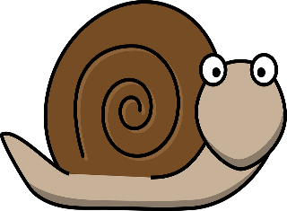
Problem
solving
How many different routes can you find?
X
What is the shortest route?

Slide 14
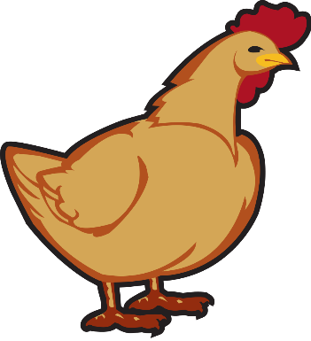
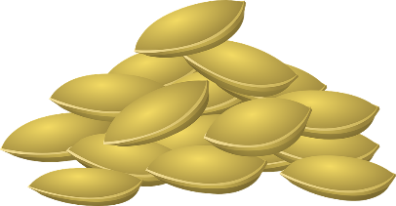
Reasoning
Spot the mistake in the route.
2 steps forwards.
A quarter turn anticlockwise.
1 step forward.
A quarter turn clockwise is needed.
(not a quarter turn anticlockwise).

Slide 15
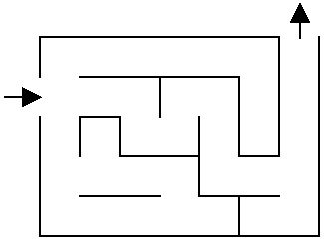

Slide 16
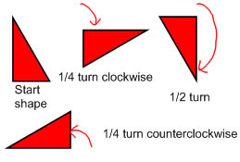
LO: Recognise and describe rotation of shapes

Slide 17
Fluency
How would you describe this pattern?
It is rotating a quarter turn clockwise each time.

Slide 18
Fluency
How would you describe this pattern?
It is rotating a half turn clockwise or anticlockwise each time.

Slide 19
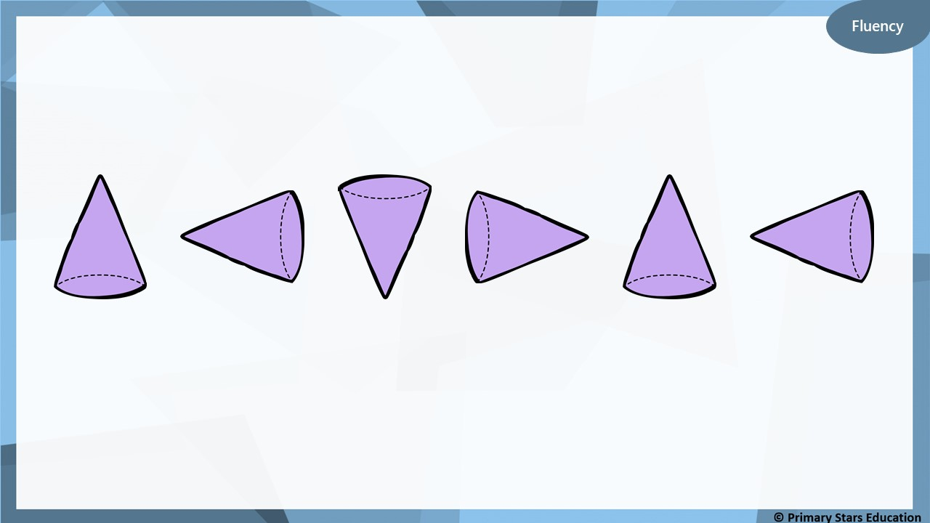
How would you describe this pattern?
It is rotating a quarter anticlockwise each time.

Slide 20
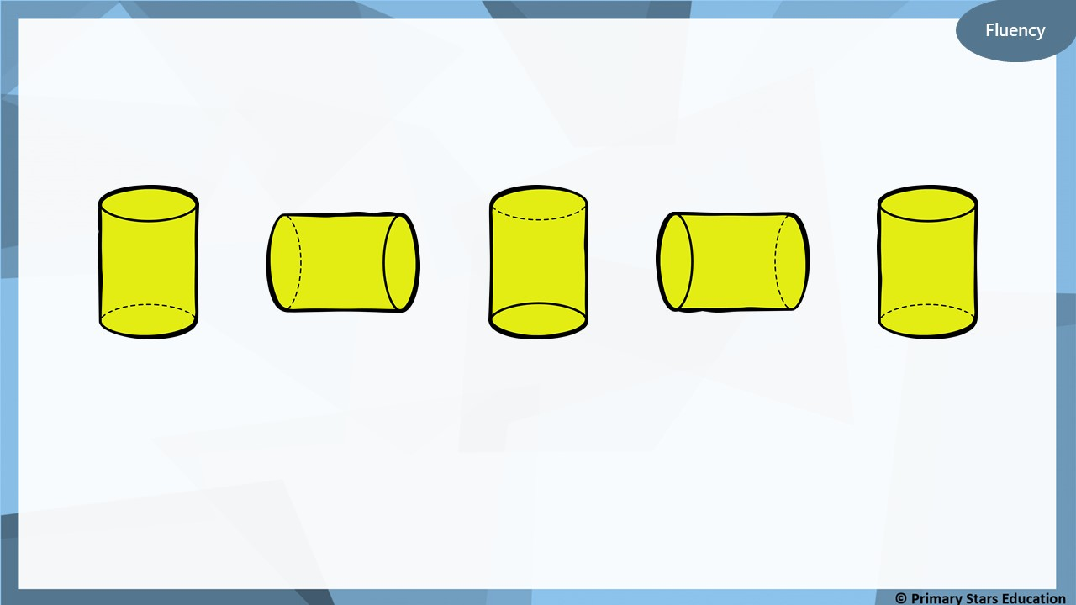
How would you describe this pattern?
It is rotating a quarter clockwise each time.

Slide 21
Fluency
How would you describe this pattern?
It is rotating a quarter turn anticlockwise each time.
What would come next?

Slide 22
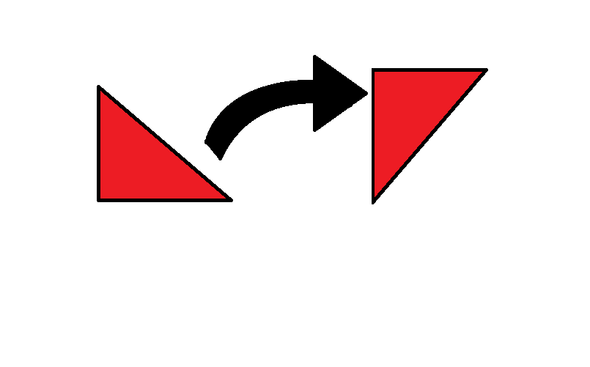
LO: Identify ‘rule’ for shape pattern
Describe rotation pattern in sequence of shapes

Slide 23
Fluency
How would you describe this pattern?
It is rotating a half turn clockwise / anticlockwise each time.
What would come next?

Slide 24
Fluency
How would you describe this pattern?
It is rotating a quarter turn clockwise each time.
What would come next?

Slide 25
Fluency
How would you describe this pattern?
It is rotating a half turn clockwise / anticlockwise each time.
What would come next?

Slide 26
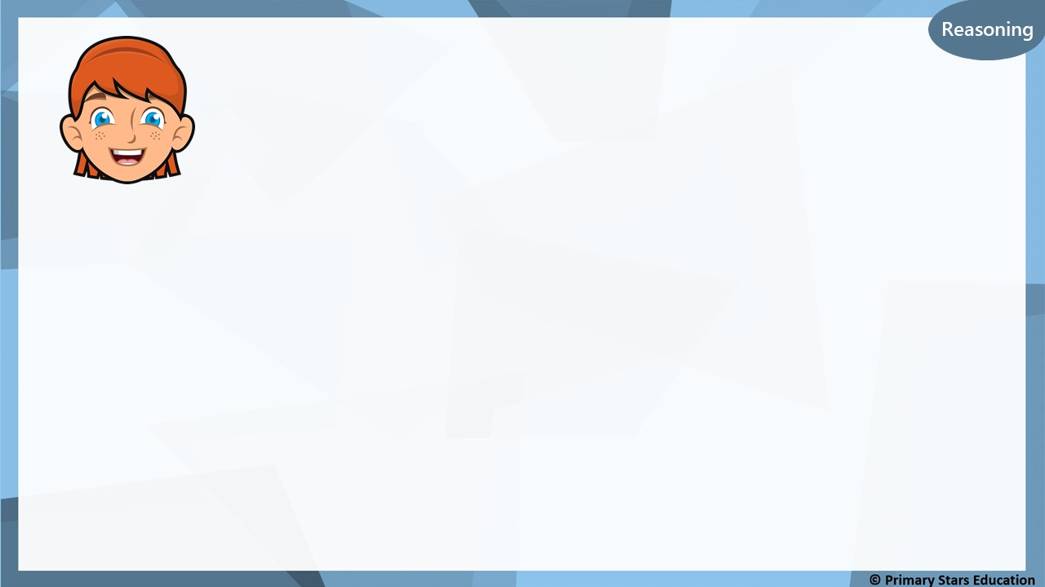
Reasoning
The pattern shows the shapes turning a quarter turn clockwise each time.
True or false?
Explain your answer.
False, the pattern shows the shapes turning a quarter turn anticlockwise each time.

Slide 27
Problem
solving
How many different patterns can you create using only this shape?
Describe each of your patterns.

Slide 28
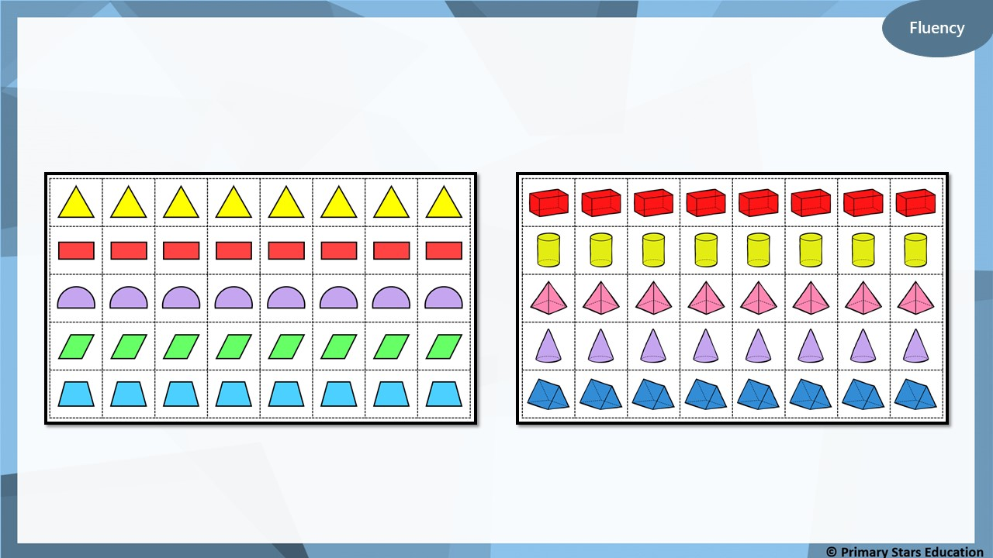
Practical:
Make patterns using the shapes given.
Can you describe your patterns?

