Slide 1
LO: to understand why Easter is so important to Christians

Slide 2
Success Criteria
To understand the Easter story leads to new life
To begin understanding Good Friday
To begin understanding Easter Sunday

Slide 3
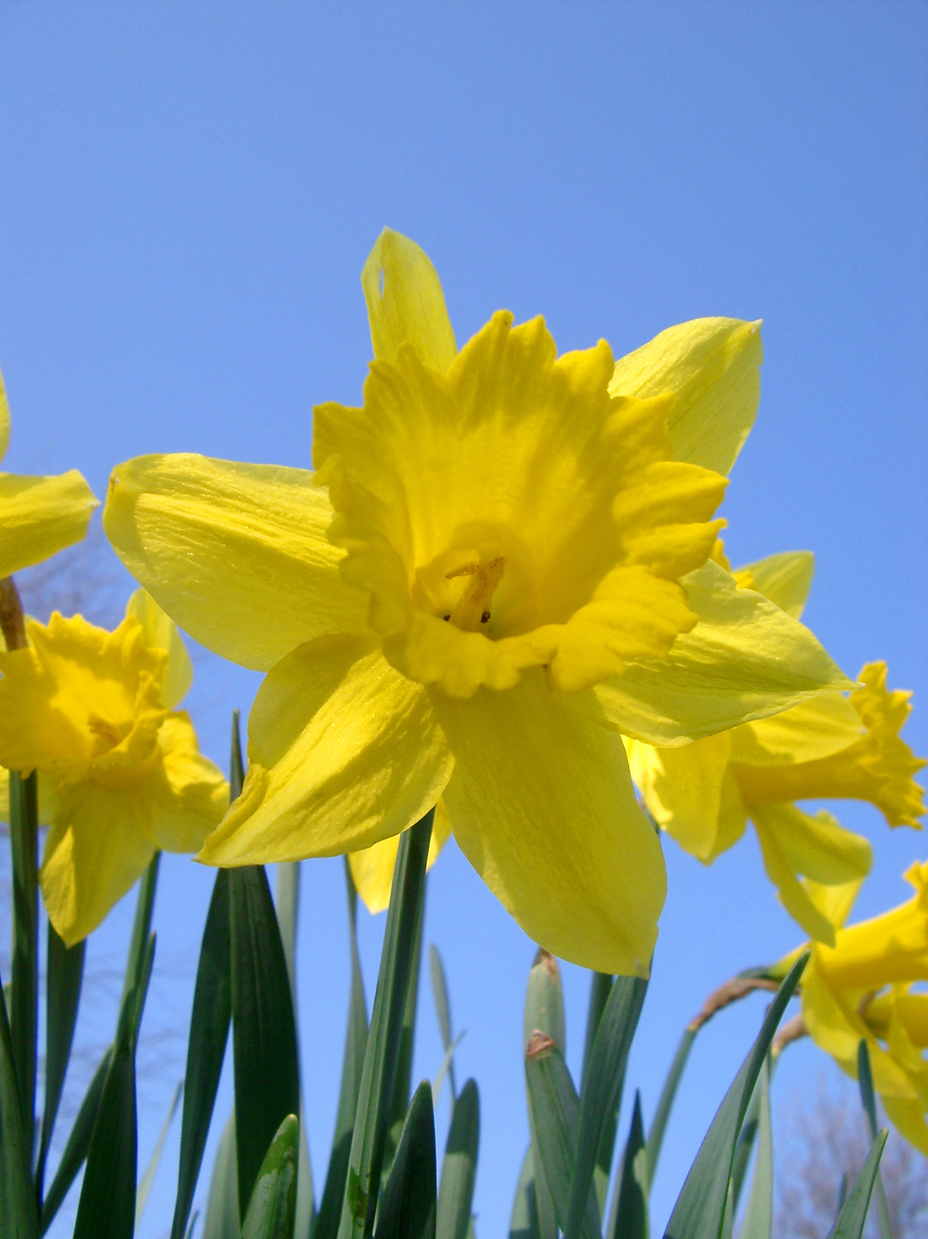
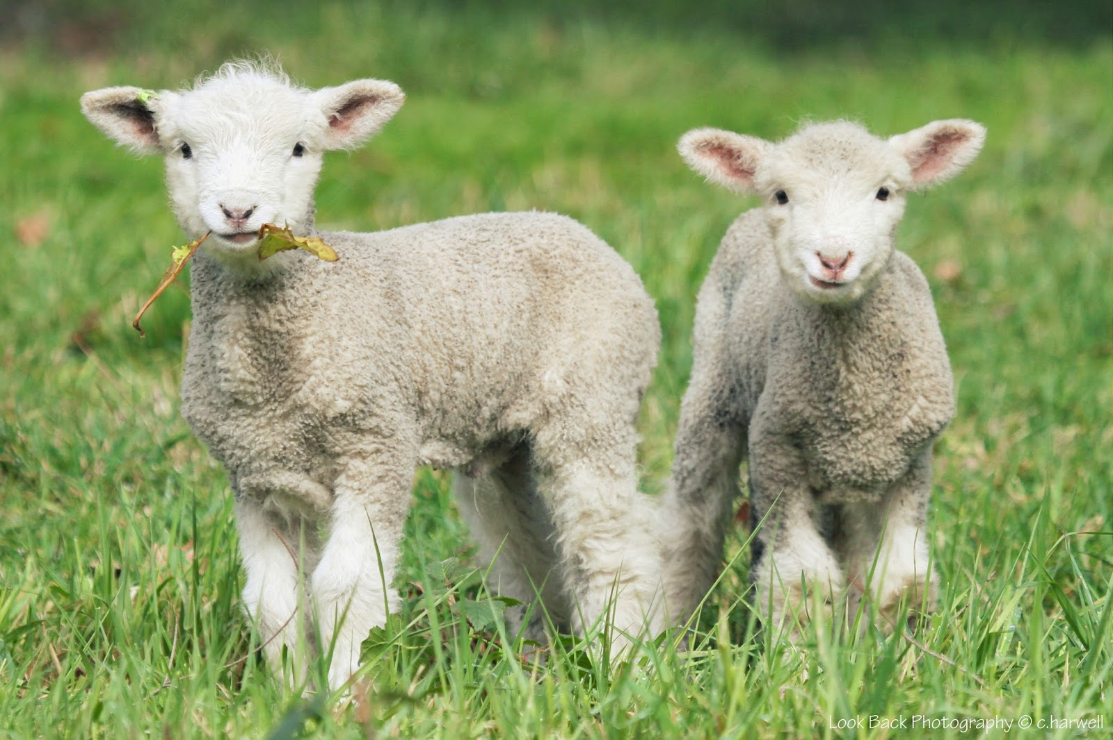
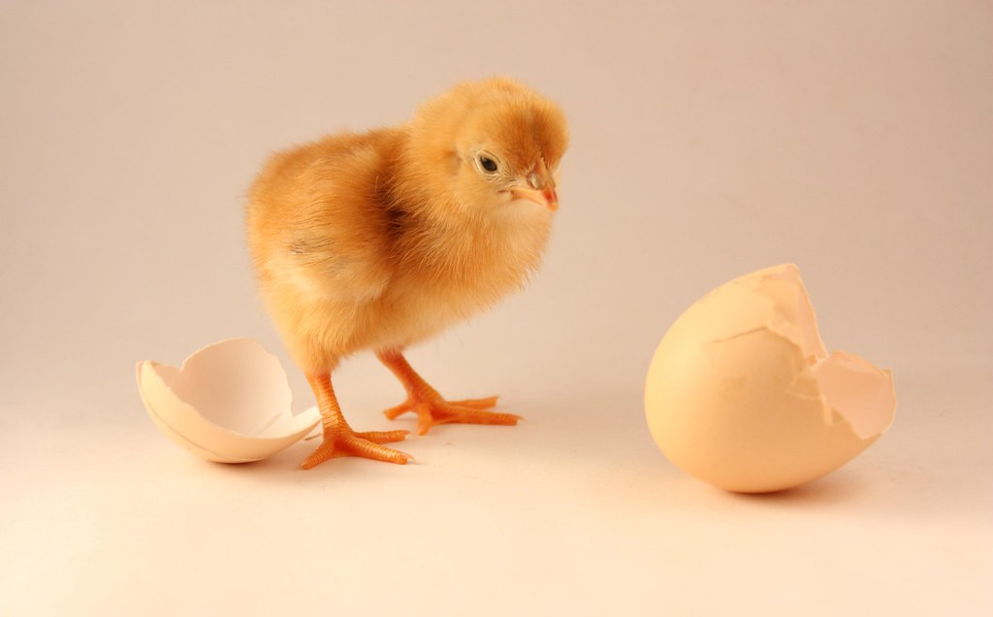
What do these pictures all have in common?

Slide 4

That's right....
A new life
Spring-time
That is why Christians celebrate Easter in Spring, it is a reminder of new life.

Slide 5
The story of Easter
Please watch the following clip about why Easter is so important to Christians.
https://www.bbc.co.uk/teach/class-clips-video/religious-studies-ks1-the-christian-story-of-easter/zhgv47h

Slide 6
What does new life mean...?
Year two, in your books I want you to write a couple of sentences with what new life means to you, it could be the birth of a baby in your family, plant life, ponds...
Start off with:
New life means.........
I'd love to see some pictures to help support your writing!!

