Slide 1
Adding ‘ed’
past tense
1. Just add ‘ed’
2. double last letter, then add ‘ed’
3. If the word ends in e’,
just add ‘d’
4. If the word ends in ‘y’,
drop the ‘y’ and add ‘ied’
DB 2012

Slide 2
Just add ‘ed’
jump
ed

Slide 3
Just add ‘ed’
call
ed

Slide 4
Just add ‘ed’
laugh
ed

Slide 5
Just add ‘ed’
turn
ed

Slide 6
Just add ‘ed’
want
ed

Slide 7

Just add ‘ed’
help
ed

Slide 8
Just add ‘ed’
sort
ed

Slide 9
Just add ‘ed’
wash
ed

Slide 10
Just add ‘ed’
rock
ed

Slide 11

Just add ‘ed’
ask
ed

Slide 12

Just add ‘ed’
bang
ed

Slide 13
Just add ‘ed’
bang
ed

Slide 14
Just add ‘ed’
land
ed

Slide 15

Just add ‘ed’
hand
ed

Slide 16

Just add ‘ed’
fill
ed

Slide 17

Just add ‘ed’
spill
ed

Slide 18
Just add ‘ed’
fold
ed

Slide 19

Just add ‘ed’
sulk
ed

Slide 20
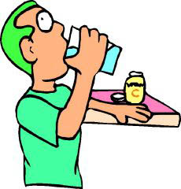
Just add ‘ed’
gulp
ed

Slide 21
2. double last letter, then add ‘ed’
hop
ped

Slide 22
2. double last letter, then add ‘ed’
trip
ped

Slide 23

2. double last letter, then add ‘ed’
nod
ded

Slide 24
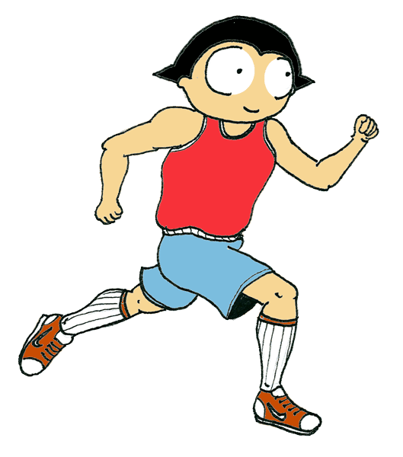
2. double last letter, then add ‘ed’
jog
ged

Slide 25
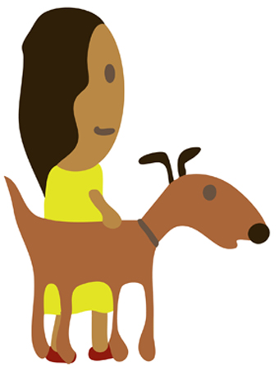
2. double last letter, then add ‘ed’
pat
ted

Slide 26

2. double last letter, then add ‘ed’
stop
ped

Slide 27
2. double last letter, then add ‘ed’
skip
ped

Slide 28

2. double last letter, then add ‘ed’
rip
ped

Slide 29
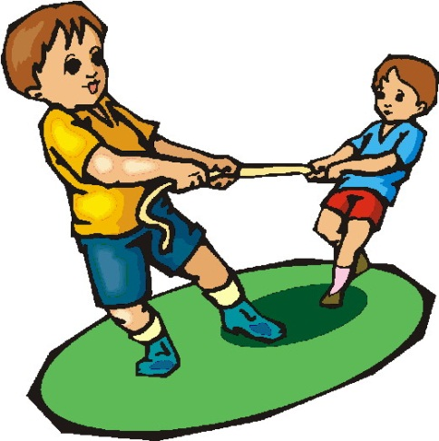
2. double last letter, then add ‘ed’
tug
ged

Slide 30
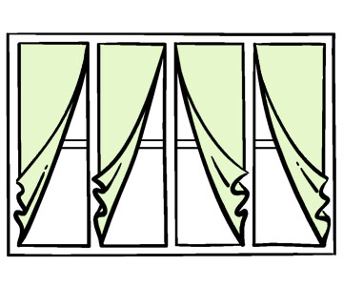
2. double last letter, then add ‘ed’
flap
ped

Slide 31

2. double last letter, then add ‘ed’
pop
ped

Slide 32
2. double last letter, then add ‘ed’
chat
ted

Slide 33

2. double last letter, then add ‘ed’
plan
ned

Slide 34
2. double last letter, then add ‘ed’
chop
ped

Slide 35

2. double last letter, then add ‘ed’
knot
ted

Slide 36
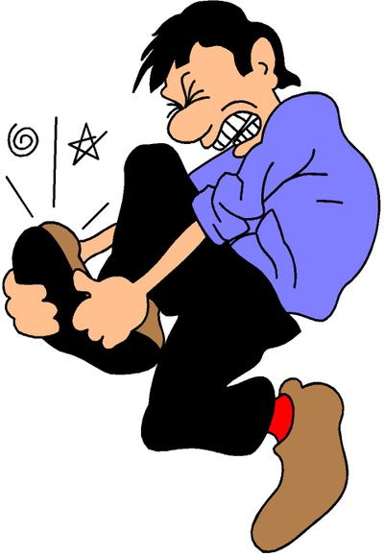
2. double last letter, then add ‘ed’
stub
bed

Slide 37

2. double last letter, then add ‘ed’
drum
med

Slide 38
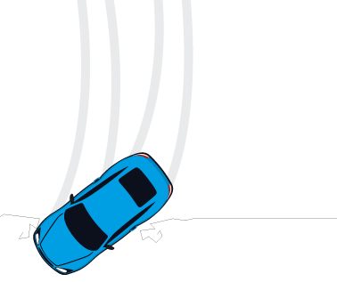
2. double last letter, then add ‘ed’
skid
ded

Slide 39

2. double last letter, then add ‘ed’
snip
ped

Slide 40

2. double last letter, then add ‘ed’
grip
ped

Slide 41
2. double last letter, then add ‘ed’
grip
ped

Slide 42
3. If the word ends in ‘e’, just ‘d’.
like
d

Slide 43
3. If the word ends in ‘e’, just ‘d’.
hike
d

Slide 44
3. If the word ends in ‘e’, just ‘d’.
bake
d

Slide 45
3. If the word ends in ‘e’, just ‘d’.
wave
d

Slide 46
3. If the word ends in ‘e’, just ‘d’.
cycle
d

Slide 47
3. If the word ends in ‘e’, just ‘d’.
cycle
d

Slide 48
3. If the word ends in ‘e’, just ‘d’.
time
d

Slide 49
3. If the word ends in ‘e’, just ‘d’.
frame
d

Slide 50
3. If the word ends in ‘e’, just ‘d’.
line
d

Slide 51
4. If the word ends in a ‘y’,
drop the ‘y’ and add ‘ied
cr
ied
y

Slide 52
4. If the word ends in a ‘y’,
drop the ‘y’ and add ‘ied’
sp
y
ied

Slide 53

4. If the word ends in a ‘y’,
drop the ‘y’ and add ‘ied’
dr
ied
y

Slide 54

4. If the word ends in a ‘y’,
drop the ‘y’ and add ‘ied’
fr
ied
y

Slide 55
4. If the word ends in a ‘y’,
drop the ‘y’ and add ‘ied
tr
ied
y

