Slide 1
L.O. To know what Ibadah means for Muslims

Slide 2
Success Criteria
-Understand obedience
-Understand devotion

Slide 3
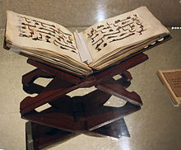
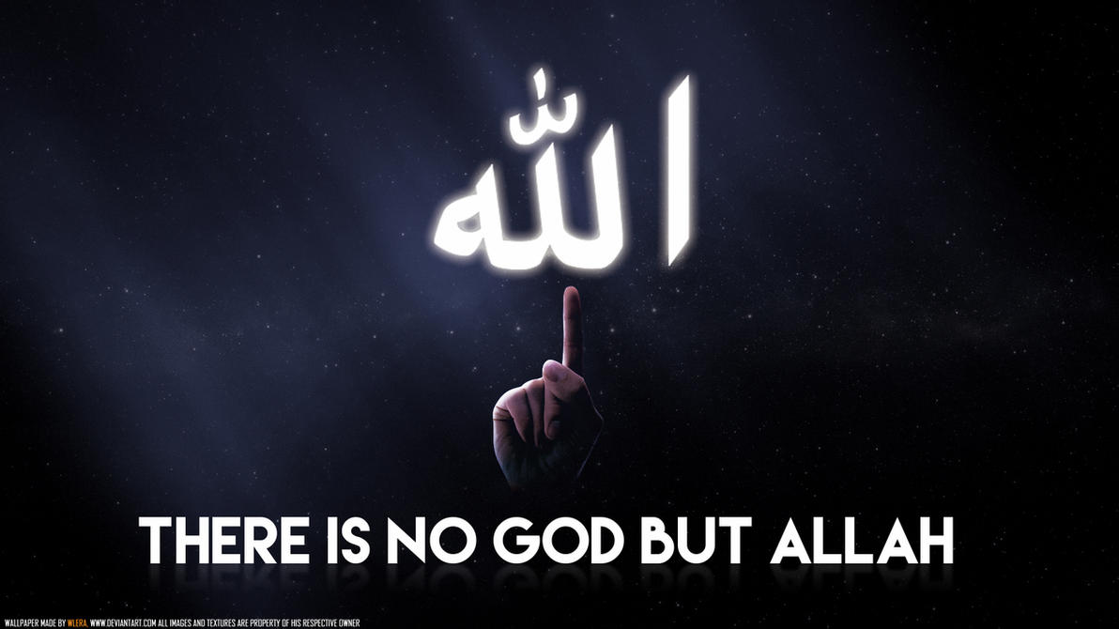
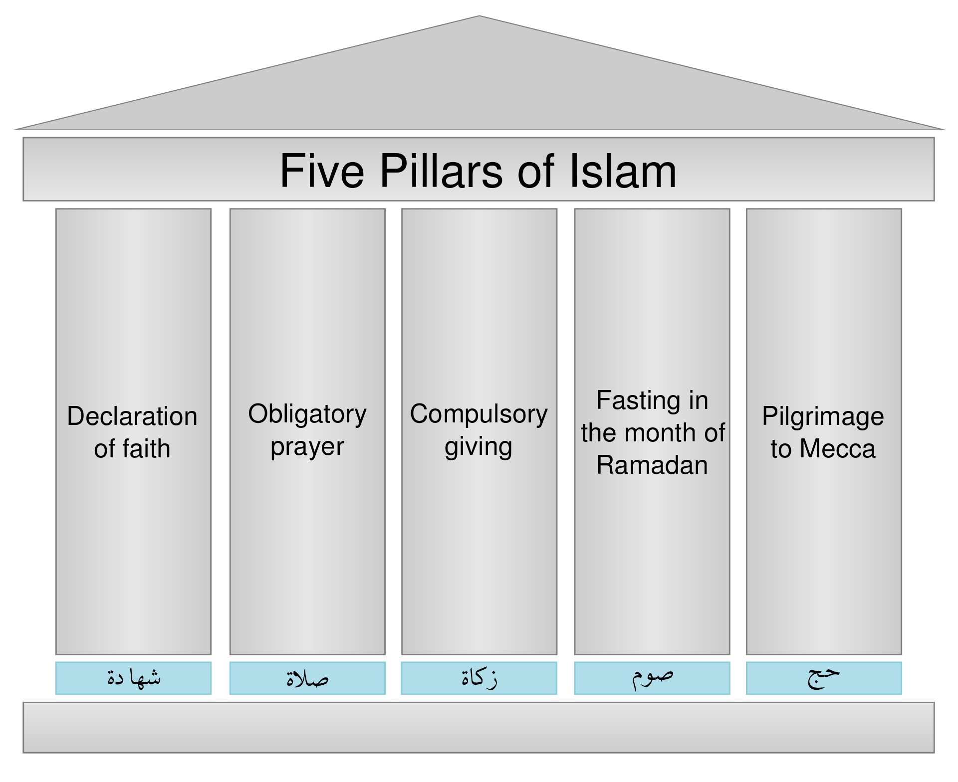
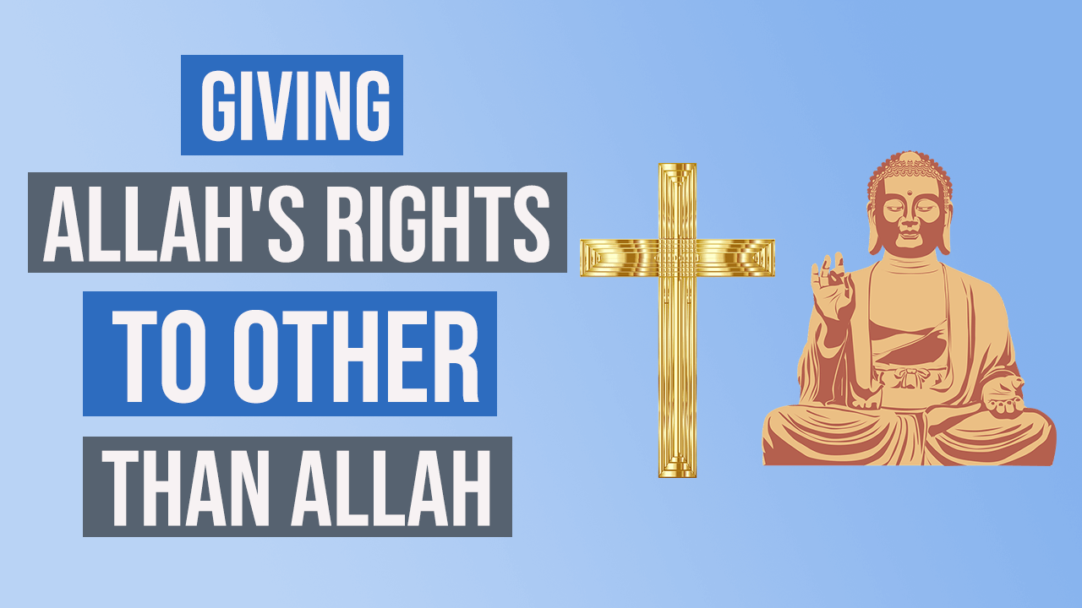
What can you remember? Match the pictures to the Muslim words
5 pillars
Tawhid (Shahadah Prayer)
Shirk
Qu'ran

Slide 4
Prayer is being Obedient and shows Devotion to Allah, watch this clip about prayer.
https://www.bbc.co.uk/bitesize/clips/z4gkq6f

Slide 5

What does Obedience mean?
Obedience means doing what you are told.
Can you see the children being obedient in the classroom with their hands up.

Slide 6

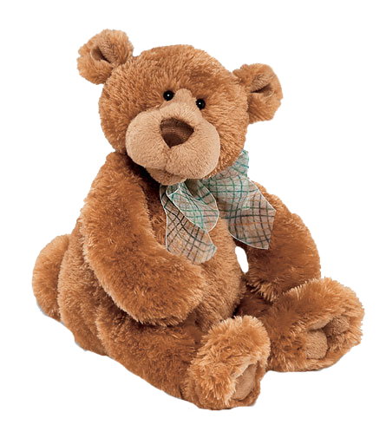
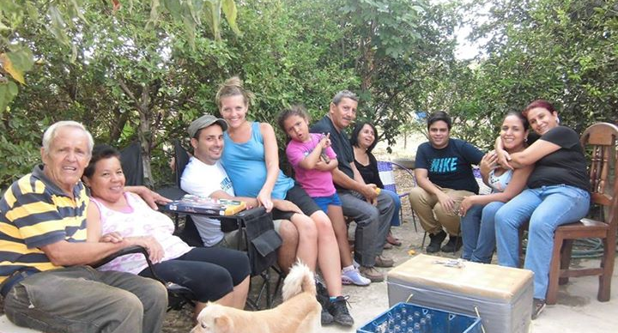
What does devotion mean?
Devotion means loving something above anything else.

Slide 7
For Muslims:
Ibadah – Muslims should show devotion to Allah (love him above anyone or anything else) and show obedience (doing what Allah says).

Slide 8
Copy and complete these sentences:
I am devoted to _________ because I love it very much.
I always do what __________ tells me to do because I am obedient.
Who are Muslims obedient and devoted to?

