Slide 1
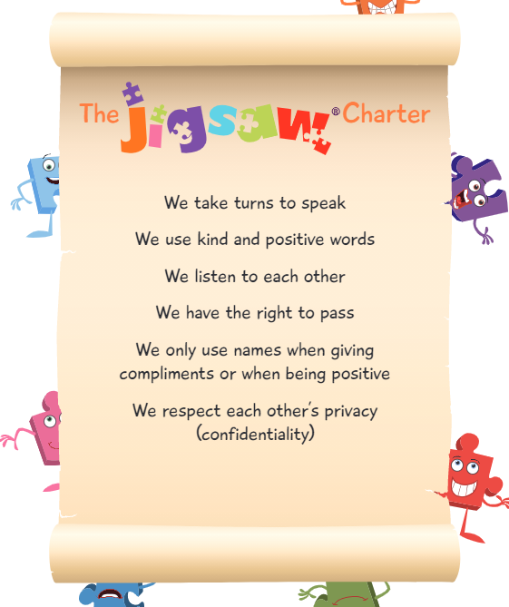
In PSHE (Personal, Social and Health Education) we always follow these rules…

Slide 2

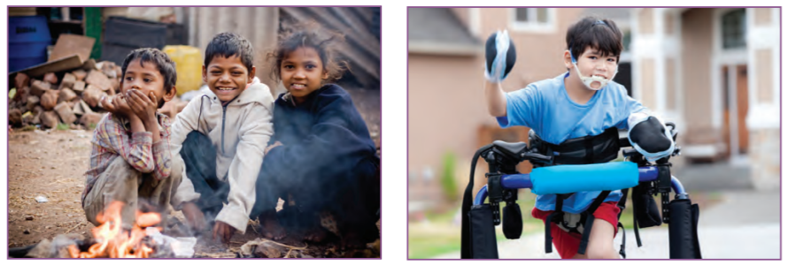
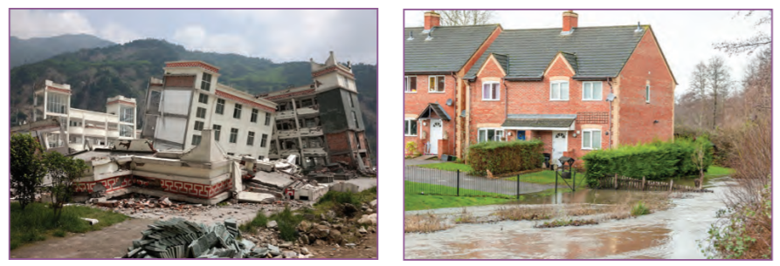
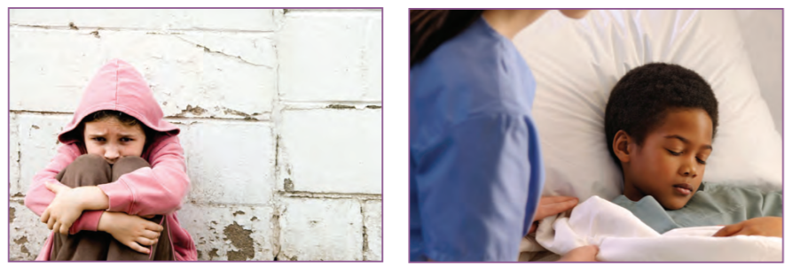
Remember the discussions we had last
week about global issues

Slide 3
Why do charities raise money?
What are the global issues people face?
https://bluepetertv.fandom.com/wiki/Blue_Peter_Appeals
https://www.comicrelief.com/
http://www.bbc.co.uk/programmes/p00q4x31

Slide 4
List some global issues that are faced by people
across the world.
Design a poster that encourages others to do
what they can to ‘stamp out’ these issues
Eg stop hunger, ensure everyone has a home

