Slide 1
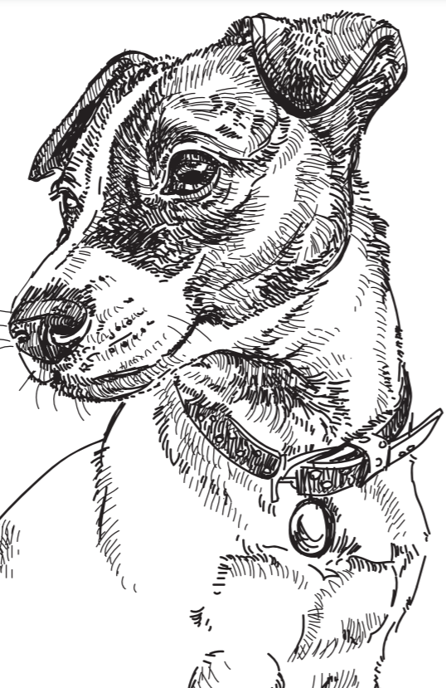
Pickles Saves The World Cup
Y 6
History of Football
Text Focus: Newspaper

Slide 2



This week you will…
identify new words when you read and discuss their meaning in context
explain and justify using evidence from the text
retrieve simple facts

Slide 3
Read ‘Pickles Saves The World Cup’ in pairs
While you are reading, you may wish to:
Underline and identify any new, unknown words
Underline any interesting facts
Challenge:
Did you find anything puzzling or confusing? Share your ideas with a partner.
Notes:
You may wish to read this first and have the children follow along and then read on their own.

Slide 4
Vocabulary Check
Discuss these the meaning of these words and phrases.
The theft of the famous trophy shocked the globe…
…the room was left unguarded as a church service took place in the hall.
…and demanding a ransom of £15,000.
Some people immediately believed that Mr Corbett may have had some part to play in the theft…
Notes:
Children could use a scale to indicate if they have heard the word or phrase before – 1 indicating no, I’ve never heard it before and 5 indicating yes, I know this word well.

Slide 5

Vocabulary Definitions
…but he has provided police with an alibi to prove his innocence.
What does the word alibi mean in this sentence?
Tick one.
 | Tick one
ability
explanation
guilty
trophy

Slide 6

Vocabulary Definitions
Mr Corbett, Pickles’ owner, said his dog would not leave the suspicious package…
What does the word suspicious mean in this sentence? Tick one.
 | Tick one
questionable/strange
glassy/smooth
bright/gleaming
expensive/valuable

Slide 7

Vocabulary Definitions
It is believed that criminals broke in that morning and committed the crime.
What does the word committed mean in this sentence? Tick one.
 | Tick one
devoted
loyal
refused
perpetrated

Slide 8
Day 2
Quick-fire retrieval
With a partner, write the answers to these!
When was the trophy stolen?
Who stole the trophy?
Who found the stolen trophy?
Where was the trophy found?
In what year did England host their first ever World Cup?
Notes:
You could set a timer and give the children 5 minutes to find the answers.

Slide 9
Quick-fire retrieval ANSWERS
With a partner, write the answers to these!
When was the trophy stolen? 20th March 1966
Who stole the trophy? Edward Betchley
Who found the stolen trophy? Pickles the dog
Where was the trophy found? under a hedge in Battersea Park
In what year did England host their first ever World Cup? 1966
Notes:
You could set a timer and give the children 5 minutes to find the answers.

Slide 10

True or false?
Tick one box in each row to show whether each statement is true or false.
STATEMENT | TRUE | FALSE
In 1950, England lost in the World cup to Spain and the USA.
The first World Cup took place in 1950.
Brazil won the World Cup in Chile in 1962.
Pickles was a white and brown collie dog.
Notes:
Challenge: Can children make up their own true/false statements to test a partner?

Slide 11
Explanation
Why do you think some people thought that Mr Corbett was involved with the theft?
Use evidence from the text to support your ideas.

Slide 12

Day 3
Which piece of information did you find the most interesting and why?
Can you summarise the text? Which information is important?
Watch this interesting video about Pickles! https://www.bbc.co.uk/sport/football/35872662
Notes:
Encourage children to justify and explain.

