Slide 1
Starter:
Make these simple sentences more exciting by adding adjectives:
The cat sat on the roof.
The girl went to the beach.
I have a book in my bag.
There was an elephant at the party.
I had pizza for dinner.
Now think about how these adjectives can be used to add relative clauses…

Slide 2
Relative Clauses
L.O.: To be able to use relative clauses in my writing.

Slide 3
What is a relative clause?
Discuss with the person next to you:

Slide 4
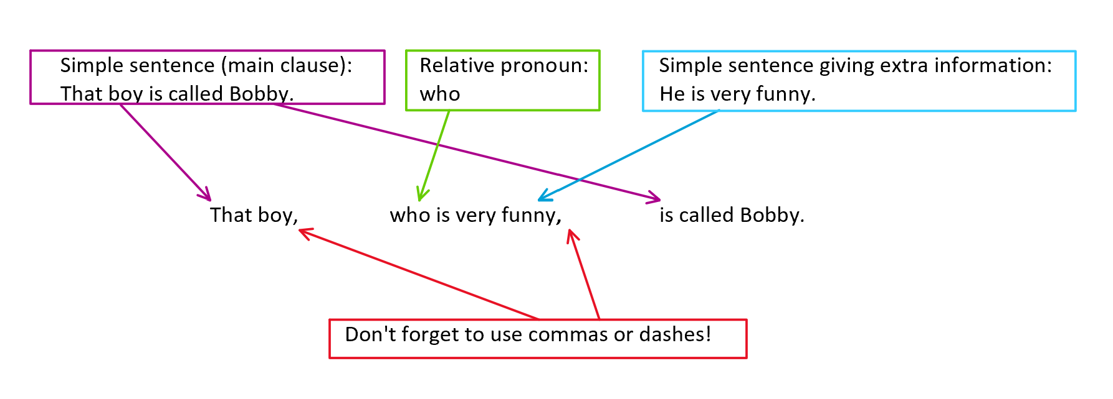
Relative Clauses
A relative clause is a clause which is added to a sentence to add extra information about a noun.
Here we see two simple sentences turned into one sentence with a relative clause:
That boy is called Bobby.
He is very funny.

Slide 5
Which of the following sentences contain relative clauses?
The cat was sat on a metal roof.
The cat, which was ginger, was sat on a metal roof.
On the metal roof, there was a cat.
The cat was sat on a roof - which was made of metal.
The ginger cat was sat on the roof.
The fluffy, ginger cat was sat on the cold, metal roof.
The cat – who was very sleepy – was sat on the roof, which was made of metal.

Slide 6
Which of the following sentences contain relative clauses?
The cat was sat on a metal roof.
The cat, which was ginger, was sat on a metal roof.
On the metal roof, there was a cat.
The cat was sat on a roof - which was made of metal.
The ginger cat was sat on the roof.
The fluffy, ginger cat was sat on the cold, metal roof.
The cat – who was very sleepy – was sat on the roof, which was made of metal.
What do you notice about the punctuation in the sentences with relative clauses?

Slide 7
Make these pairs of simple sentences into a sentence with a relative clause.
Michael went to the park. Michael was twelve years old.
Susan likes to sing. Susan has a cat.
The cat is ginger. The cat likes to eat fish.
There was an elephant at the party. The party was very fun!

Slide 8
Make these pairs of simple sentences into a sentence with a relative clause.
Michael went to the park. Michael was twelve years old.
Michael, who was twelve years old, went to the park.
Susan likes to sing. Susan has a cat.
Susan – who likes to sing – has a cat.
The cat is ginger. The cat likes to eat fish.
The cat, which is ginger, likes to eat fish.
There was an elephant at the party. The party was very fun!
At the party, which was very fun, there was an elephant!

Slide 9

Now let’s do some about Shackleton’s expedition! Add a relative clause to these simple sentences…
The Endurance is very sturdy.
The expedition was led by Ernest Shackleton.
Frank Worsley was the captain of The Endurance.
If you finish these, try writing some of your own…
Check your spelling, punctuation and grammar
Use commas and dashes with your relative clauses!
Pick the most appropriate relative pronoun.

