Slide 1

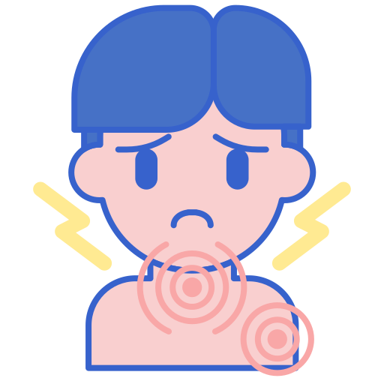
Fledgling Word of the Day
Word of the Day: |  | Meaning/Definition: The feeling when something hurts a lot.
Find the Rhyme: chain brain rain |  | Pyramid Spelling:
Phoneme Frame:
How many syllables? 1 | Write the Caption: pain in the neck
p
pa
pai
pain
p | ai | n

Slide 2
Fledgling Word of the Day
Word of the Day: |  | Meaning/Definition: The feeling when something hurts a lot.
Find the Rhyme: |  | Pyramid Spelling:
Phoneme Frame:
How many syllables? | Write the Caption: _________________________________________________________

