Slide 1

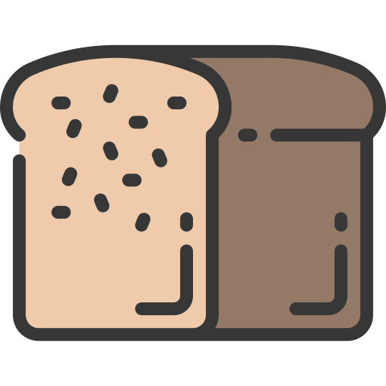
Fledgling Word of the Day
Word of the Day: |  | Meaning/Definition: A block of bread.
Find the Rhyme: - |  | Pyramid Spelling:
Phoneme Frame:
How many syllables? 1 | Write the Caption: cut the loaf
l
lo
loa
loaf
l | oa | f

Slide 2
Fledgling Word of the Day
Word of the Day: |  | Meaning/Definition: A block of bread.
Find the Rhyme: |  | Pyramid Spelling:
Phoneme Frame:
How many syllables? | Write the Caption: _________________________________________________________

