Slide 1

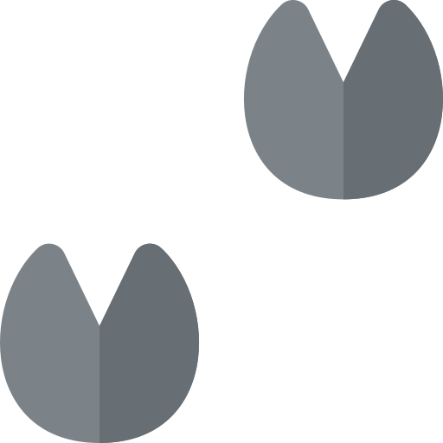
Fledgling Word of the Day
Word of the Day: |  | Meaning/Definition: The hard foot of a horse.
Find the Rhyme: roof proof goof |  | Pyramid Spelling:
Phoneme Frame:
How many syllables? 1 | Write the Caption: the hoof of a foal
h
ho
hoo
hoof
h | oo | f

Slide 2
Fledgling Word of the Day
Word of the Day: |  | Meaning/Definition: The hard foot of a horse.
Find the Rhyme: |  | Pyramid Spelling:
Phoneme Frame:
How many syllables? | Write the Caption: _________________________________________________________

