Slide 1

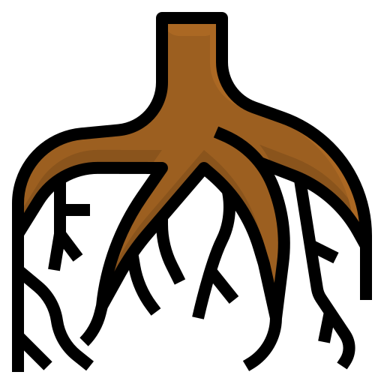
Fledgling Word of the Day
Word of the Day: |  | Meaning/Definition: The underground part of a plant that sucks up water.
Find the Rhyme: boot shoot loot |  | Pyramid Spelling:
Phoneme Frame:
How many syllables? 1 | Write the Caption: a root in the mud
r
ro
roo
root
r | oo | t

Slide 2
Fledgling Word of the Day
Word of the Day: |  | Meaning/Definition: The underground part of a plant that sucks up water.
Find the Rhyme: |  | Pyramid Spelling:
Phoneme Frame:
How many syllables? | Write the Caption: _________________________________________________________

