Slide 1

Fledgling Word of the Day
Word of the Day: |  | Meaning/Definition: A place where food is sold, sometimes outside.
Find the Rhyme: - |  | Pyramid Spelling:
Phoneme Frame:
How many syllables? 2 | Write the Caption: get carrots at the market
m
ma
mar
mark
marke
market
m | ar | k | e | t

Slide 2
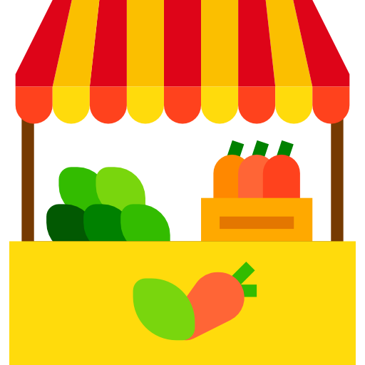
Fledgling Word of the Day
Word of the Day: |  | Meaning/Definition: A place where food is sold, sometimes outside.
Find the Rhyme: |  | Pyramid Spelling:
Phoneme Frame:
How many syllables? | Write the Caption: _________________________________________________________

