Slide 1
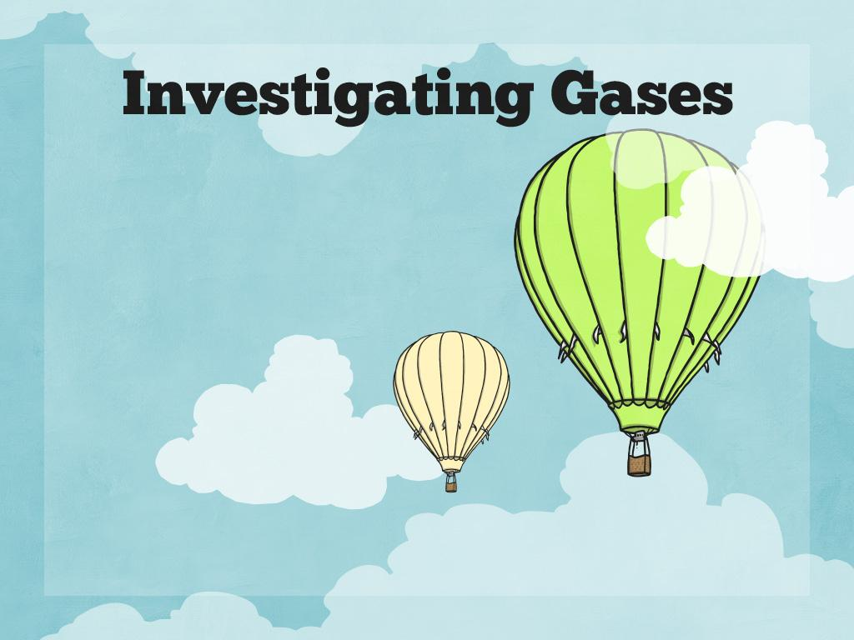

Slide 2
Can you identify a gas?
Watch the clip
Gases in daily life (clip compilation) - KS2 Science

Slide 3
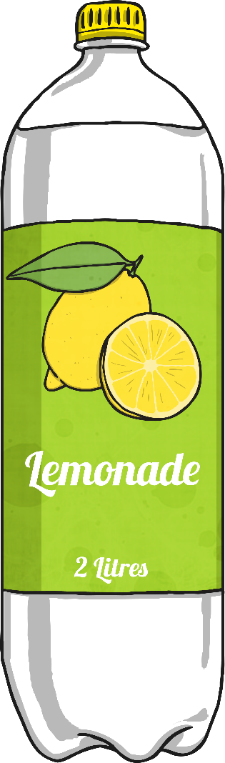
Identifying States of Matter
On your table you will see a bottle of fizzy drink.
Which states of matter can you identify in the materials that make up the bottle of fizzy drink?

Slide 4
Identifying States of Matter
Which of these materials and states of matter did you identify?
Draw this in your books and fill in the labels to show which states
plastic lid
solid
bubbles
?
paper label
?
lemonade drink
?

Slide 5


Bubbles of Gas
What are the bubbles in fizzy drinks made of?
Why are there bubbles in fizzy drinks?
How are fizzy drinks made?

Slide 6
What Are the Bubbles in Fizzy Drinks Made Of?
Bubbles in fizzy drinks are made from a gas called carbon dioxide.
Carbon dioxide is a gas that is all
around us. It makes up only about
0.04% of the Earth's atmosphere.

Slide 7
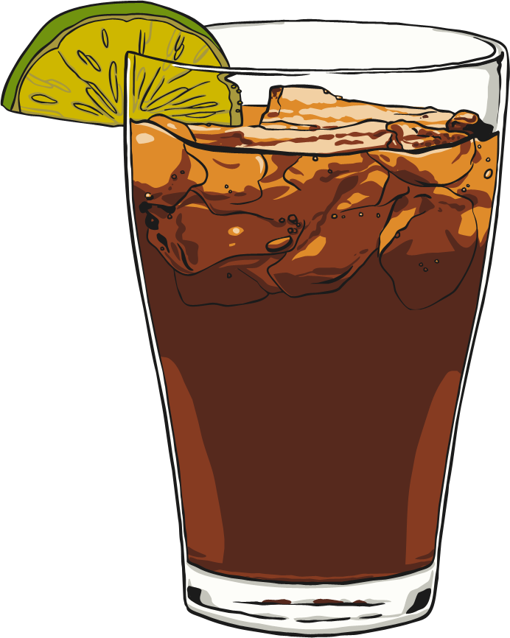
How Are Fizzy Drinks Made?
Fizzy drinks are made by adding carbon dioxide to liquid under huge pressure. The carbon dioxide dissolves in the liquid and settles in the space above the liquid in the bottle or can.
When the container is opened, the pressure decreases and the gas escapes quickly, making a hissing sound. The bubbles appear as the carbon dioxide turns into gas.

Slide 8
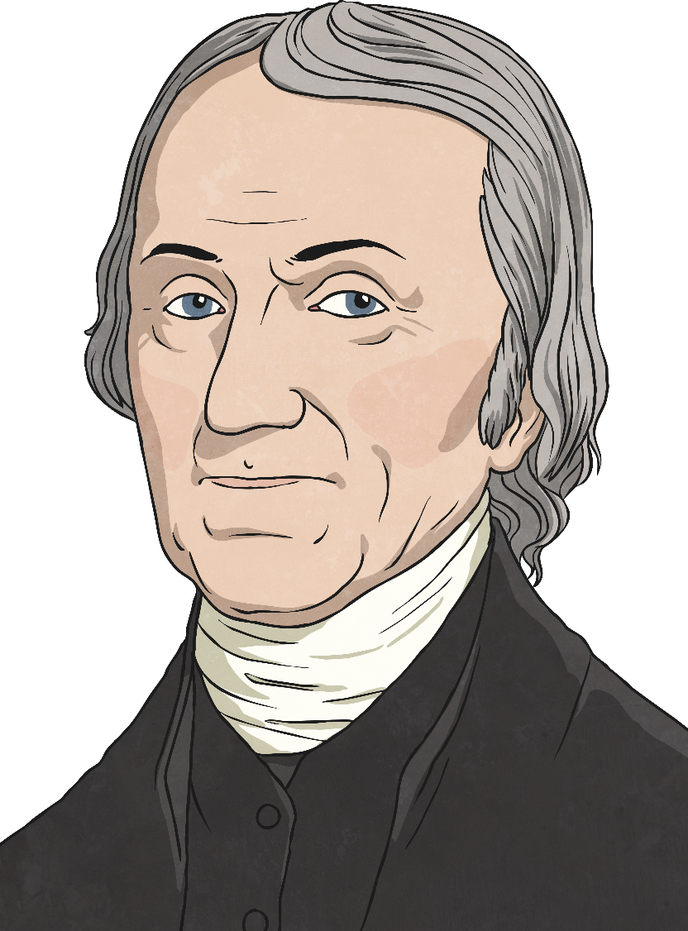
Who Invented the First
Fizzy Drink?
In 1767, a clergyman and scientist called Joseph Priestly accidentally invented the first fizzy drink. He found a way to dissolve gas in water, making the first soda water, or carbonated water.
When he drank the fizzy water, he described a “peculiar satisfaction”.

Slide 9

Bubbles of Gas
Carbon dioxide can be very useful.
Some fire extinguishers use carbon dioxide to cool flames and to stop oxygen getting to the fire.
Carbon dioxide freezes at -78°C, and it becomes a solid called dry ice. It is used to transport food that needs to be kept cool and fresh, such as on aeroplanes and trains.
And as you have read, carbon dioxide is dissolved in water to create fizzy drinks.

Slide 10



Do Gases Weigh Anything?
These children are talking about the weight of gas. Who do you agree with?
Gases are lighter than air, so they do not weigh anything.
Gas has no weight because it is invisible.
A gas does have weight because it is a material.

Slide 11

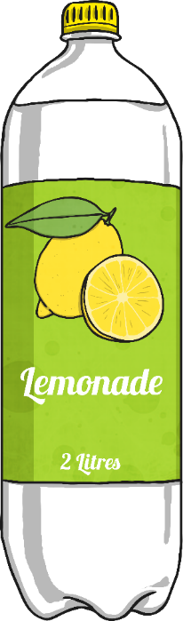


Do Gases Weigh Anything?
This is Maya. She weighed a glass of fizzy lemonade. It weighed 173.1g. Gently, she swirled the glass around to make the liquid flat, in other words, to remove the carbon dioxide. She weighed the glass again and this time it weighed 172.6g. The drink was lighter after the gas had been removed.
what does this show?

Slide 12
True or False?
Look at the statements and decide whether they are true or false.
Carbon dioxide is a gas at room temperature.
Gases keep
their shape.
Carbon dioxide
is useful.
The bubbles in
fizzy drinks are bubbles of gas.
Gases that are lighter than air weigh nothing.
You can find the weight of gases.

Slide 13
True or False?
How did you do?
True.
Carbon dioxide is a gas at room temperature.
Gases keep
their shape.
False.
Carbon dioxide
is useful.
True.
The bubbles in
fizzy drinks are bubbles of gas.
True.
Gases that are lighter than air weigh nothing.
False.
You can find the weight of gases.
True.

