Slide 1
LO: To gather research for your biography
Friday 22nd January 2021

Slide 2
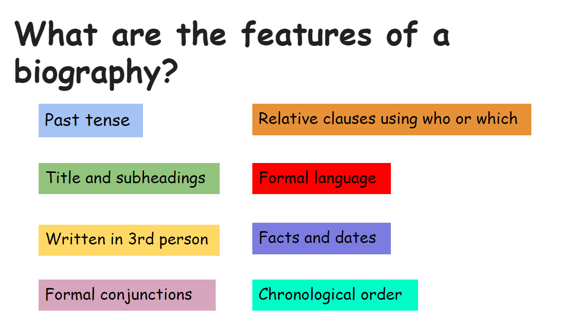

Slide 3

Starter
Which of these sentences are written in 3rd person?
Yesterday, I walked a long way to the park.
She ran on ahead towards the park.
Write your own sentence in 3rd person.

Slide 4
You will be writing your biography about a person that inspires, influences or interests you.
You could pick
A scientist
A family member
A key historical figure
A member of the royal family
An inventor
A leader
Anyone that inspires you
Anyone that influences you
Anyone that is of interest to you and you want to find out more about!
Have a think about who you would like to write your biography about

Slide 5

For the purpose of today’s lesson I’ve picked David Attenborough as the inspirational person I wish to focus on.
Need to find out facts and dates that are significant to their life.
Facts are information that is true
Have a think, what sort of facts and dates do we need to know to build up a picture of someone’s life?

Slide 6
When they were born (date) and where they were born (fact)
Information about their family (facts)
Where they went to school (fact)
The jobs they may have had (fact)
Significant events in their lives (facts and dates)
How did they get to being an inspirational/influential person? (facts)
If they have died, find this too (date)

Slide 7
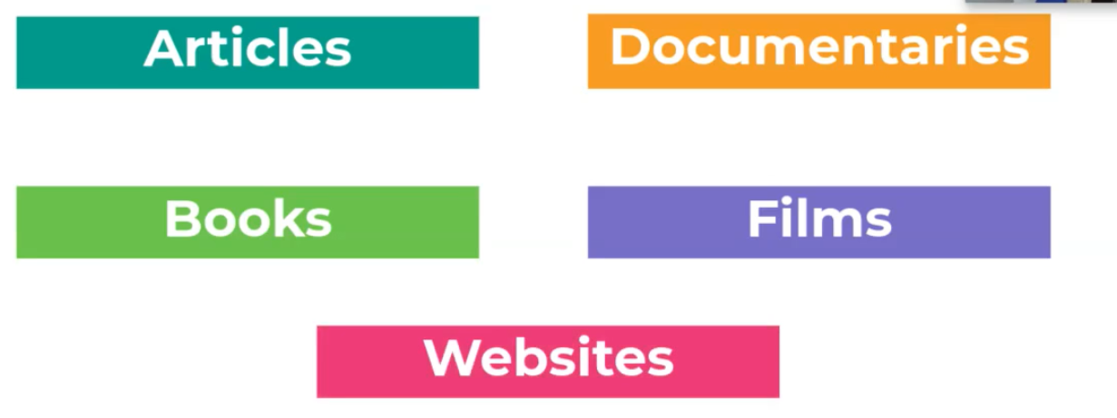
Where can we look for information?

Slide 8
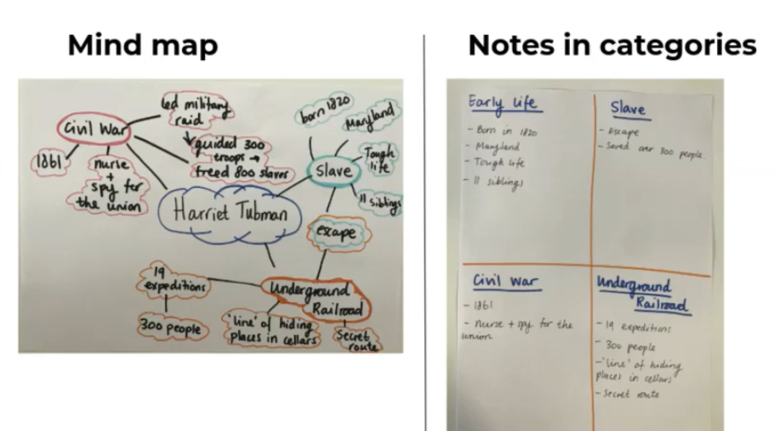
How do we collate information?
Collect and combine
These are examples of collated information
about Harriet Tubman, who is a slave and
a key historical figure.
The information has been sorted into
categories.
Decide how you would like to collate your
information. Either in a mind-map or in
notes in categories.

Slide 9
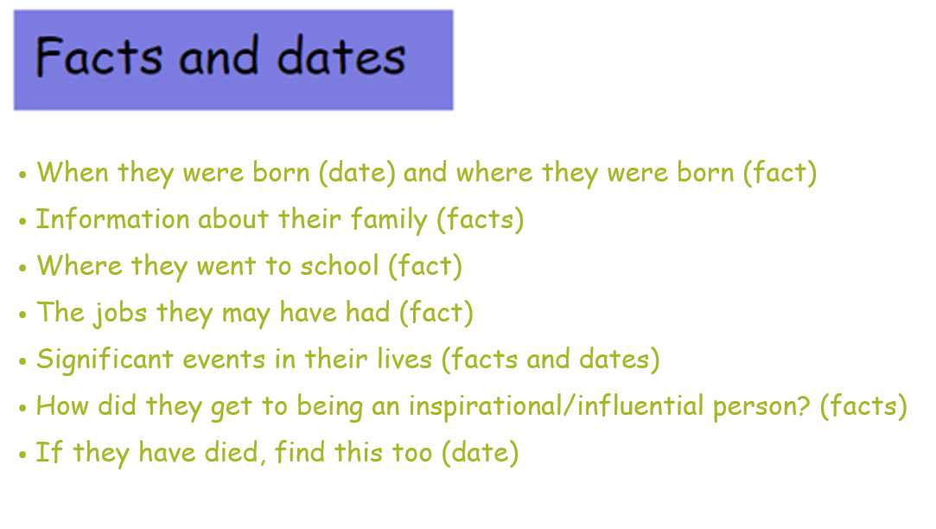
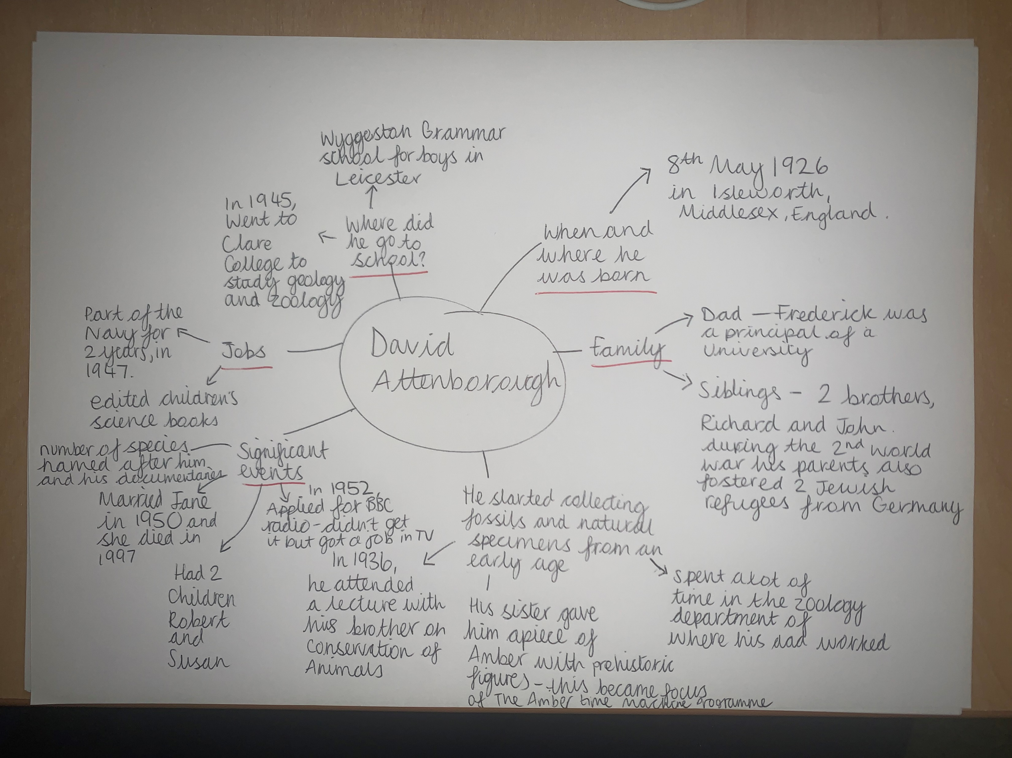
David Attenborough
Below is a mind-map of my research of David Attenborough.
You may wish to create a timeline of events too.
I am going to watch some of his documentaries over the weekend to find out some more information.

Slide 10
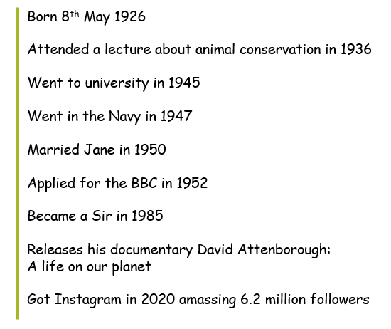
Timeline of David Attenborough’s life

Slide 11
Now it’s your turn to do some research
Select your person of inspiration/influence or interest.
Decide how you will collate the information you are gathering (either in a mind-map or organised note form).
Use articles, documentaries, books, films and websites to find your information.
You may want to organise the important dates of the persons life into a timeline once you’ve finished your fact finding.
Please use the ‘facts and dates’ slide to guide you towards the information you need to find out for your biography.
This research is not limited to the lesson, if you are going to watch a documentary or a film about your subject. Your research may span over the weekend.

