Slide 1
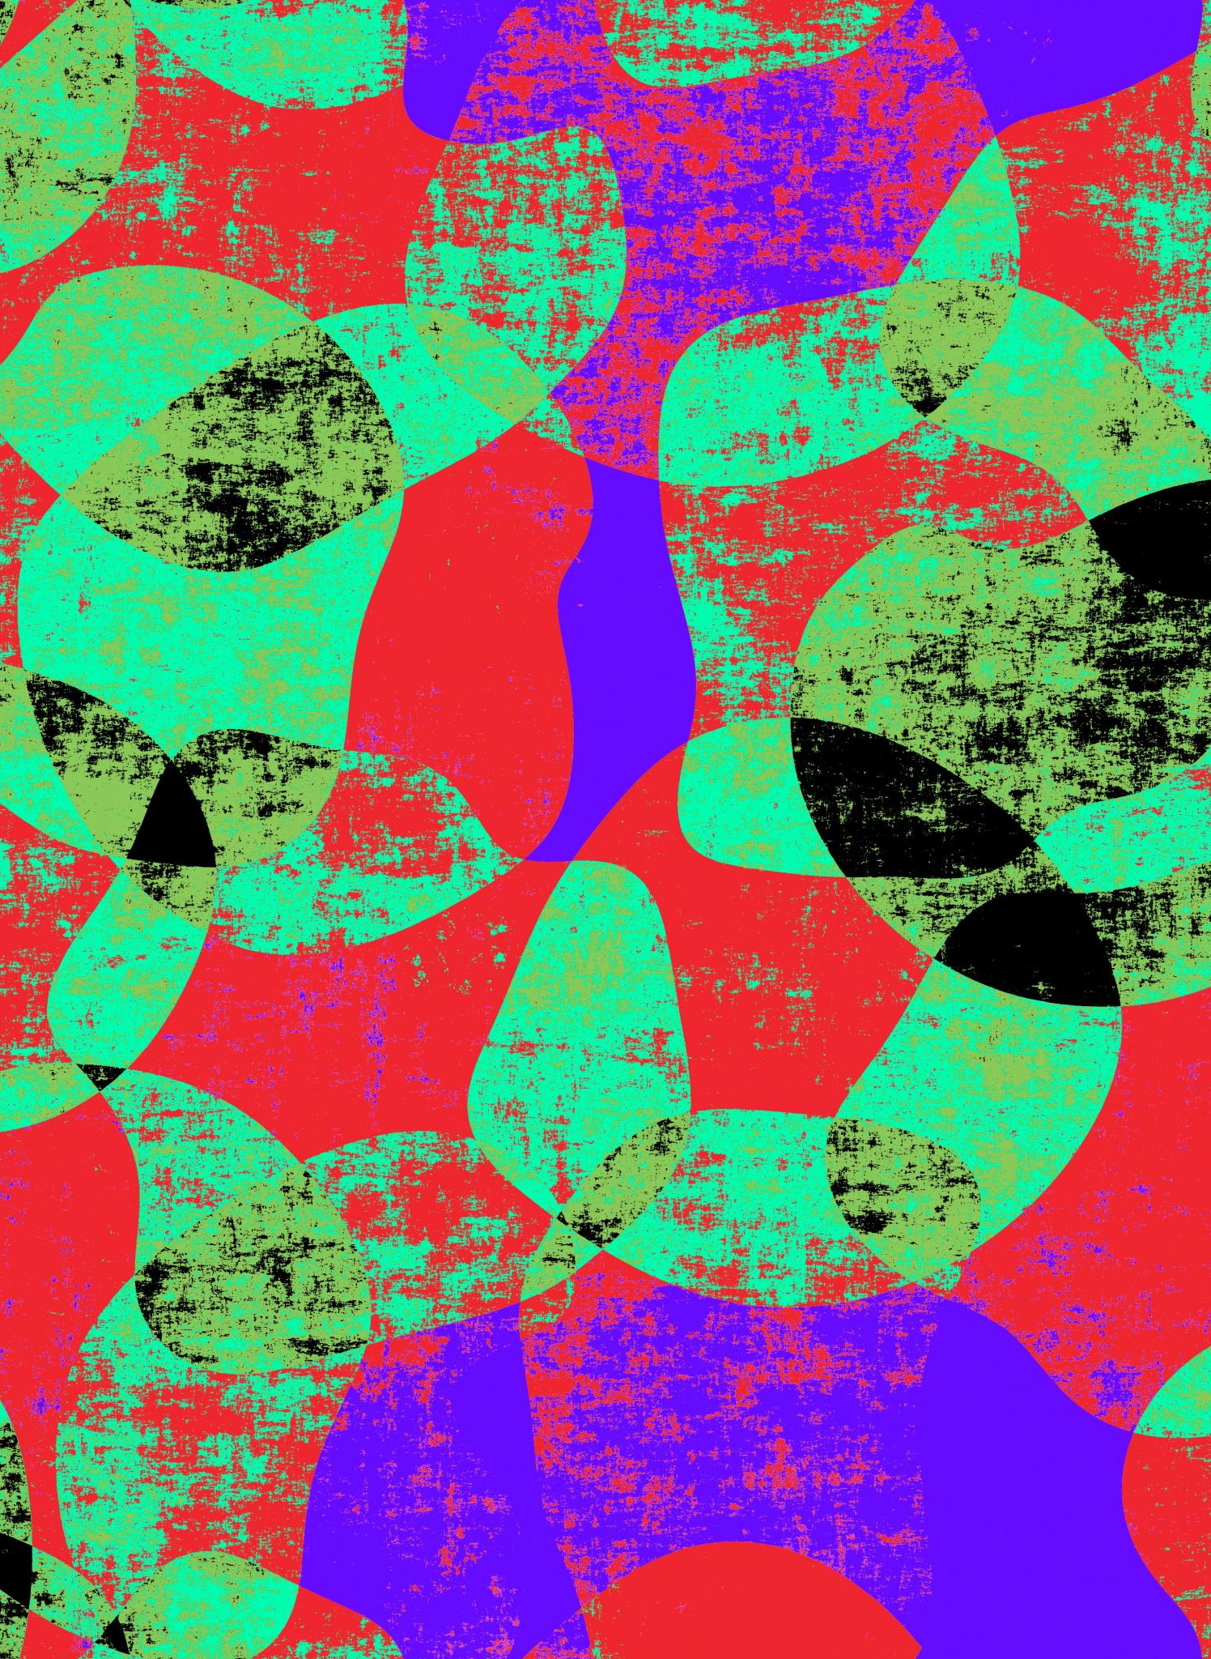

LO: To explore a range of additive techniques
Thursday 21st January 2021
Please click the speaker icon to hear the introduction!

Slide 2
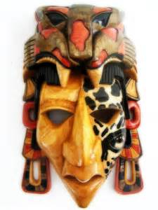
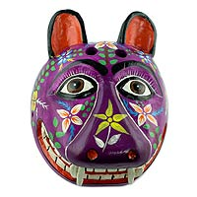
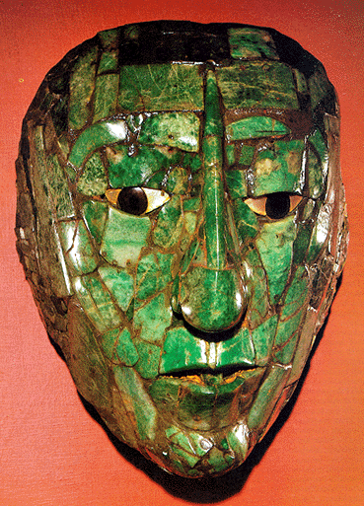
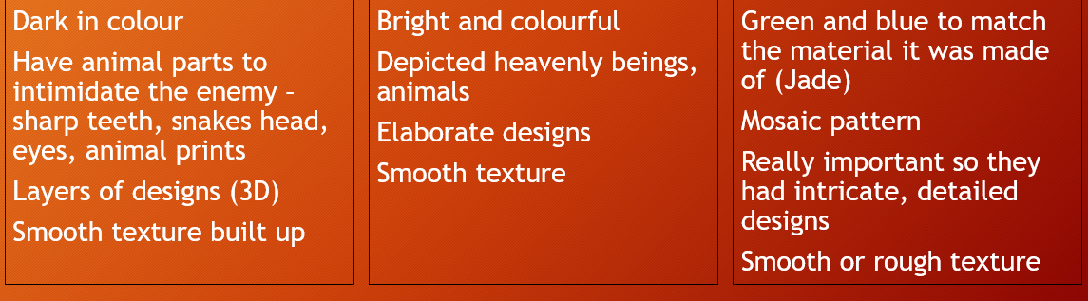
What are the different types of Mayan masks?

Slide 3
What is an additive process?
Sculptors gather and join different materials to create an assembled sculpture.
Assembling is an additive process.
The additive process is the process of creating sculpture by adding materials together to make the work.
Please click the speaker icon!

Slide 4
What is an additive process?
Because you are going to be making Mayan masks, we will be looking at the construction part of the additive process to join materials together to make a mask.
In the additive process, the sculptor needs to think about the materials they use, what they do with those materials and how they stick them together.
Please click the speaker icon!

Slide 5
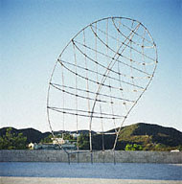
This is the sculpture called ‘That Profile’ by Martin Puryear
What do you think it is made from?
What do you think he’s used to bind the materials together?
Why is this an additive sculpture?

Slide 6
This is the sculpture called ‘That Profile’ by Martin Puryear
What do you think it is made from?
It is made from metal. Stainless steel tubes.
What do you think he’s used to bind the materials together?
He’s welded them together using another metal called bronze.
Why is this an additive sculpture?
Because he has joined the materials together.
Would metal be a good material to make your mask from?
Please click the speaker icon

Slide 7
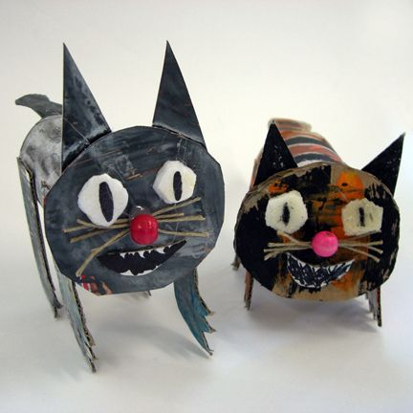
Another example of additive sculptures
What do you think they are made from?
What do you think has been used to bind the materials together?
Do you think this is an additive sculpture?
Would these materials be suitable to use on your mask?
Think about the questions then click on the speaker icon.

Slide 8
Watch this video
https://youtu.be/jtfsPc7yqEM
Can you note down…
What materials is the sculptor is using?
Why do you think they are using them?
How are they binding them together?
What makes this an additive sculpture?

Slide 9
What materials could you use to make your mask?
Paper
Cardboard
Tissue paper
Card
Remember you need to think about how you will stick them together.
What properties do they have that would make them good additives?
Can you paint or draw on these materials easily?

Slide 10
Your task
If you have any of these materials at home such as
Cardboard
Paper
Tissue paper
Card
Try out all the different ways these materials can be manipulated (changed)
Twisting Crumpling
Folding Rolling
Ripping Shredding
Cutting Weaving
Pinching Curling
Write down what techniques you might use when creating your mask and how you will stick them to your mask.
https://www.youtube.com/watch?v=Ey6U7D5fdgM
Please click the speaker icon to hear the task!
Click this link for a demonstration on paper manipulation

