Slide 1
LO: to write instructions as to how bit maps work

Slide 2
Success criteria
I can make a complex bitmap with multiple colours
I understand how more pixels can effect the quality of the image

Slide 3
Recap
Last week we were able to create a simple bitmap using binary code
Binary code is information that’s passed on in the form of 0’s ans 1’s
These 0’s and 1’s are known as bits, and there are 8 bits in 1 byte

Slide 4
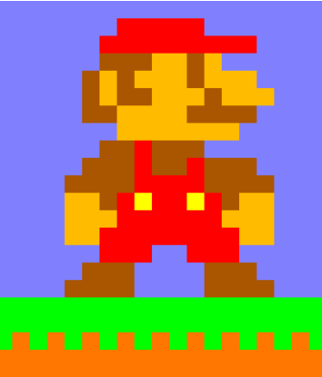
Here we have an image of one of the most recognisable characters in gaming history, Mario.
This character was created using a bitmap, using the image here, do you think you could create the bitmap that is paired with this image?
Have a think about the colours used and how you could represent these colours in binary code
e.g:
000 = light brown
001 = red
011 = green
111 = dark brown
100 = yellow
101 = gold
Independent task
Create the bitmap that partners this image of Mario

