Slide 1
I know about a range of jobs carried out by people I know and have explored how much people earn in different jobs I appreciate the contributions made by people in different jobs

Slide 2
What jobs can you think of?
Have a think to yourself, what jobs do you know? Perhaps you know the jobs of your parents or careers
What jobs have you seen on TV or in books?
Perhaps you know jobs that are on the internet such as youtubers!
When you’ve thought of a couple jobs that adults have, think about how important you believe them to be?
What in your opinion would be a job that is incredibly important?

Slide 3
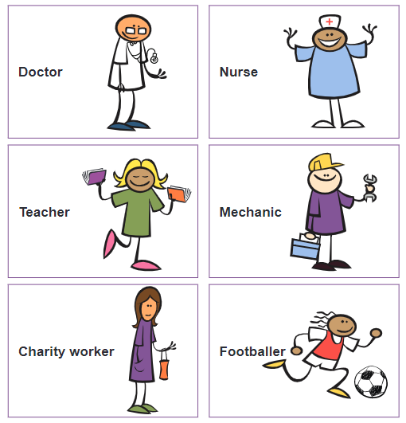
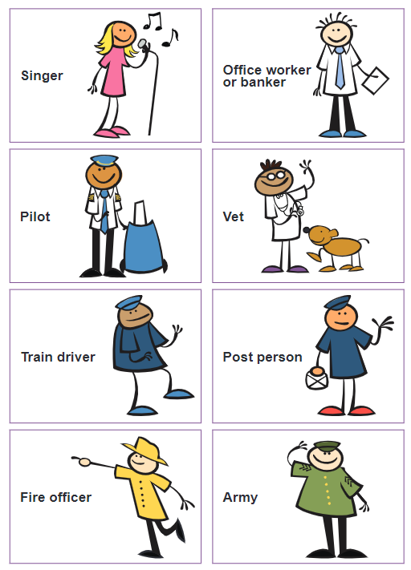
Take a look at these jobs, are these jobs important?
What makes one job more important than another?

Slide 4
Now think about how much each people earn in these jobs?
Can you sequence these jobs, first in order of how important you believe them to be (most important first)
Secondly you can sequence these jobs again, this time by who makes the most money (the job that makes the most money starting in first)

Slide 5
Contributions to society
Who do you believe offers the most help and support to the general public?
Are there any jobs in particular that have a positive impact on everyone they meet?

Slide 6
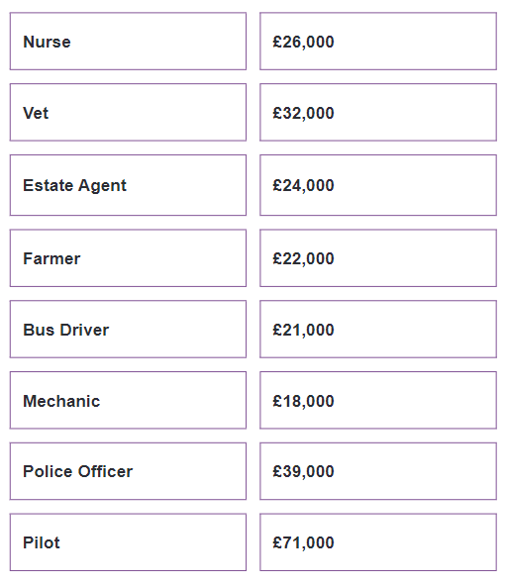
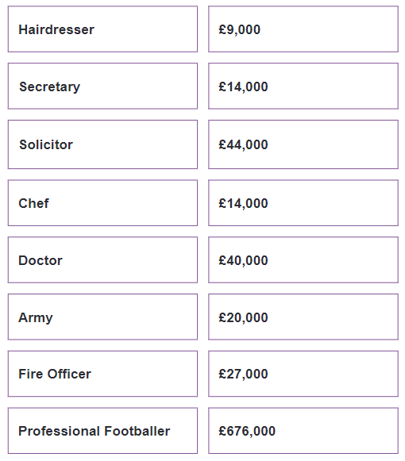
Take a look at the average yearly wages (amount of money you earn per year) of these jobs.
Is this what you expected?

Slide 7
Independent task
Have a think first, do you believe the most important people in this list get paid the most?
Now I want you to write down and explain who you believe the most important job on this list is, and describe the contributions that they make to society

