Slide 1
LO: To understand past tense
Tuesday 18th January 2021

Slide 2
Sort these words into the correct categories
Noun | Adjective | Verb | Adverb
quickly
huge
toy
walked
happily
blue
London
jumped

Slide 3
Sort these words into the correct categories
Noun | Adjective | Verb | Adverb
London
huge
walked
quickly
toy
blue
jumped
happily

Slide 4
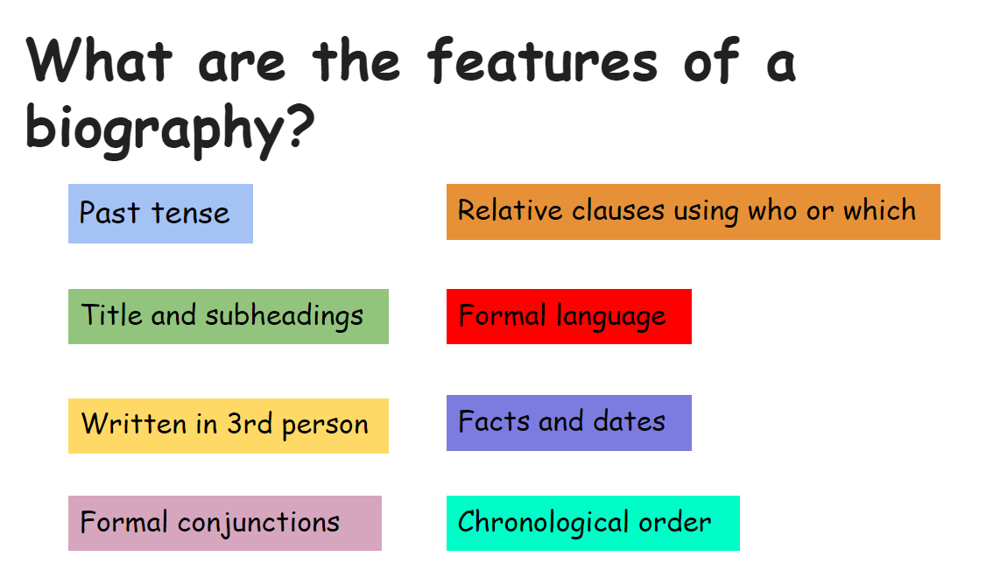

Slide 5
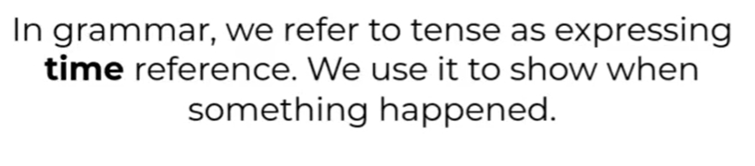
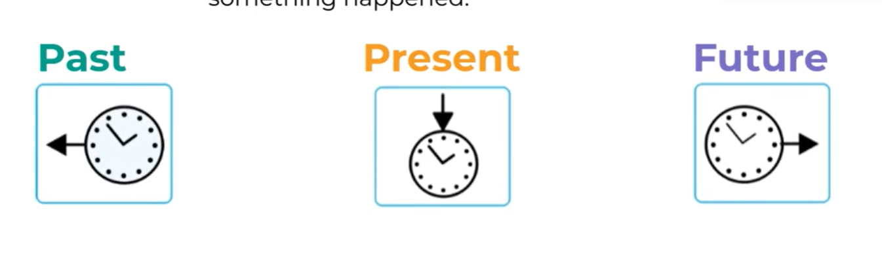
What is meant by ‘tense’?
Talking about something that has already happened
Talking about something that is happening now
Talking about something that will happen
I walked home.
I’m walking home.
I will walk home.

Slide 6
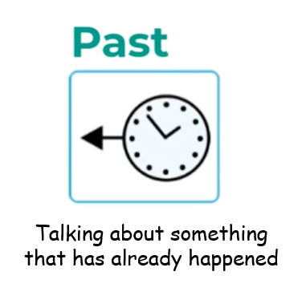

Specifically, simple past tense
The simple past tense is used to talk about a completed action in a time before now. The time of the action can be in the recent past or the distant past and action duration is not important.
She opened the door.
Amy played in the park.
Open - opened
Ben turned on the heating.
Play - played
He jumped off the step.
turn - turned
jump - jumped
I baked a cake.
What do you notice about the verbs?
I pulled up my socks.
bake - baked
Pull - pulled
They all end in -ed

Slide 7
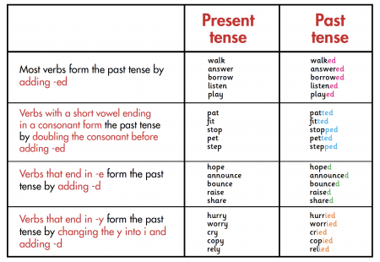
Regular past tense verbs
See if you can come up with your own sentence using one of these past tense words!

Slide 8
Irregular past tense verbs
These are past tense verbs that don’t follow the –ed rule
She built a sandcastle.
Charlotte understood the task.
Grandad drank his cup of tea.
Understand - understood
Build - built
Drink - drank
He wrote a shopping list.
David caught the ball.
Catch - caught
The boss paid her staff.
Write - wrote
Pay - paid

Slide 9
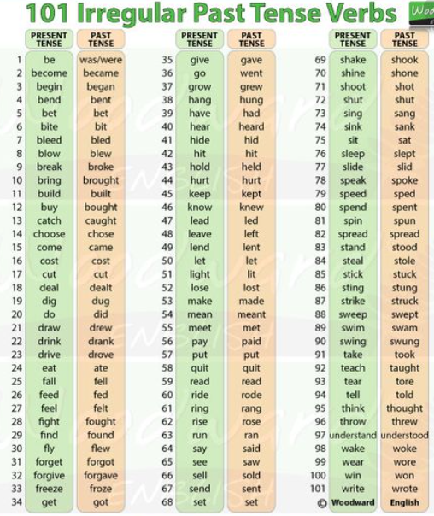
Here are some more irregular verbs!

Slide 10
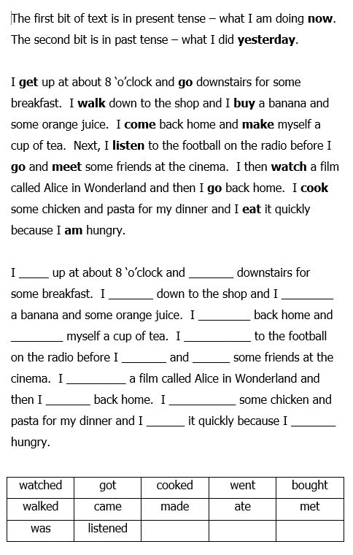
Task a
Turn this present tense paragraph into past tense using these words above.

Slide 11
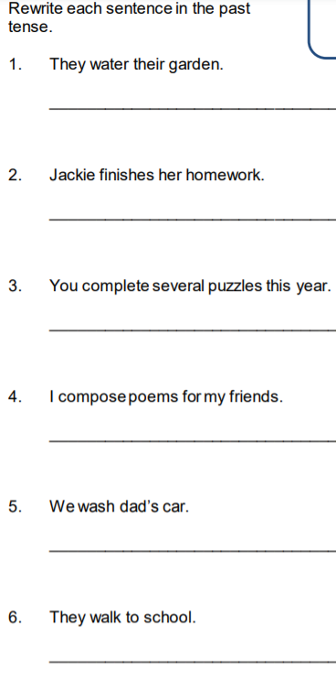
Task b

Slide 12
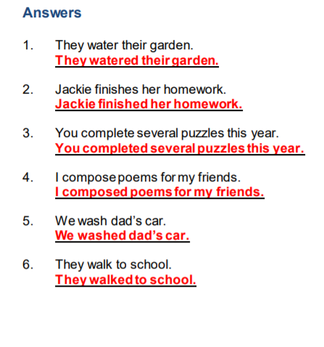
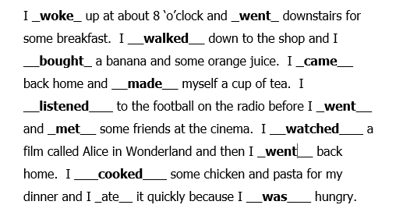
Answers
Task a Task b
You may have found that more than one word fits in a space!

