Slide 1
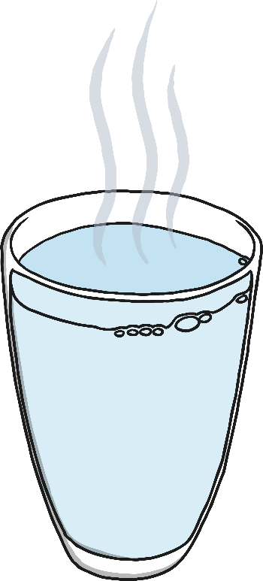
What Makes
Materials Change State?
When a solid turns into a liquid it is called melting.
The temperature at which a solid material melts is called its
melting point. Different materials have different melting points.
If a solid material is heated to its melting point, it will start to
melt and will change state from a solid to a liquid.
In a solid, the particles are closely packed together and are vibrating
on the spot. When a solid is heated, the particles start to move faster and faster. If enough heat is applied, the particles will have enough energy to move about. They are still close together, but can move over and around each other. At this point, the solid has melted to form a liquid.

Slide 2
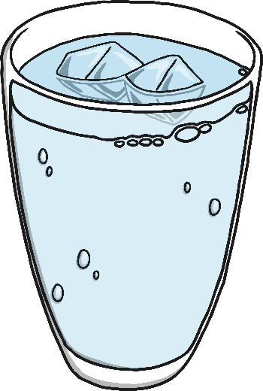
What Makes
Materials Change State?
When a liquid turns into a solid it is called freezing.
The temperature at which a liquid material freezes is called its
freezing point. Different materials have different freezing points.
If a liquid material is cooled to its freezing point, it will turn from a
liquid to a solid.
The particles in a liquid are close together, but can move quite quickly around and over each other. As it is cooled, the particles start to slow down. Eventually, they slow down so much that they only move gently on the spot, and a solid structure is formed. The material has frozen.

Slide 3
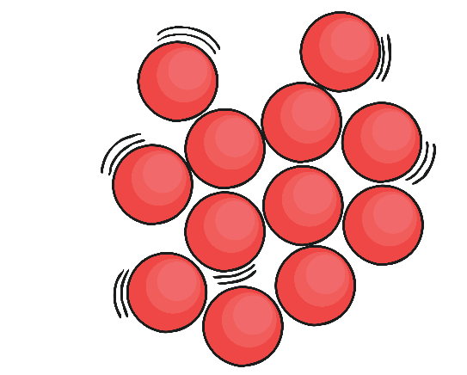
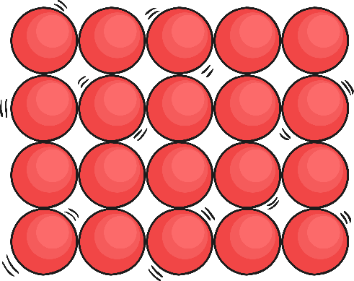
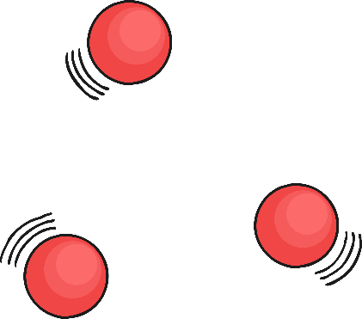
What Makes
Materials Change State?

