Slide 1
LO: to sequence and pronounce the months of year

Slide 2
Warm up

Slide 3
Petite et grande
Listen to the instructions that Mr Skinner is saying
Mr Skinner will ask you to move around your safe area and he will ask you to Sautez (jump), courez (run), marchez (walk), marchez sur la pointe des pieds (tiptoe).
You might have to do this outside if you can’t find space inside
Mr Skinner will also say petite or grande.
If you hear petite, you need to crawl up as small as possible
if you hear grande, you need to stretch out as big as possible
It would be amazing to see any pictures or videos of you becoming these fantastic animals

Slide 4
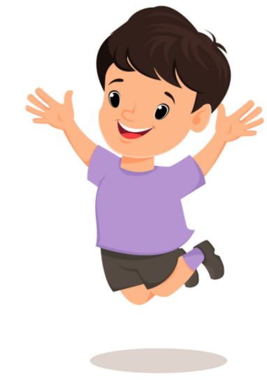
Sautez (jump)

Slide 5
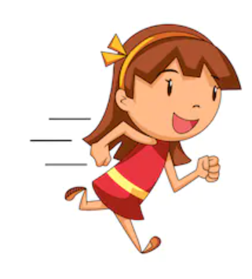
Courez (run)

Slide 6
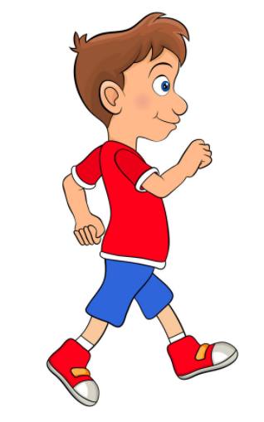
Marchez (walk)

Slide 7
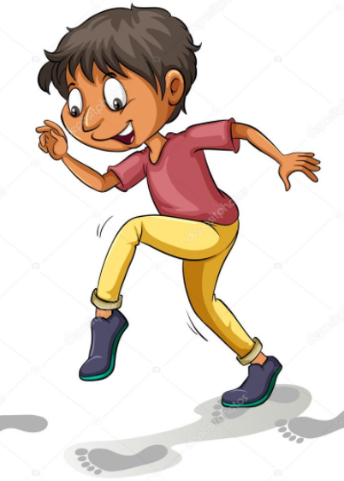
marchez sur la pointe des pieds (tiptoe)

Slide 8
Months of the year
ce mois-ci = this month
le mois dernier = last month
le mois prochain = next month

Slide 9
Months of the year
Below are the months of the year in French, can you sequence them and write them down in the right order. Are there any that are spelt similar to their english versions?
Juin
Novembre
Août
Mai
Janvier
Mars
Décembre
Avril
Juillet
Octobre
Février
Septembre

Slide 10
pronunciation
‘an’ and ‘em’ and ‘en’
Look at these words we have already learnt, what do you notice about the sounds?
Janvier, septembre, novembre, décembre, vendredi, un éléphant, une panthère, blanc/ blanche

