Slide 1
LO: to sort words with ‘ie’ and ‘ei’ digraph

Slide 2
Sort these words into anyway you want.
conscience
species
deceive
conceive
receive
tries
ceiling
pie
receipt
perceive
ancient
believe
cried
science

Slide 3
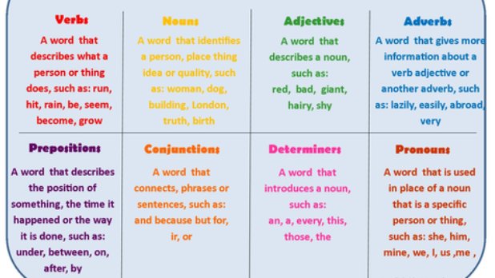
Sort these words into word classes
(you may not have a word in every word class)

Slide 4
Please move these words around in the sorting tasks.
conscience
species
deceive
conceive
receive
tries
ceiling
pie
receipt
perceive
ancient
believe
cried
science

