Slide 1
Tuesday 5th January 2021
LO: To identify regions in South America on a map
Success Criteria:
-To locate the position of South America on a globe/ in an atlas/ on a world map.
-Describe the location of south America. Make reference to the equator and the UK. (name the sea that lies between them- Atlantic Ocean)
- Identify Brazil, Venezuela, Colombia, Peru, Chile and Uruguay on a map.

Slide 2
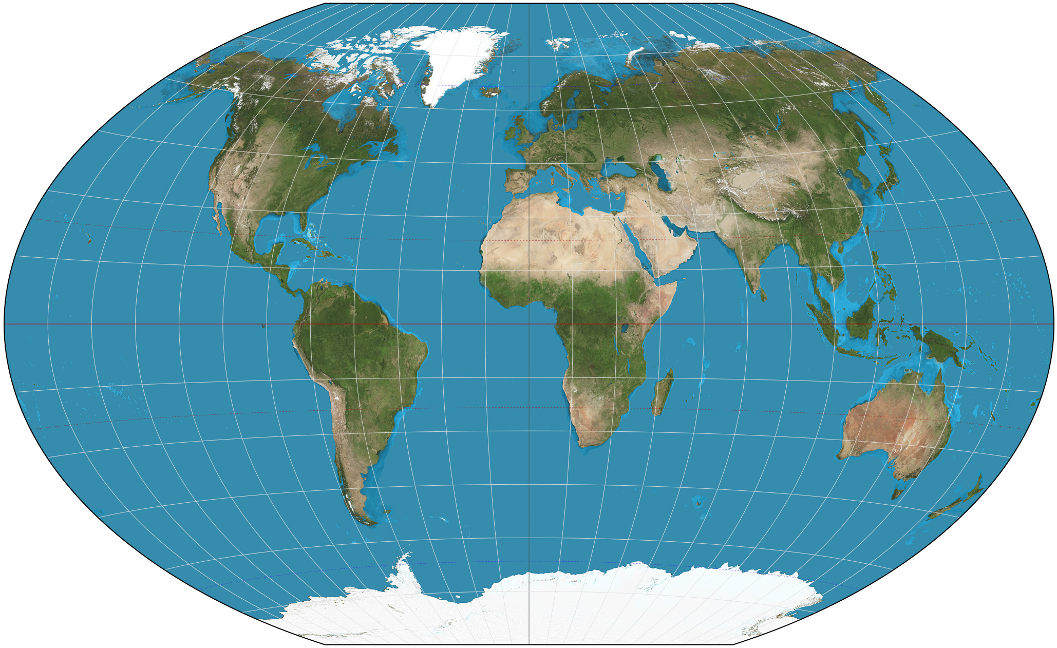
What continents can you label already?

Slide 3
Where is South America?
What do you already know about it?
How can you describe South America in relation to the map?
Things to think about:
The equator
Biomes
Northern/Southern Hemisphere
Climate/weather

Slide 4
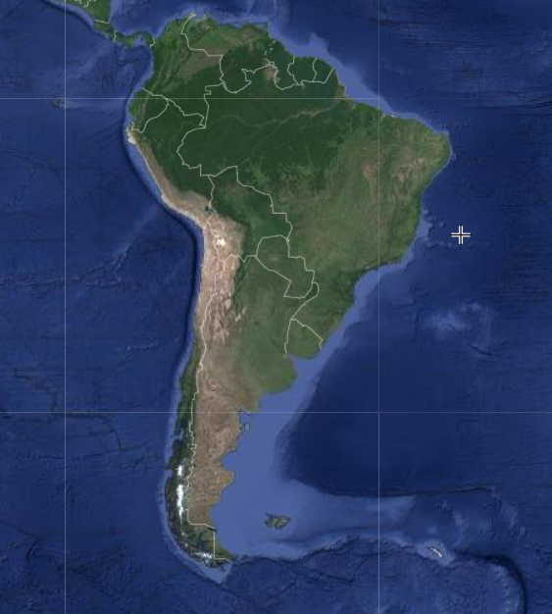
https://www.scribblemaps.com/create/#/lat=51.0164992&lng=-4.2401792&z=3&t=hybrid
Use the link to take you to Scribble Maps. This will allow you draw on and label the countries you find! Alternatively, edit this powerpoint and put arrows to the countries. You may wish to print out a picture and label it! Take a picture and email it to us once you’ve completed it!
Can you identify these countries on the map?
Brazil
Venezuela
Colombia
Peru
Chile
Uruguay
Argentina
More?
Once you’re finished, can you find the capital cities for these countries?
See next slide for more help using scribble maps.

Slide 5
SCRIBBLE MAPS
https://www.scribblemaps.com/
This link will take you to a website called scribble maps. It is a resource which lets you explore different maps from around the world!
Take some time today to have a look around the website. You shouldn’t need to sign up/register (we haven’t had to) but please let us know if that’s not the case!
Looking at the view maps tab lets you see the other maps that people have drawn.
Create maps lets you search for a continent/country. You will need to zoom out so you can see the continent properly and then you can select the pen tool to draw with! You could screenshot/print screen the map once you have finished!

