Slide 1
LO: to know about Muslim festivals

Slide 2

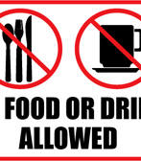
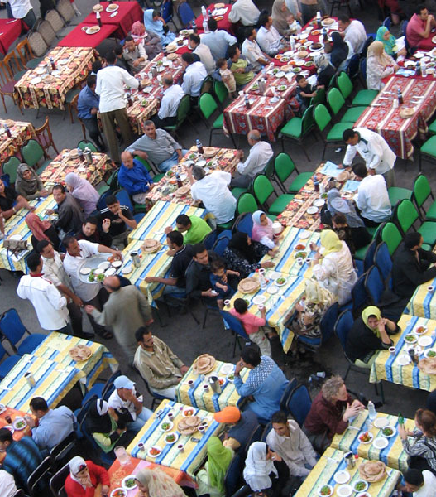
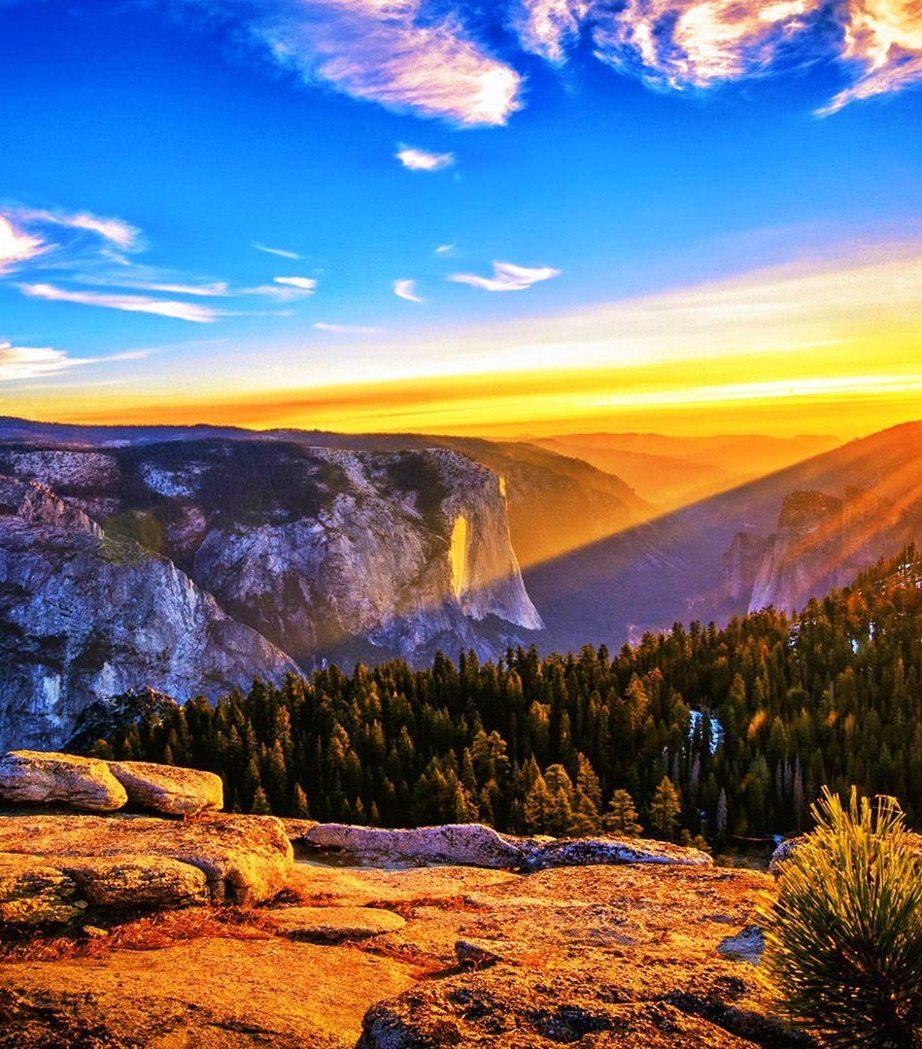
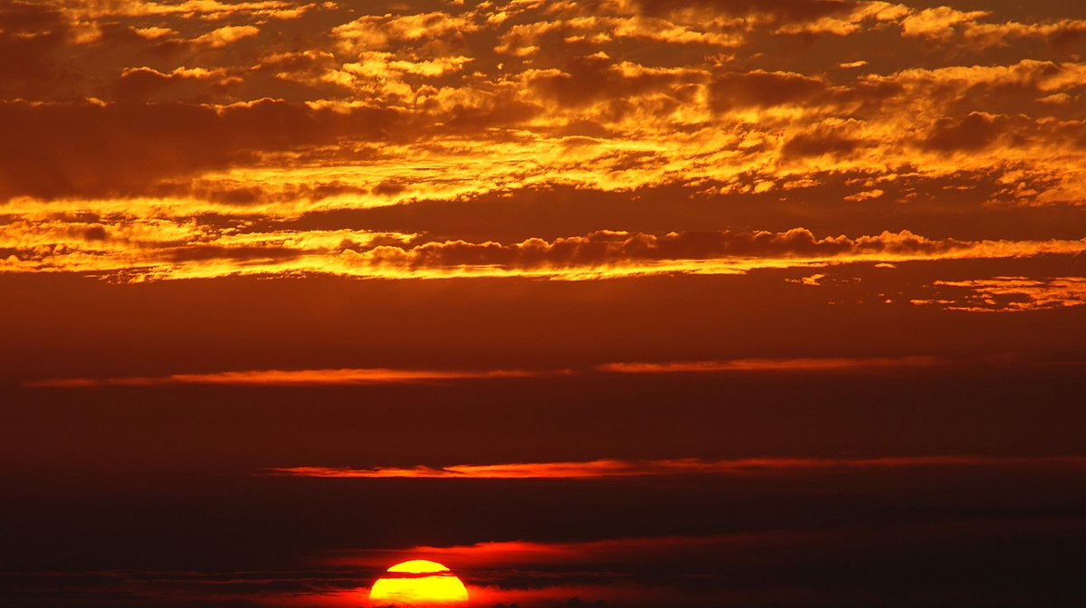
What we have learnt, match the words to the picture...
This Photo by Unknown author is licensed under CC BY-SA.
Ramadan
Ramadan Moon
Food/drink can be eaten when?
Food/drink can't be eaten when?
What is EID?

Slide 3
Watch these clips as a reminder, to help you answer the questions.
https://www.bbc.co.uk/newsround/23286976 (Ramadan during the pandemic)
https://www.bbc.co.uk/cbeebies/puzzles/lets-celebrate-eid

Slide 4
Why do Muslims celebrate Ramadan?
Write in your books what you have learnt so far about Ramadan and why they make this sacrifice.

Slide 5
Why do Muslims celebrate EID?
Write in your books what you have learnt so far about EID and why it's an important festival to Muslims.

