Slide 1
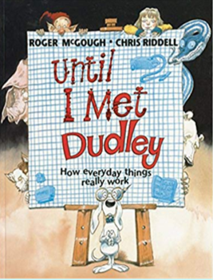
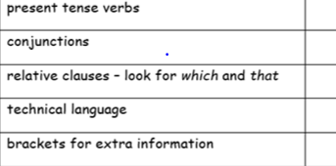
Focus: Explanation
LO: to learn a paragraph
Thursday 4th February 2021
Success Criteria:
- look at the map to rehearse the text
- use the punctuation to pause appropriately
- identify the key features

Slide 2
Until I Met Dudley
We are going to be writing some explanations based upon the book ‘Until I met Dudley’. The book is about a little girl who has all these wonderful, imaginative ideas about how day to day things work like dragons that breathe fire to toast the bread in toasters! Dudley the dog then explains to her how things really work. These explanations use a combination of the features that we have been learning about.

Slide 3
Today’s task
For today’s lesson, we are going to have a go at learning a paragraph in which the little girl explains how she believes dishwashers work. We are learning this paragraph to gain a really clear understanding of the language structure (what your explanations will need to look like) and the features of the text (what specific writing skills you will need to include in your writing) that you will need to include in your own explanations.
Pictures of the book are uploaded onto the website if they are too small to read on the PowerPoint.

Slide 4
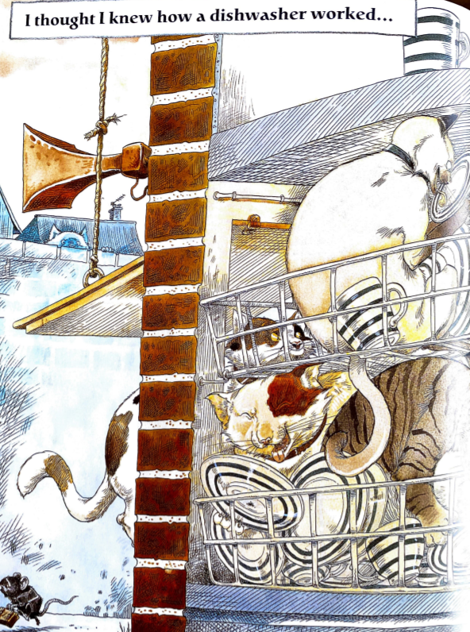
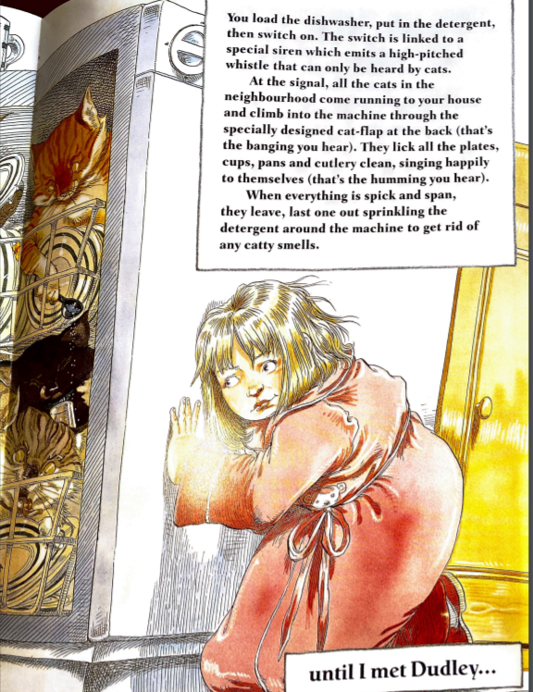

Slide 5
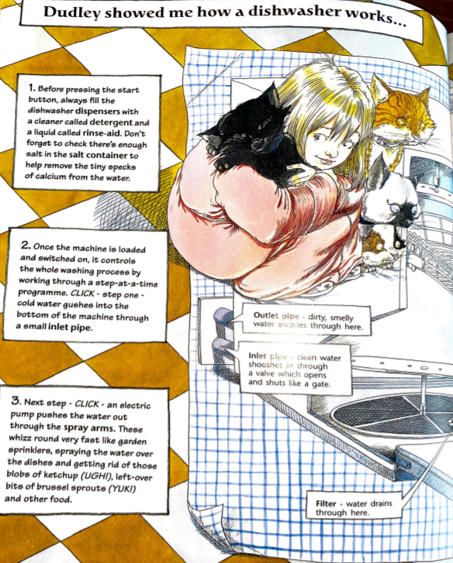
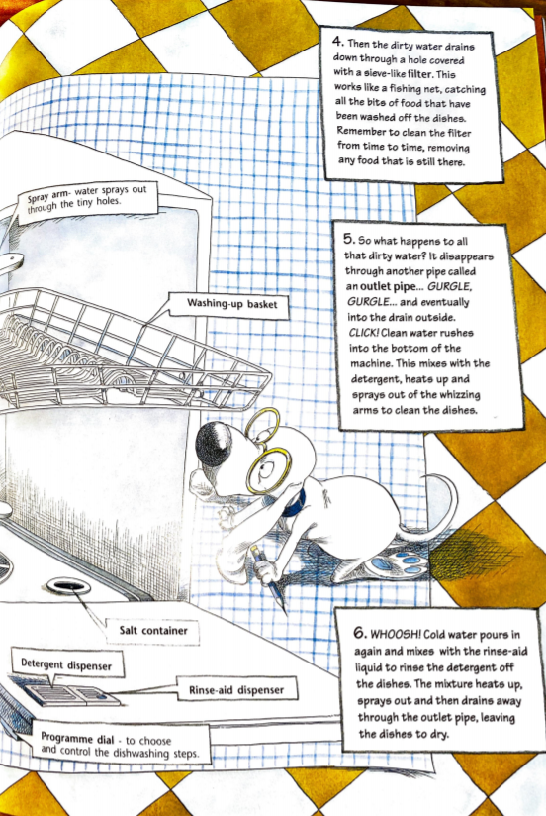

Slide 6
Paragraph to learn:
How a dishwasher really works:
Once the dishwasher is loaded, put in the detergent (soap), close the door and switch it on. The switch is linked to a special siren which emits a high-pitched whistle which can only be heard by cats. at the signal, all the cats in the neighbourhood come running to your house. They climb into the machine through the specially designed cat-flap (that's the banging you hear). They lick all the plates, cups, pans and cutlery clean while singing to themselves (that's the humming you hear). When everything is spick and span, they leave. The last one out sprinkles the detergent around the machine to get rid of any catty smells.

Slide 7
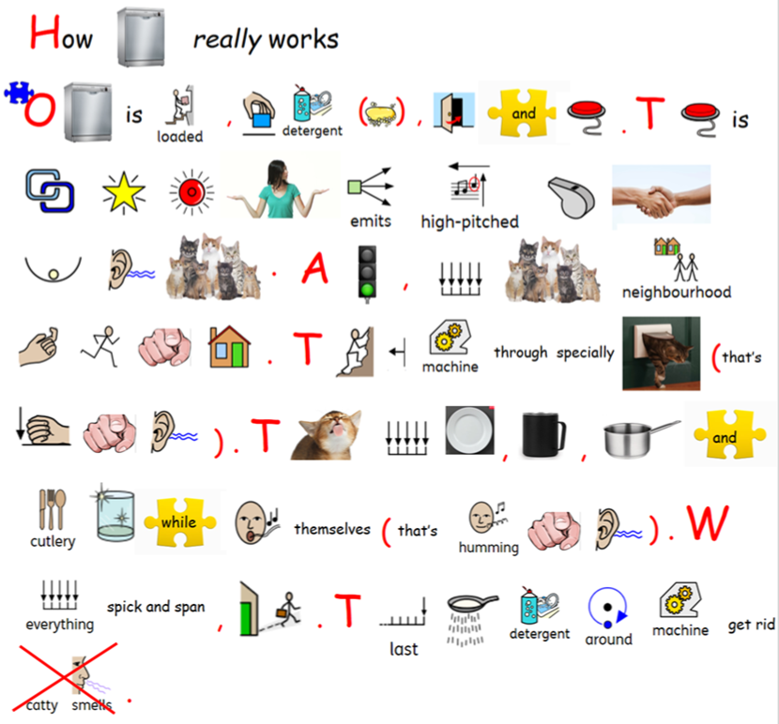
This story map might be useful to help learn the text! Perform this poem to somebody at home – how much can you remember?
If you are struggling to remember it all, choose your favourite sentences to learn.
How many of the language features can you spot?

Slide 8
I really hope you have a lot of fun with this book! Next week, I will read some of the other explanations to you as hopefully this will inspire your own explanation writing!
Come back next week to learn about the pigs in the back of rubbish lorries gobbling up the rubbish and how vacuume cleaners are actually Hoover-Snakes sucking up dust! In the meantime, keep an eye out for those pesky dragons who breathe fire to make toast in toasters in the mornings… they have a tendency to breathe fire for too long and it burns!

Slide 9
Focus: Explanation
LO: to learn a paragraph
Thursday 4th February 2021
Success Criteria:
- look at the map to rehearse the text
- use the punctuation to pause appropriately
- identify the key features

