Slide 1
LO: Continuing with Rosh Hashanah and why it's important to Jewish people.

Slide 2
Success Criteria
To understand why Jewish people, celebrate Rosh Hashanah
To understand how Jewish people, celebrate Rosh Hashanah

Slide 3
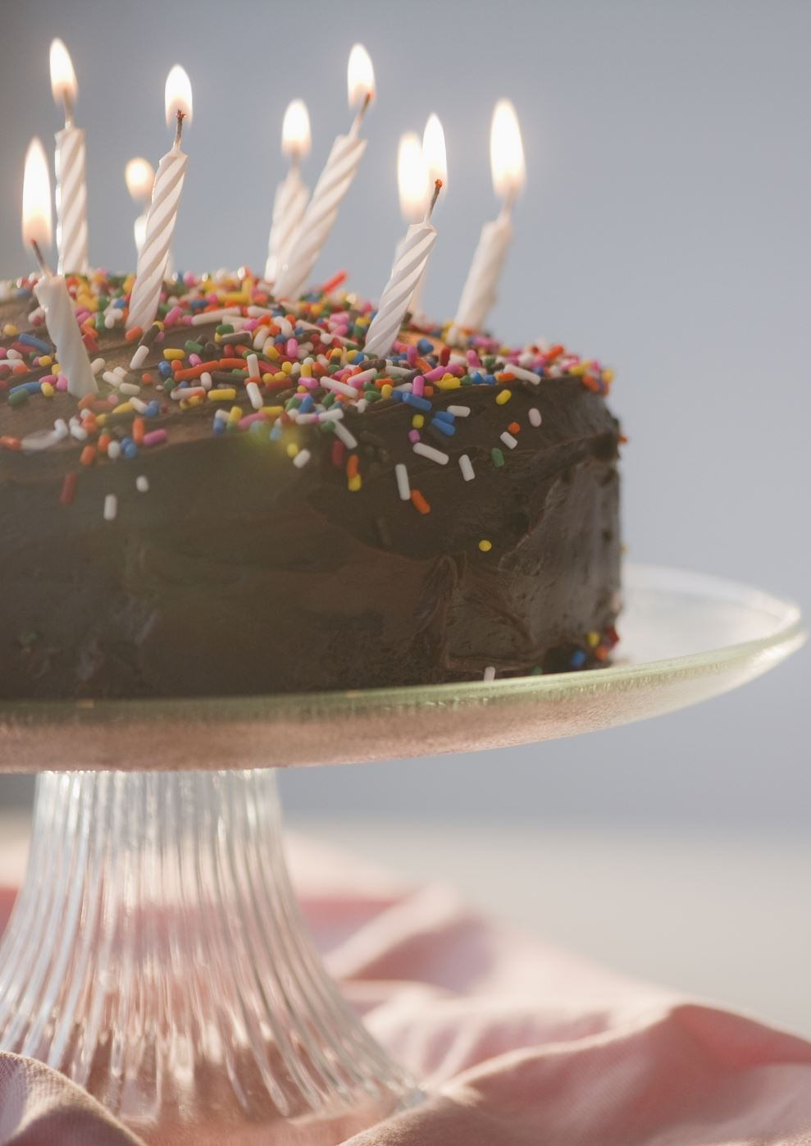
Let's recap..
What is Rosh Hashanah?
Why do they eat sweet foods?

Slide 4
Celebrating Rosh Hashanah in the Synagogue
Please watch this clip
https://www.bbc.co.uk/programmes/p02n2jc5

Slide 5
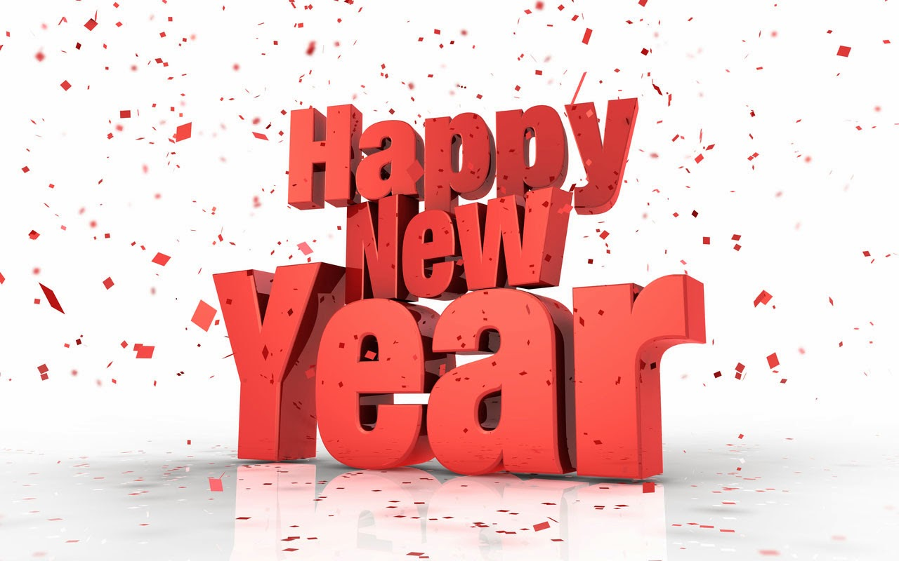
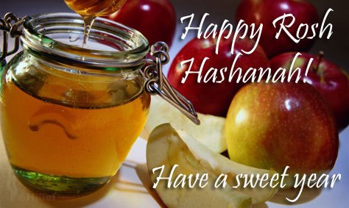
Well done if you said...
Rosh Hashanah is the Jewish New Year.
They eat sweet food to welcome in a sweet new year.
This Photo by Unknown author is licensed under CC BY-NC-ND.

Slide 6

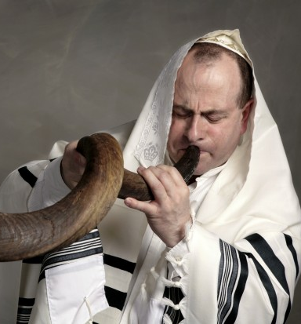
It is a time to repent
Meaning of repent:
to be very sorry for something bad you have done in the past and wish that you had not done it.
They sound the Shofar for 7 seconds in the synagogue to start the 7 days of Rosh Hashannah and the time to ask for forgiveness.
This Photo by Unknown author is licensed under CC BY-NC.

Slide 7

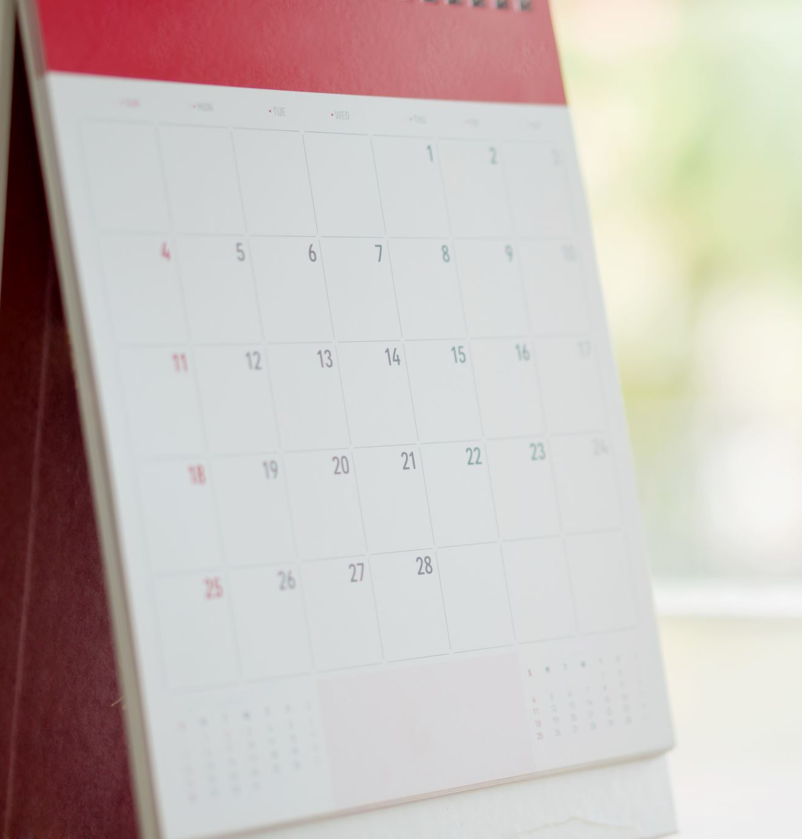
What would you repent?
Write the LO and Date in your books.
Year 3 think about something you would like forgiveness for and how you would improve in the coming year. Write this up in your books.
I would repent (ask forgiveness for)___________________________

Slide 8
LO: to learn about Rosh Hashannah and Yom Kippur

Slide 9
Success Criteria
To understand that Rosh Hashanah is the Jewish New Year
To Understand that Yom Kippur is the day of "Atonement"

Slide 10
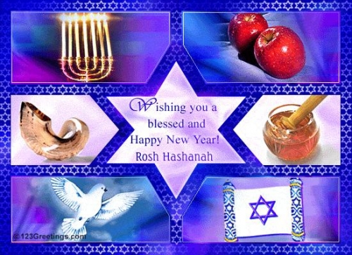
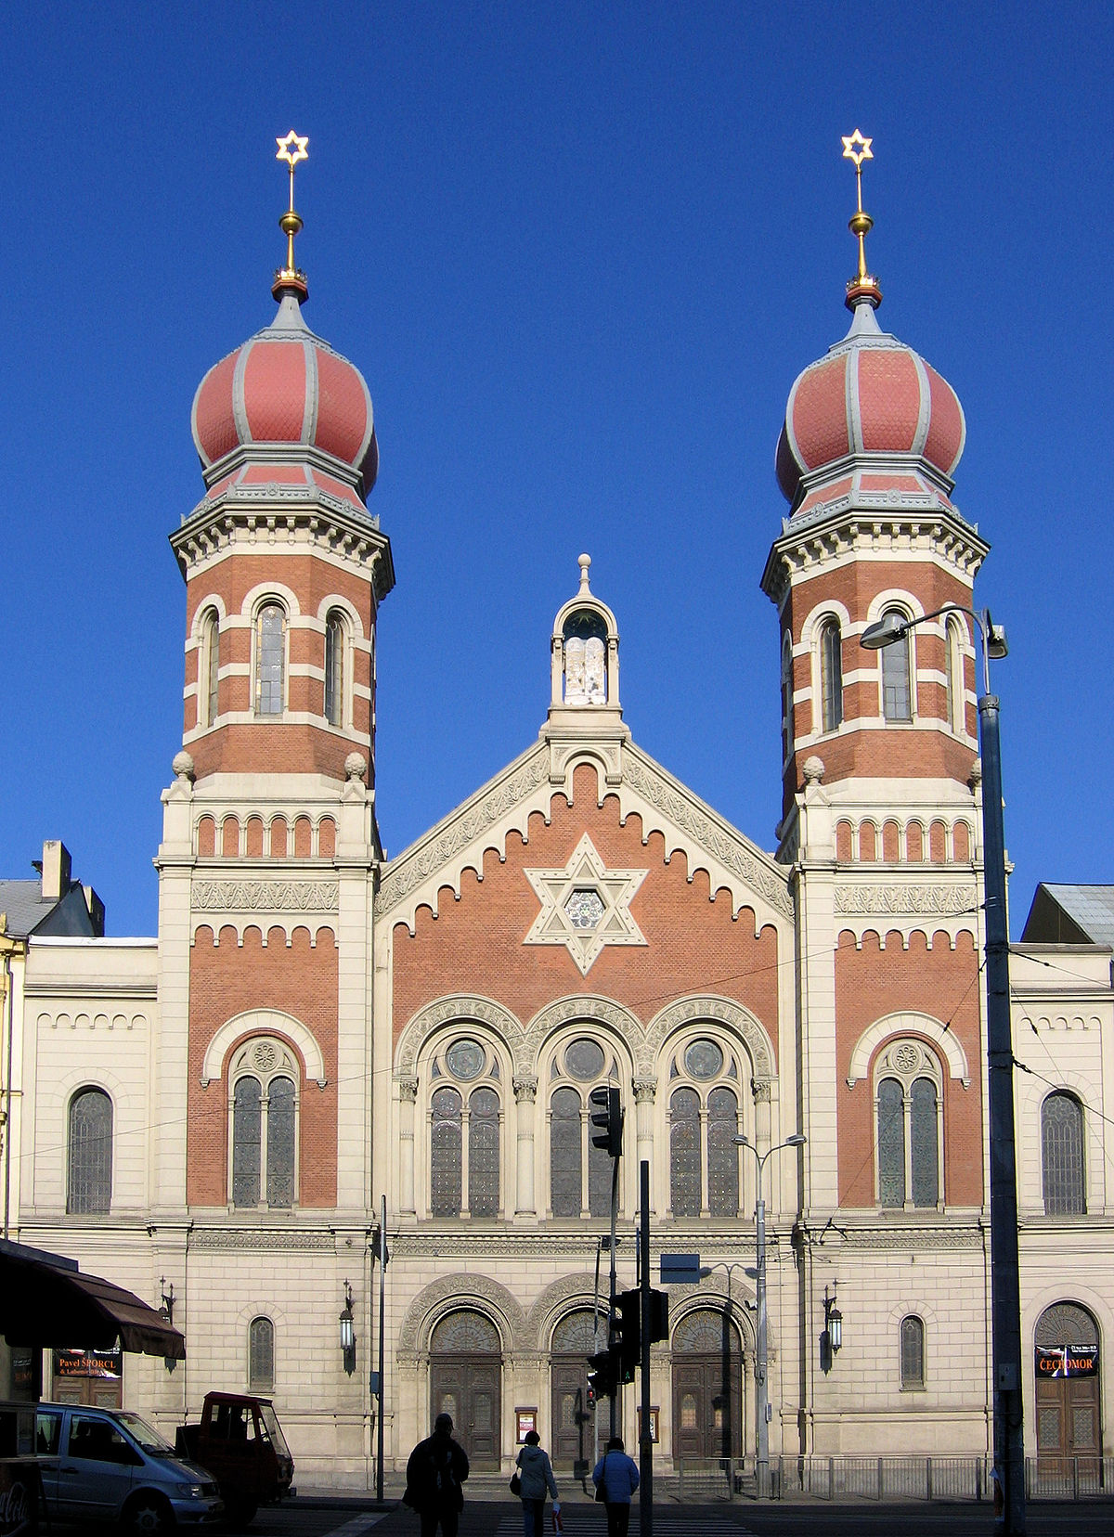
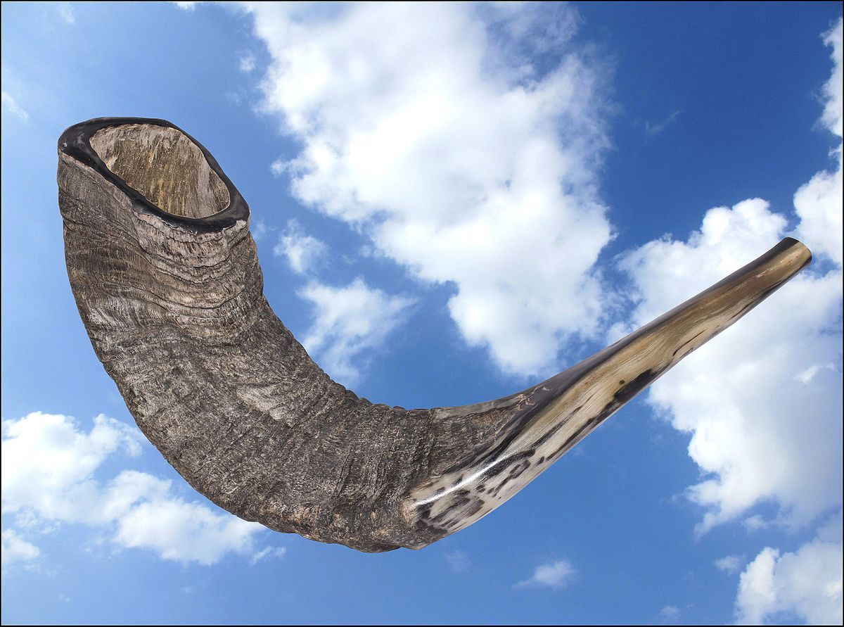
Let's recap...
What is a Shofar?
Where is the Shofar blown?
When do they blow it?
How long do they blow it for?
This Photo by Unknown author is licensed under CC BY-NC-ND.

Slide 11
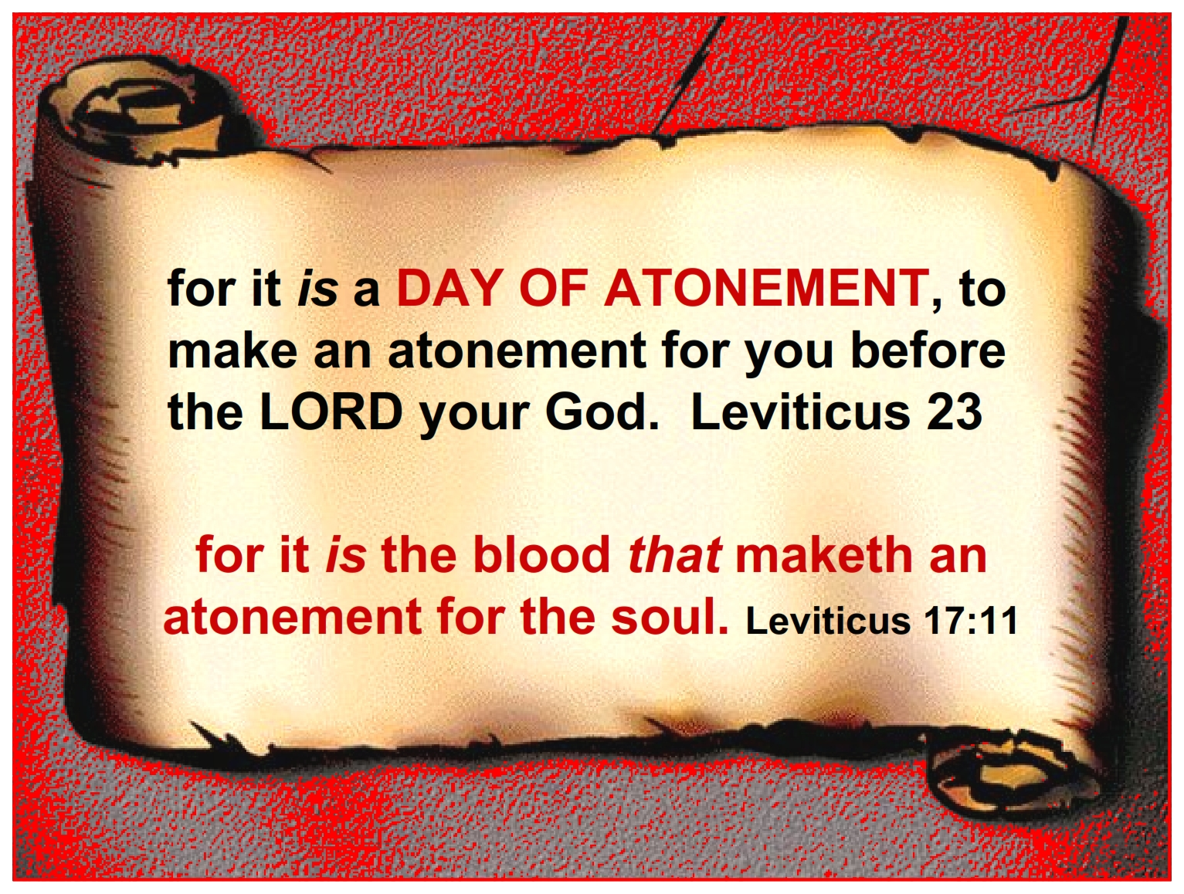
Yom Kippur "The Day of Atonement"
What does Atonement mean?

Slide 12
Yom Kippur means Day of Atonement. It is the most sacred and solemn day in the Jewish calendar.
https://www.bbc.co.uk/bitesize/topics/znwhfg8/articles/z4vvjhv
Celebrated 10 days after Rosh Hashannah
Jewish People don't eat or drink (fast)for 25 hours and when the Shofar is blown in the Synagogue they can eat again.
They do not wear leather, wear make-up or have any luxuries
It is a solemn event
https://www.bbc.co.uk/newsround/41337138

Slide 13
Your task year 3
Write a paragraph about Rosh Hashannah and Yom Kippur
Find out what "Solemn" means and write the definition in your books.

