Slide 1
Monday 1st February 2021
LO: understand how adverbs are used for cohesion in explanation texts
Success Criteria
To know what an explanation is
To understand how explanation texts are different to instructions
To know what an adverb is
To know what cohesion is
To use commas for clarity

Slide 2
What is cohesion?

Slide 3
Cohesion:
Cohesion means that writing is well structured with linked ideas to create meaning. Sentences and paragraphs flow smoothly and are written in the same tense, meaning the piece of writing as a whole is fluid and makes sense.

Slide 4
What is an adverb?

Slide 5
What is an adverb?
An adverb is a word or an expression that modifies a sentence to give more description. They quite often modify a verb! E.g. The girl quickly ran to the park. Adverbs typically express manner (how), place (where), time(when) , frequency (how often) and level of certainty (how likely).

Slide 6
Causes
therefore
thus
consequently
as a result
Contrasts
however
meanwhile
nevertheless
instead
Adverbs link ideas in a paragraph
Flipflops do not protect the feet.
Therefore, do not wear them when operating machinery.
Most modern phones can access the Internet.
Consequently, they are banned in exams.
Flipflops do not protect the feet.
Instead, they keep feet cool on hot days.
Most modern phones can access the Internet.
However, dumb phones make calls only.
Adverbs link sentences – they do not join them.
Adverbs can link ideas which explain cause or contrast.

Slide 7
Causes
therefore
thus
consequently
as a result
Contrasts
however
meanwhile
nevertheless
instead
Adverbs can also link ideas in a paragraph
I enjoy online gaming.
however
I never give out personal details, like my name.
I like racing games.
meanwhile
My sister prefers building games.
I don’t have a tablet.
I play on an X-Box.
instead
I do clubs after school.
therefore
I mainly play at the weekend.
Adverbs link sentences – they do not join them.
Can you select adverbs to link these sentences?
IDEAS

Slide 8
Punctuating Adverbs
When opening with an adverb, punctuate with a comma.
An adverb in the middle is separated by a pair of commas.
Adverbs placed at the end do not usually need a comma.
However, I never give out personal details, like my name.
My sister, meanwhile, prefers building games.
I mainly play at the weekend therefore.

Slide 9
Punctuating Adverbs
When opening with an adverb, punctuate with a comma.
An adverb in the middle is separated by a pair of commas.
Adverbs placed at the end do not usually need a comma.
Players therefore have to pay a monthly fee to play the game.
Some prefer to play free games instead.
However this type of game often contains lots of adverts and in-game purchases.
How would you punctuate these adverbs?
ANSWERS

Slide 10
Punctuating Adverbs
When opening with an adverb, punctuate with a comma.
An adverb in the middle is separated by a pair of commas.
Adverbs placed at the end do not usually need a comma.
,
,
Players therefore have to pay a monthly fee to play the game.
Some prefer to play free games instead.
,
However this type of game often contains lots of adverts and in-game purchases.
How would you punctuate these adverbs?
ANSWERS

Slide 11
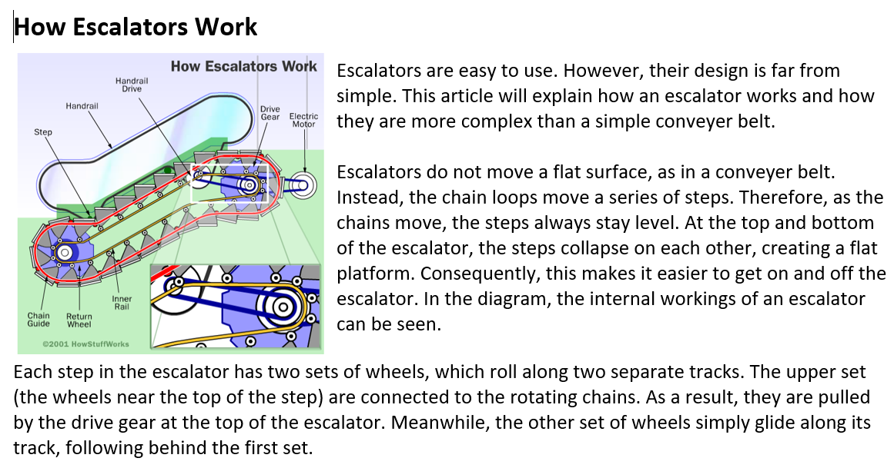

Slide 12
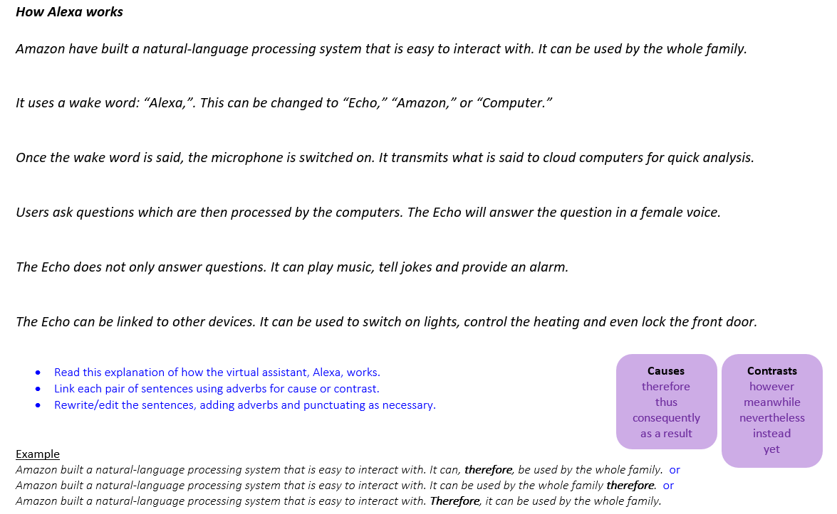

Slide 13
Monday 1st February 2021
LO: understand how adverbs are used for cohesion in explanation texts
Success Criteria
To know what an explanation is
To understand how explanation texts are different to instructions
To know what an adverb is
To know what cohesion is
To use commas for clarity

