Slide 1
Thursday 14th January 2021
LO: I can understand the structure of a cinquain poem

Slide 2
Metaphors
Comparing something to something else, saying it is something
For example,
The ocean is an arena of life.
Personification
Giving human qualities to an object or idea
For example,
The waves fell into the rocks.

Slide 3
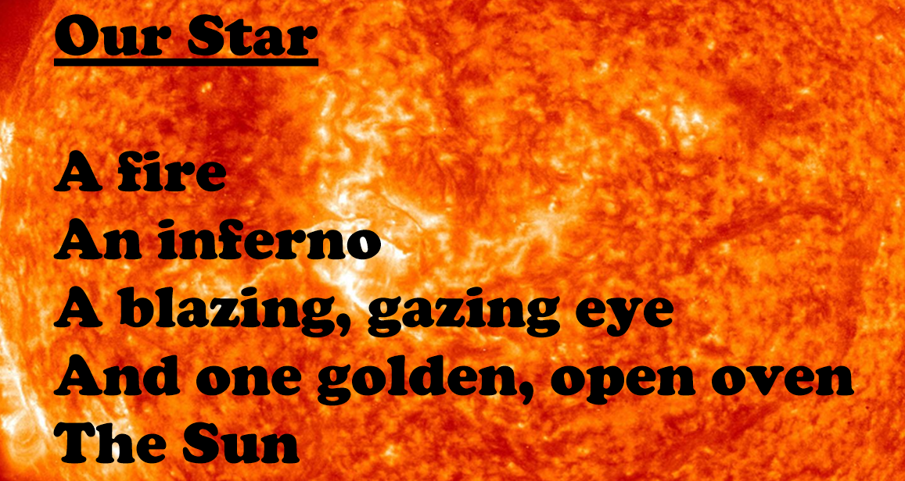
Have a look at this poem

Slide 4
Have a look at this poem, what do you notice about it?
What is this poem about?
Do you like this poem?
Does this poem contain a metaphor? (remember a metaphor says that something is something else)
The whole poem is a metaphor because it’s comparing the sun to a fire, an inferno, a blazing gazing eye and an oven

Slide 5
Have a look at this poem, what do you notice about it?
This is a certain type of poem called a cinquain.
We’re going to investigate the cinquain structure and have a look at another poem.

Slide 6
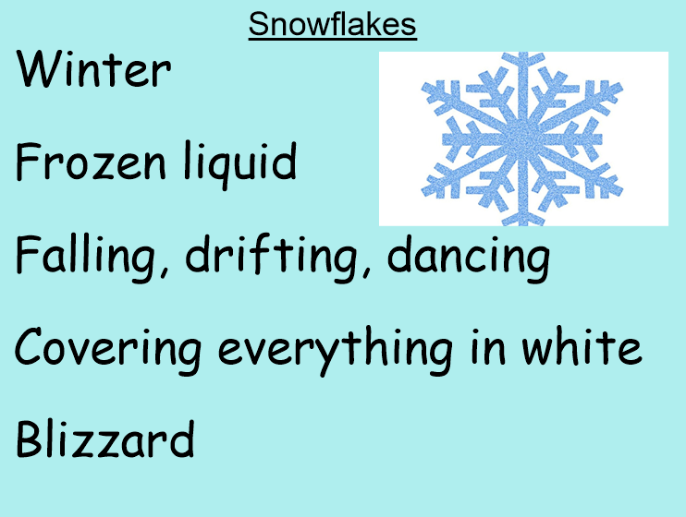
Investigate
Is it clear what the subject of the poem is?
Does this poem include a metaphor?
Does it follow the same structure as the previous poem?

Slide 7
Investigate - comparing
What do you notice about them both?
What language features do they contain?
Do they follow the same structure?

Slide 8
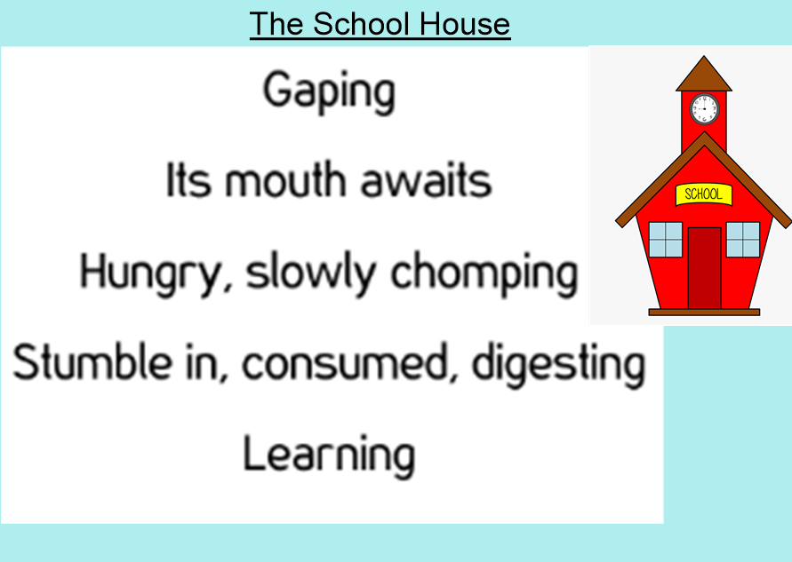
What is a cinquain?
It is a type of poem.
They contain metaphors and personification.
It has a certain structure.
It has a certain number of lines.
Each line has a certain number of syllables.
The last line is a summary of the poem
This poem is a cinquain, lets look at the structure!
2
4
6
8
What do you notice about the syllables in each line?
2
This poem has 5 lines

Slide 9
A cinquain
Has 5 lines
Follows the 2, 4, 6, 8, 2 syllable structure
Is a metaphor
Contains personification
The last line is a summary of the poem

Slide 10
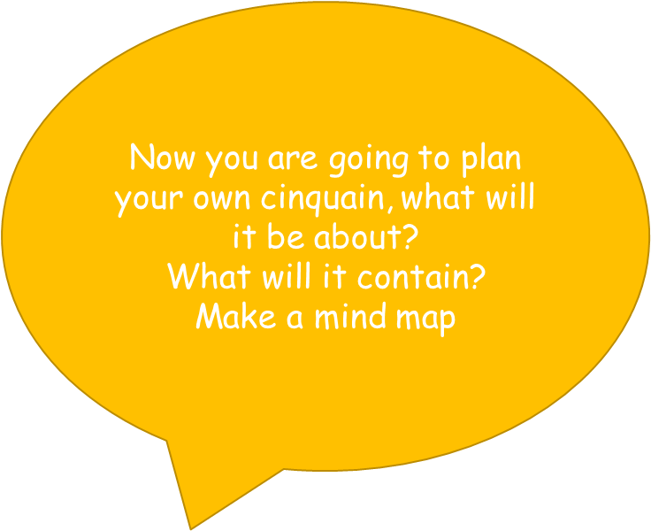
Planning your own cinquain
Title
Summary word
My cinquain
of your ideas
and personification
Metaphors
Related words to my theme
Themes you may want to use...
Flowers, outer space, school, family, the seasons, the world, your pet, friends, fruit, the ocean

Slide 11
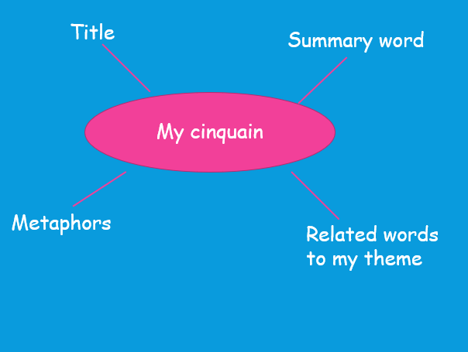
Example of a plan
Flowers
Blossom
The petals were confetti
Rainbow of colour
and personification
Standing, dancing in the wind, playing in the sun, swaying, waving hello,
Bright, yellow, purple, pink, ground, earth, green, petals, pretty, colourful, beautiful, bees, plants, sunflower, leaf, bloom, blossom, growing

