Slide 2

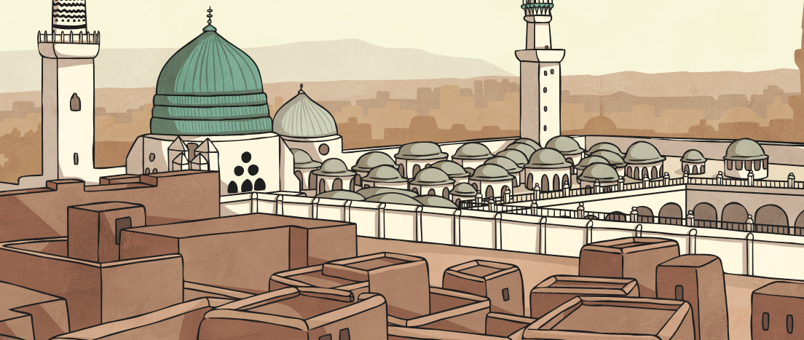
It was a blazing hot day in the city of Medina. The residents found shade in the many beautiful gardens in the city. They sat under the shade of tall trees and sipped cool drinks.

Slide 3



The Prophet Muhammad(PBUH) was walking through one of the gardens. He enjoyed the cool shade of the trees as he listened to people having fun together.
Ahah
That’s funny!

Slide 4

All of a sudden, the Prophet Muhammad(PBUH) heard a strange, wailing noise. The Prophet Muhammad(PBUH) looked around to see where the sound was coming from.

Slide 5
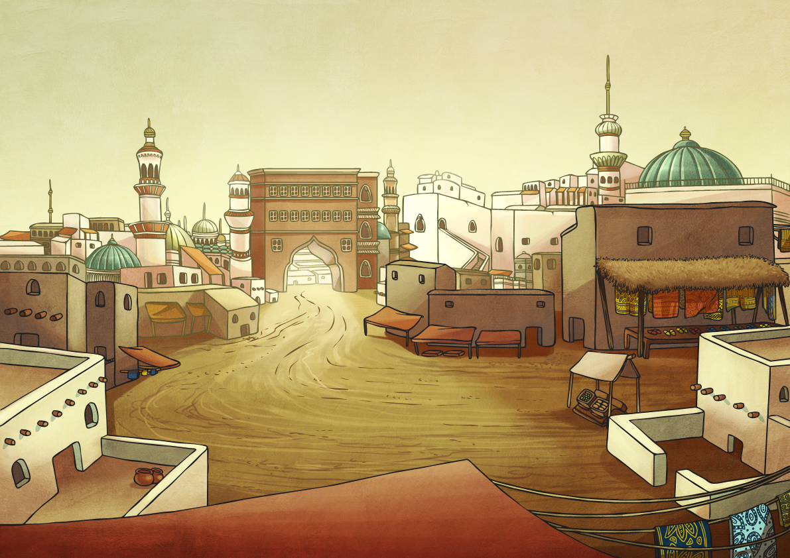

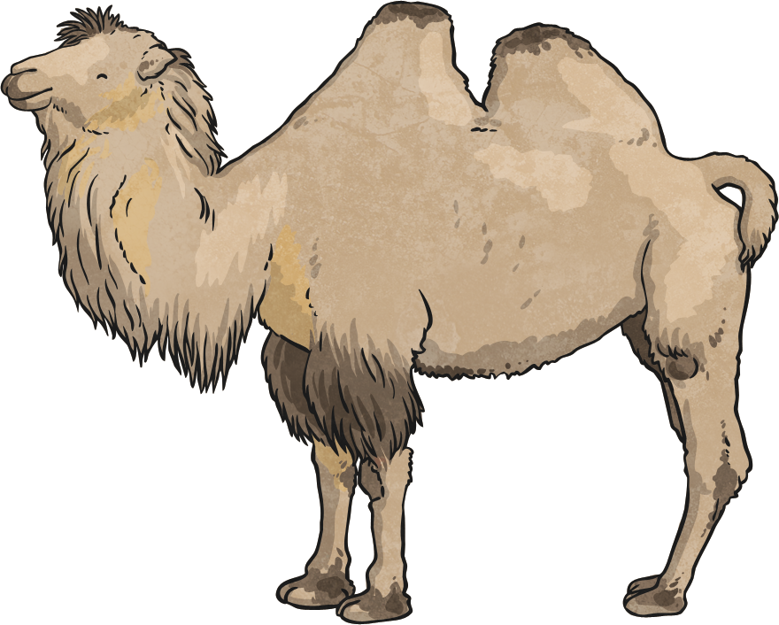

Eventually, the Prophet Muhammad(PBUH) discovered the source of the noise. It was a camel. The camel was tied to a wooden post, out in the blazing sunshine with no shade. The camel was hot and thirsty.

Slide 6
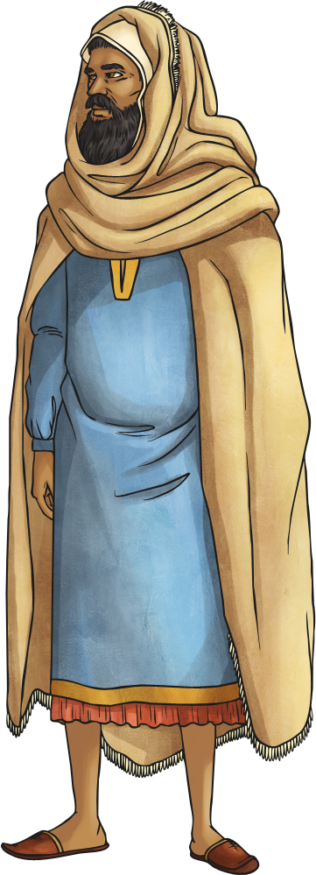

‘Who owns this camel?’ roared the Prophet Muhammad(PBUH). The camel’s owner eventually appeared. ‘This camel is one of Allah’s creatures,’ explained the Prophet Muhammad(PBUH), ‘you should treat him with kindness and provide everything he needs.’

Slide 7
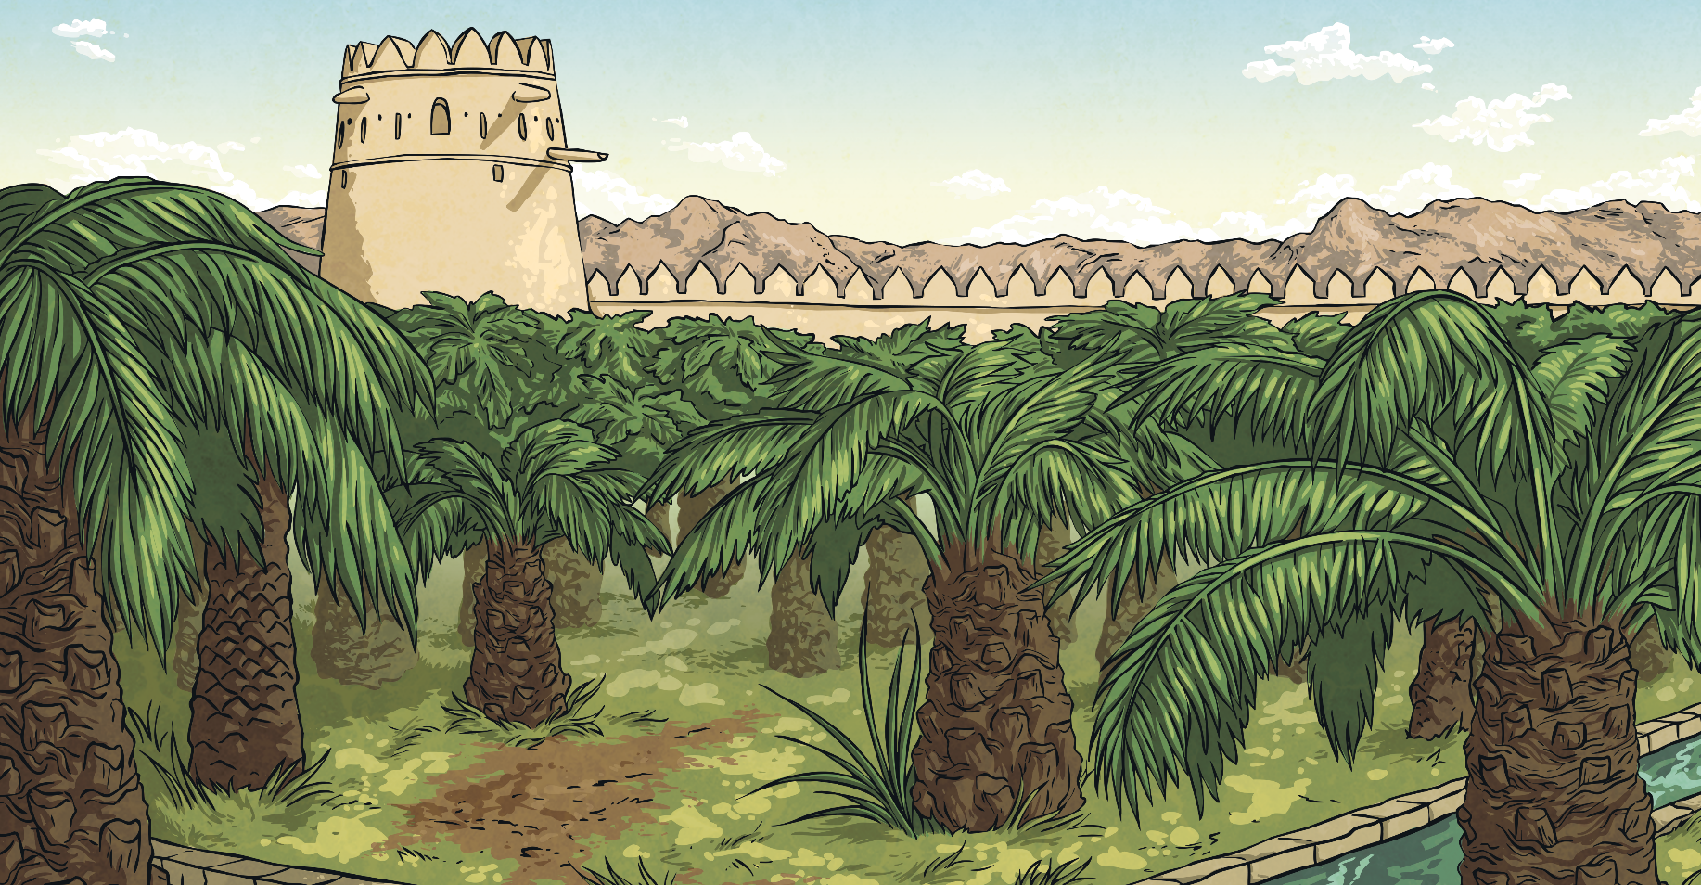
The owner of the camel felt ashamed. He knew he had been selfishly looking after himself without a thought for the poor animal who worked so hard for him. From that day on, he cared for all his animals. The camel never cried again.

