Slide 1
LO: to create metaphors
Tuesday 12th January 2020

Slide 2
What is a metaphor?

Slide 3
What is a metaphor?
Metaphors say exactly what they want to say! They are a stronger comparison than a simile.
The curtain of darkness fell quickly on Exmouth.

Slide 4
How do we create our own?
We are going to look at creating metaphors about the sun (you can look back at yesterday’s session to see the metaphors about the moon to give you some help).
Success Criteria
Share adjectives to describe the sun.
Think of comparisons - what could the sun be instead?
Write your chosen metaphors (leave a line between each one)
The sun is ________________________.

Slide 5
You could use this to help you come up with some adjectives to describe the Sun.
https://www.youtube.com/watch?v=aSIDelAAHiA
Shape
Watch this video for some inspiration!
Size
The sun
Features
Colour

Slide 6
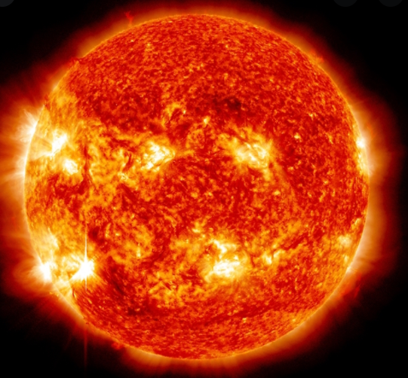
What could the Sun be compared to?

Slide 7
The sun is the burning lightbulb of the universe.

Slide 8
LO: to create metaphors
Success Criteria
Share adjectives to describe the Sun
Think of comparisons - what could the Sun be instead?
Write your chosen metaphors (leave a line between each one)
The Sun is ________________________.

