Slide 1
Tuesday 12th January
LO: to multiply 2 digit numbers by 2 digit numbers

Slide 2
Our journey so far
Knowing our x table facts
Using our x table facts to work out multiples of 10,100,1000
Partitioning 2/3/4 digit numbers by 1 digit numbers
Multiplying 2 digit numbers using the area model

Slide 3
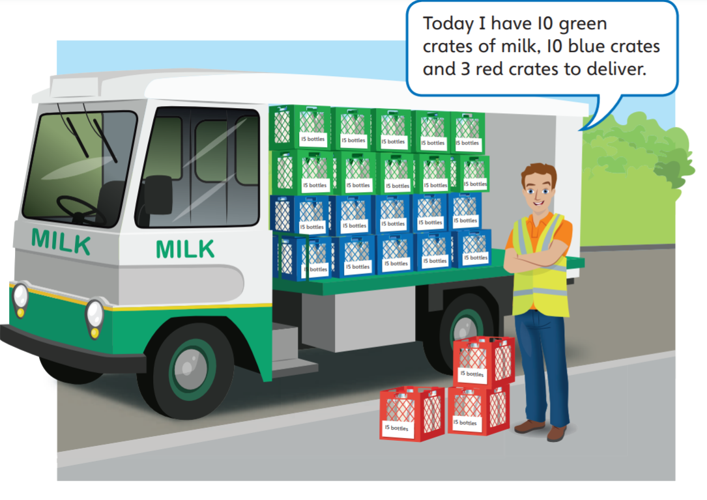
How many bottles of milk is Tom delivering today?
What is the calculation you need to do?

Slide 4
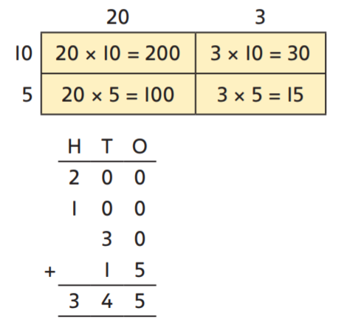
Method 1 Partitioning both of the numbers like we did yesterday.

Slide 5
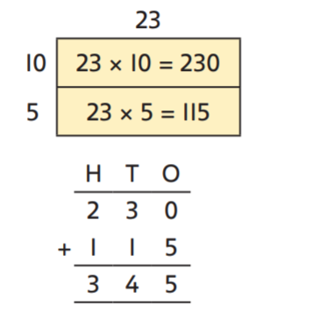
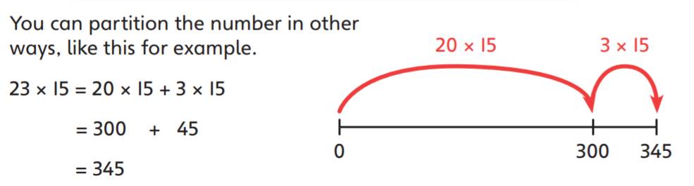
Method 2
Only partitioning one of the numbers using place value

Slide 6
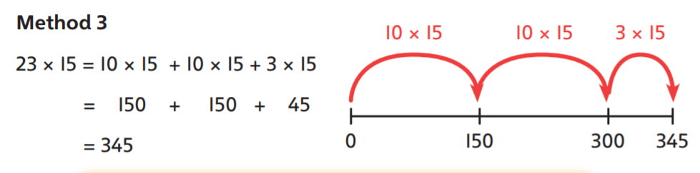
Method 3
Only partitioning one of the numbers (not by place value but in groups)

Slide 7
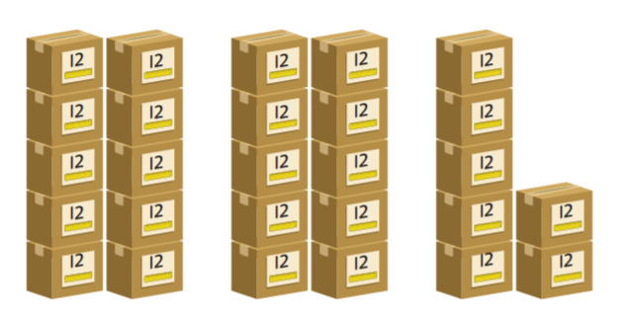
Each box contains 12 rulers. How many rulers are there in total?
27 x 12 = 10 x + 10 x + x
= + +
=
There are rulers in total.

Slide 8
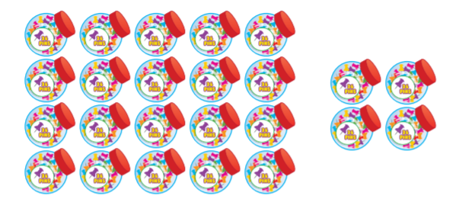
Mrs Batten has 24 tubs of drawing
pins. Each tub contains 36 pins.
How many pins does Mrs Batten have?
4
20
…… x ……. = | …… x ……. =
36
Mrs Batten has ………… pins.

Slide 9
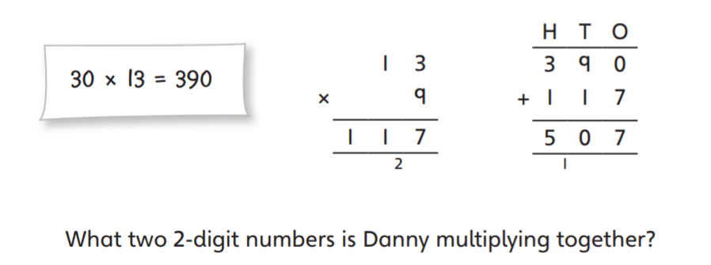

Slide 10
Have a go at the tasks on the website
If you are stuck, you could try these things:
re-watch the video to see if that helps,
Go back to the area model you used yesterday
Follow these 'Steps 2 success'
Partition one of your two-digit numbers using place value columns.
Multiply each part by the other 2-digit number
Add your two products (answers) together

