Slide 1
LO: To create a bitmap using simple binary code

Slide 2
Success criteria
I can use simple binary code to create a graphic
I can follow simple binary code to produce a graphic

Slide 3

First of all we need to remind ourselves what a pixel is!
A 'pixel' (short for ‘picture element') is a tiny square of colour. Lots of these pixels together can form a digital image.
Each pixel has a specific number, and this number tells the computer what colour the pixel should be.
This fish is made up of loads of squares (pixels) to create an image, when storing the picture a computer will record what number each pixel was. This is where we bring back our knowledge of Binary Code from last lesson!

Slide 4
What is a bitmap?
A bitmap is a way of storing images using pixels.
It’s called a bitmap because it is a ‘map’ of where the ‘bits’ of information are stored.
The information is stored as a sequence of numbers (Binary Code)
For our task later you are going to use our binary code to create your own bitmap where the pixels will receive information telling you whether the pixel should be black (0) or white (1).
Follow the link below to watch a video on creating your very own bitmap.
https://www.bbc.co.uk/bitesize/topics/zf2f9j6/articles/z2tgr82

Slide 5
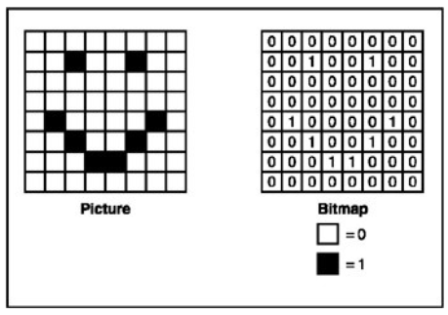
Independent task
Can you create a bitmap grid that when made, creates a picture. Then can you write out a set of instructions explaining to a classmate how to create your bitmap.
An example here shows the bitmap
and the picture it has created.
Remember, the more pixels (squares)
you use the more detail you can add.

Slide 6
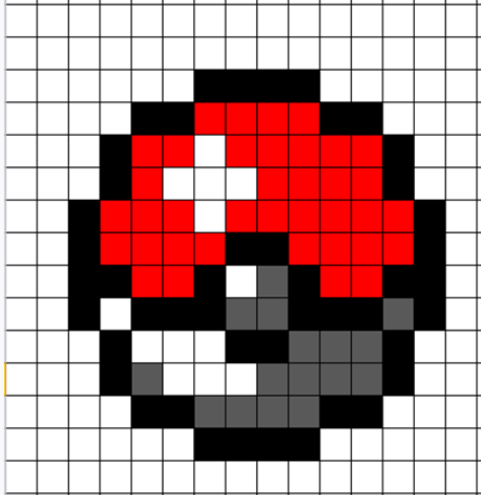
Challenge
Try increasing the amount of numbers you use, for example:
  00 = black
  01 = white
  11 = red
  10 = grey
You could choose to create a bitmap for the pokeball or you could choose to create a new picture yourself.
Remember our bitmap must follow the binary code of only using ‘0’ or ‘1’

Slide 7
You can use this grid as a bitmap
Leave the presentation so you can edit this page
Click on the square you want to change the colour of
At the very top centre of the page it will say ‘table tools’ click on ‘design’ just under it
Then click the button that says shading (it should have a little bucket next to it)
Then select the colour you wish to use.
If this doesn’t work then you will have to draw your own grid the old fashioned way with a ruler and pencil.

