Slide 1




Notes:
Before you begin:
Review the slide content and make any adaptations to suit the time you have available for your lesson starter.
You may wish to prepare two measured amounts of sugar to show pupils or to pass around, which show the maximum sugar a child aged 7 to 10 should eat each day (6 cubes – 24 grams), and how much children consume in practice (13 cubes – 52 grams). You can do this using sugar cubes or by weighing grams of loose sugar. Place your samples in a clear, sealed container like a washed and dried jam jar.
You may also want to provide a single cube of sugar, again in a sealed container, as a reference for when pupils guess how much sugar they do, and should, consume each day.

Slide 2

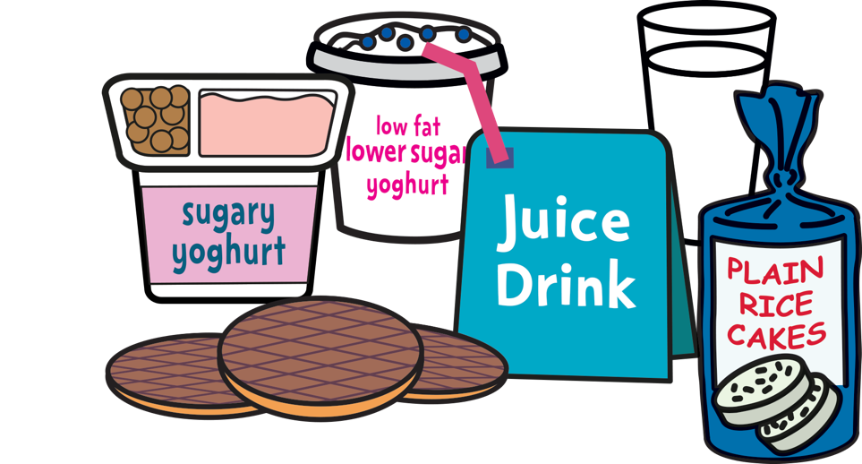

Notes:
Ask children ‘What does it mean to be food smart? and find out what they think this phrase means. (You may wish to also use an alternative phrase, like ‘being healthy’, to help younger pupils.)
Invite pupils to share their ideas and congratulate them on any good suggestions they share.
Explain that we are all eating too much sugar, a kind of fat called saturated fat, and salt. There are surprising amounts of sugar, saturated fat and salt in the everyday food and drinks we enjoy. We might seem fine on the outside, but too much sugar and saturated fat can lead to the build-up of harmful fat on the inside that we can’t see. This fat can cause serious diseases in the future.
But when we’re food smart, we make healthier food and drink choices that are lower in sugar, saturated fat and salt.
This lesson is going to help all of us to be food smart and begin to learn how we can make these healthier food and drink choices!

Slide 3

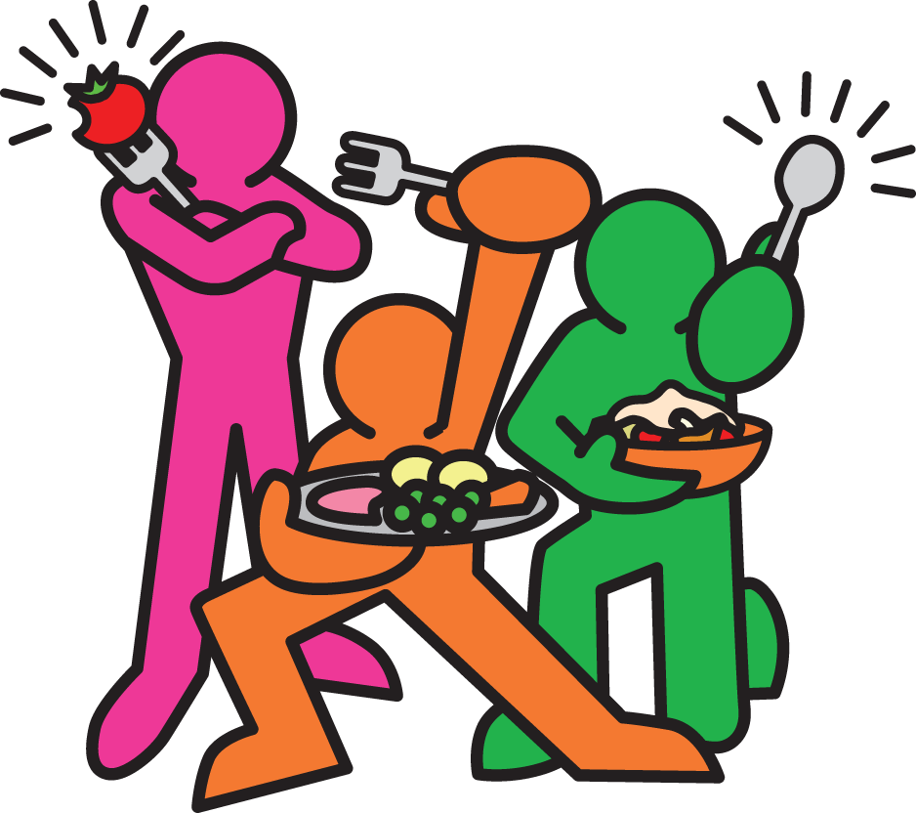
Notes:
Ask pupils if they can name some foods that are high in sugar. (The biggest source of sugar in children’s diets is sugary drinks like cola, fizzy pop, juice drinks, squashes, cordials and energy drinks. There can also be lots of sugar in sweets and chocolate, fruit juice, buns, cakes, pastries and fruit pies, biscuits and breakfast cereals.)
Ask pupils to guess how much sugar they eat each day. As a reference unit, you may want to show pupils a single sugar cube or pass a few around.
How many cubes like this do they think they should eat each day (at most) in the foods they enjoy?
Gather pupils’ ideas and share them with the group, to get a feel for the range of values they have suggested.
Remind pupils that eating too much sugar can lead to the build-up of harmful fat we can’t see. Ask pupils if they can name some of the health harms too much fat can cause. (These include heart disease, type 2 diabetes and some cancers. And too much sugar can also cause tooth decay.)

Slide 4

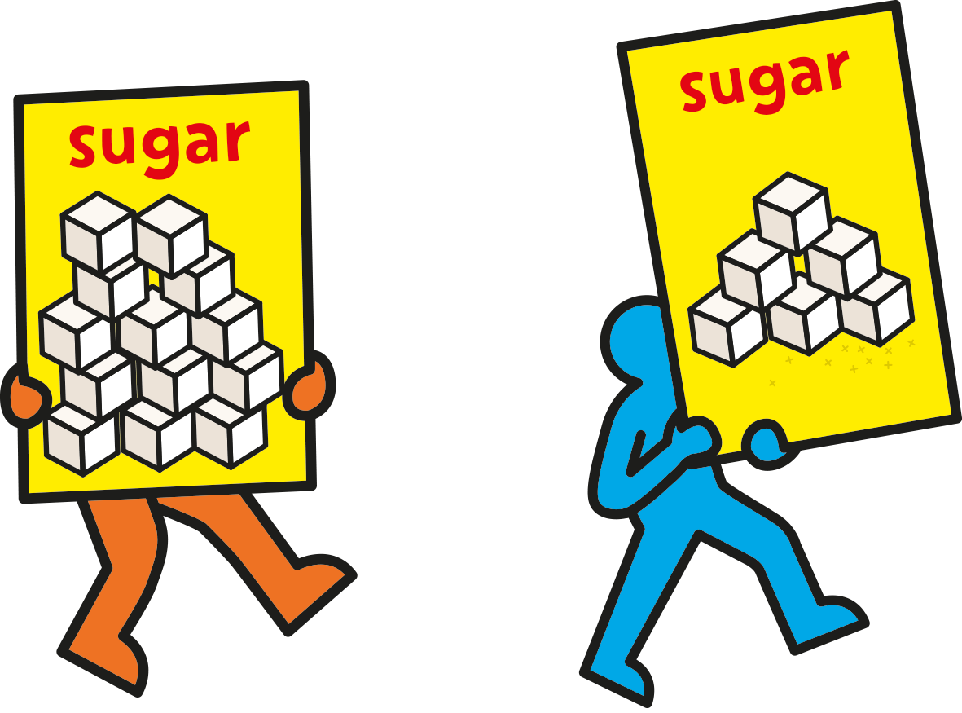
Notes:
Explain that most children are eating over 13 cubes of sugar each day. If you have prepared one, circulate the jar containing 13 cubes of sugar.
Ask pupils what they think about this amount of sugar. Does it seem like a lot, or a little? Highlight that this is about three times as much as the maximum they should be eating!
Explain that to stay healthy a child aged 7 to 10 should eat no more than 6 cubes of sugar a day or less – that’s about 24 grams of sugar. Now circulate the jar containing 6 cubes or 24 grams of sugar. (A child aged 4 to 6 should eat no more than 5 cubes, or 19 grams, each day.)
An average can of cola contains 9 cubes of sugar. That means that drinking just 2/3 of a can, or around 200ml, would provide the maximum daily limit.

Slide 5

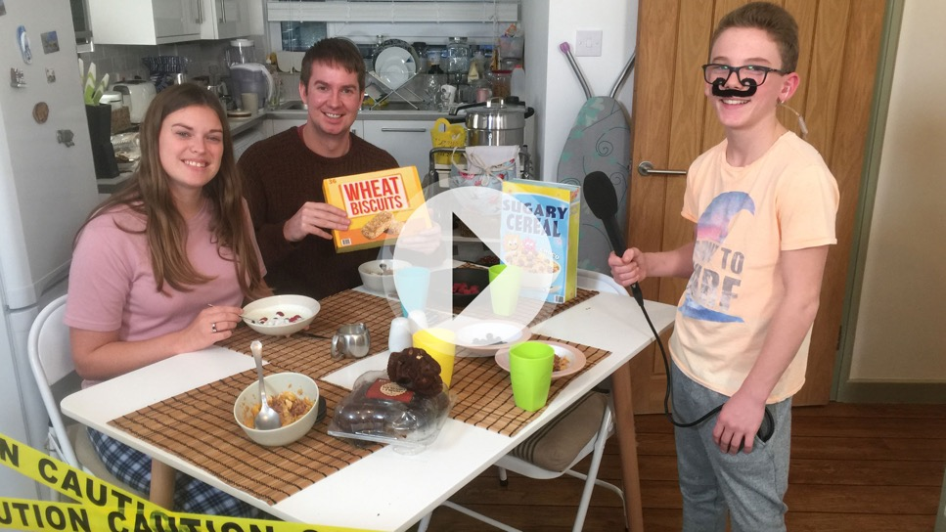
Notes:
Explain to pupils that when we know how to find this information, choosing healthier alternatives to sugary food becomes much easier! And the good news is that it isn’t difficult!
As well as using the food labels, which are sometimes colour-coded to work like traffic lights, there’s a new Be Food Smart app that helps you make healthier food and drink choices that are lower in sugar, saturated fat and salt. With a simple scan you can see how much sugar saturated fat and salt is in your food, with hints and tips for healthier choices.
Click to open the assembly film page on the Change4Life School Zone, where you will be able to play the film.
This shows pupils how to find out how much sugar is in food using food labels and the Food Smart app, and reinforces some of the benefits of making healthier choices.
When pupils have watched the film, ask them:
how do the children find out what is really in their food and drink?
what did they find out that surprised them?
what are they going to do in future after using the app?
Explain that they can ask their parents to download the app and they can be Food Detectives like the children in the films.

Slide 6

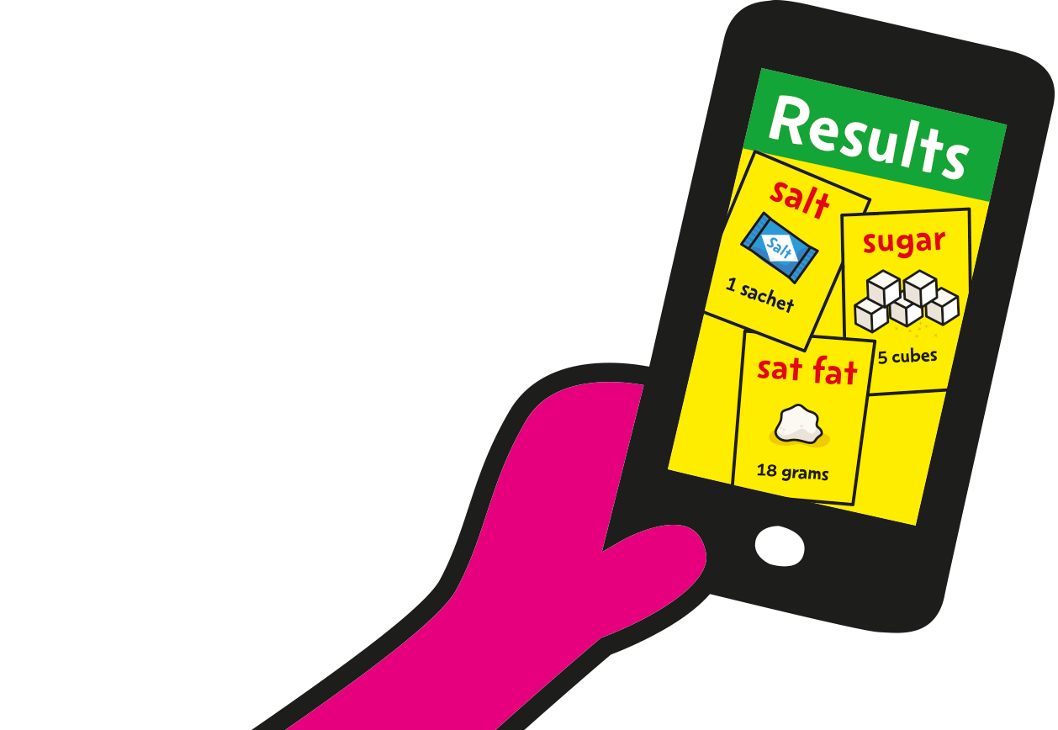
Notes:
Use this slide at the end of the lesson.
Ask pupils whether they have learned something new today, that will help them think differently about sugar and sugary foods? (With older pupils mention saturated fat and salt as well.)
Invite pupils to share their ideas. You may wish to share a food swap that you might make yourself in the future!
Invite pupils to show, with a show of hands:
Who is going to look at the food label on food packaging, on their own or with a family member? (Then ask pupils to remind you of which colours they should look for more of, and which colour they should aim to avoid.)
Who is going to ask a family member to download the Be Food Smart app and find out how much sugar is in their favourite foods?’
If you have time, you might invite pupils to make some specific suggestions about foods they might swap, or other actions they might take.
You may also wish to highlight healthier options available at your school, for example break-time fruit and vegetable snacks and healthy options available through your school meal service.
Thank pupils for taking part and helping to answer your questions, and encourage them all to be food smart!
If you are going to hold a Be Food Smart campaign in your school and invite parents, this is a good time to explain what pupils are now going to do to help their whole family to be food smart!

