Slide 1

LO: to infer meaning from metaphors
Monday 11th January 2021

Slide 2
What is a metaphor?

Slide 3
What is a metaphor?
It is a type of comparison. Writers use it to describe something as if it were something else.
In other words, it is a fib used for effect!

Slide 4
Metaphors say exactly what they want to say! They are a stronger comparison than a simile.
The curtain of darkness fell quickly on Exmouth.

Slide 5
Why are we looking at metaphors?
We are starting a new poetry unit this week and metaphors are going to be really important for adding description… because the poems are only 5 lines long!

Slide 6

Let’s take a look at some metaphors used in poems
These poems are by Pi Corbett – we have looked at his poems before!
The moon is an Olympic Stadium for
intergalactic races - planet jumping,
star throwing and meteoric vaulting.
Where are the “fibs” in this poem?
Can you spot any metaphors?
How do you know they are metaphors?

Slide 7
The moon is a silver coin tossed into
space - heads or tails, wins or fails

Slide 8
The moon is a giant light bulb
left on throughout the night.

Slide 9
The moon is a loose marble
rolling across the darkness.

Slide 10
Can you think of any metaphors to describe the moon?

Slide 11
LO: to infer meaning from metaphors
Success Criteria
Identify the metaphor by finding the fib!
The _____ is being described as though it were a ________.
Explain why the poet has made this comparison. I can infer that the ________________________.
Use what you already know

Slide 12
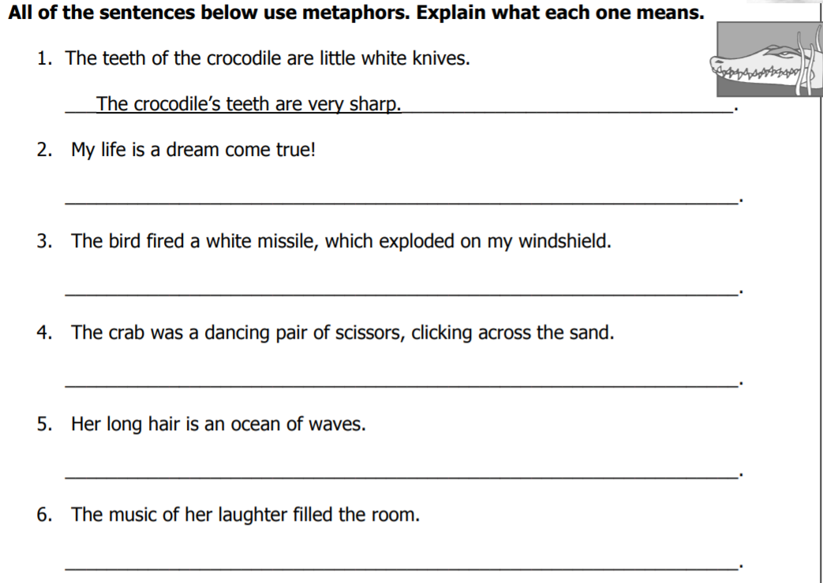
Find the task sheet on the school website!
Challenge:
Come up with some of your own.

