Slide 1
Monday 11th January
LO: to multiply 2 digits

Slide 2
Our journey so far……
knowing our x tables eg 3x 4
using our x table facts to work out multiples of 10, 100, 1000 eg 30x4, 300x 4, 3000 x 4
partitioning 2/3/4 digit numbers and multiplying by 1 digit numbers

Slide 3
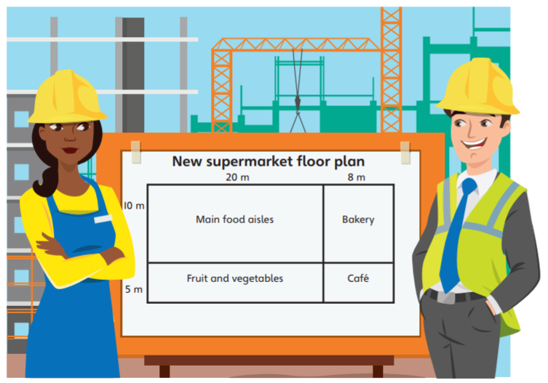
What will the length of the new supermarket be?
What will the width of the supermarket be?
Can you remember how to find the area?
What will the calculation be?

Slide 4
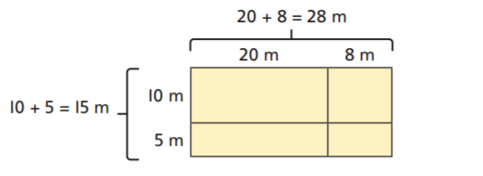

Slide 5
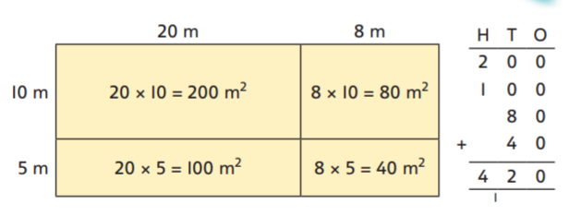

Slide 6
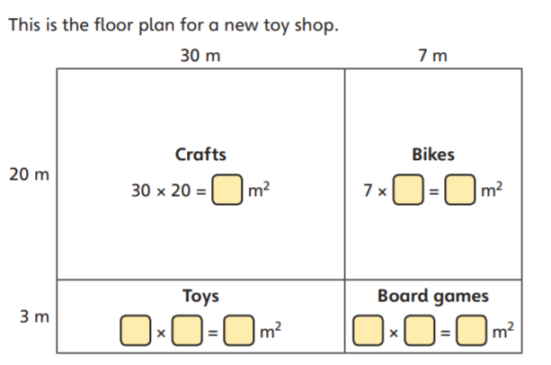
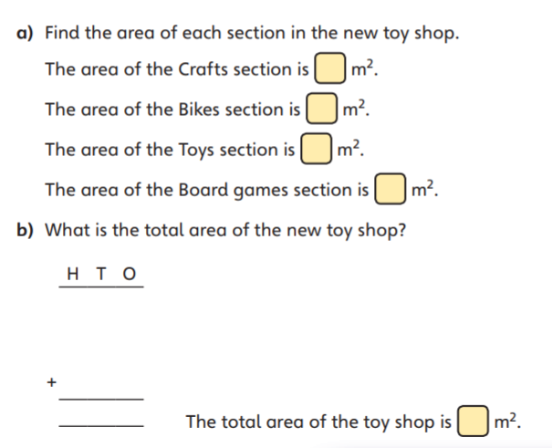

Slide 7
Craft section 30mx20m= 600m²
Bike section 7mx20m= 140m²
Toy section 3mx30m= 90m²
Board section 3mx7m=21m²
600+140+90+21= 851m²

Slide 8
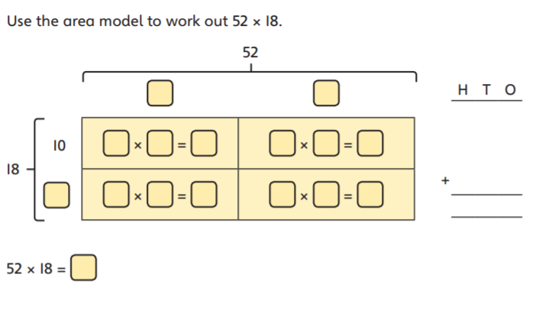

Slide 9
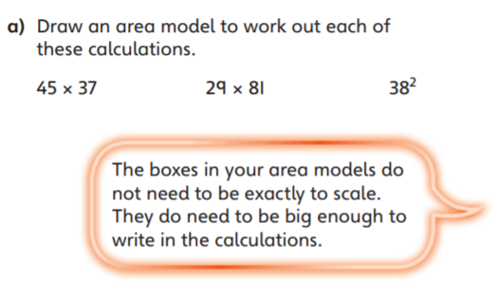

Slide 10
Draw out a grid like this one
40
5
30
7

Slide 11
Draw out a grid like this one
The ones from
your first number
The 10's from your
first number
The 10's from your second number
The ones from your second number

Slide 12

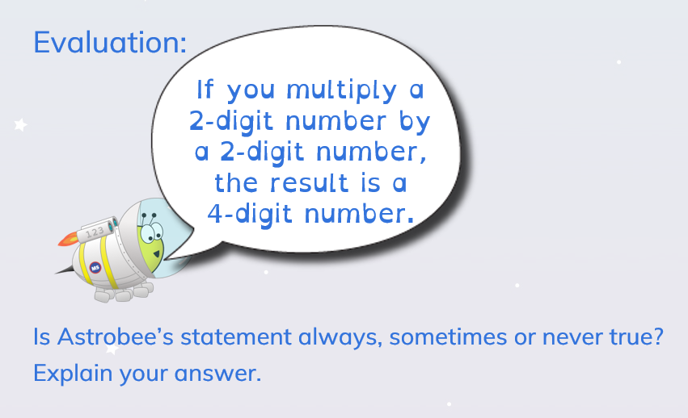
Complete the tasks on the website
Once you have completed the tasks; have a go at this...
Let your teacher know if you have found anything hard today

