Slide 1
LO: what qualities would a saviour need?

Slide 2
LO: what qualities would a saviour need?
What does the word saviour mean?
It literally means “to save”.
So what qualities would you need in order to be a saviour?

Slide 3

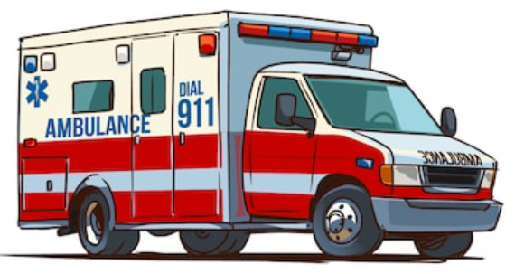
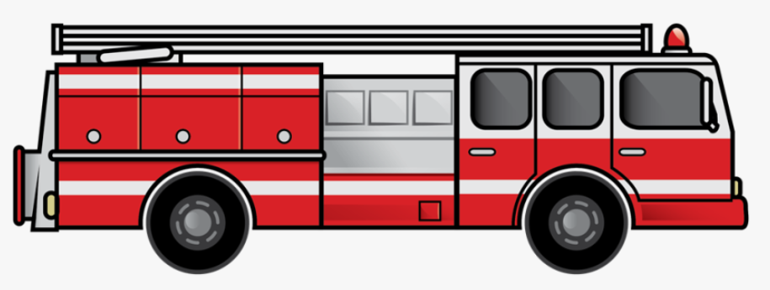
LO: what qualities would a saviour need?
Are there any people out in the world that you believe save other people?

Slide 4
LO: what qualities would a saviour need?
What qualities do Fire marshals have when they have to run into a burning building to help save people?
What qualities do the police have when they have to be calm and defuse a situation that could resort in people getting hurt.
How must doctors, paramedics and nurses react when they need to help save somebodies life?

Slide 5
Independent task
Please can you create a mind map that collects your ideas about what qualities are needed to be a saviour.
Brave
What qualities would a saviour need?
A saviour needs to be able to put all their fears aside in order to put themselves in a dangerous position ready to help those in need

