Slide 1
LO: to understand homophones (there, their, they’re)
(are, our)

Slide 2
LO: to understand homophones
(there, their, they’re)
(are, our)
Remember homophones are words that are spelt differently, have multiple meanings, but sound exactly the same!

Slide 3
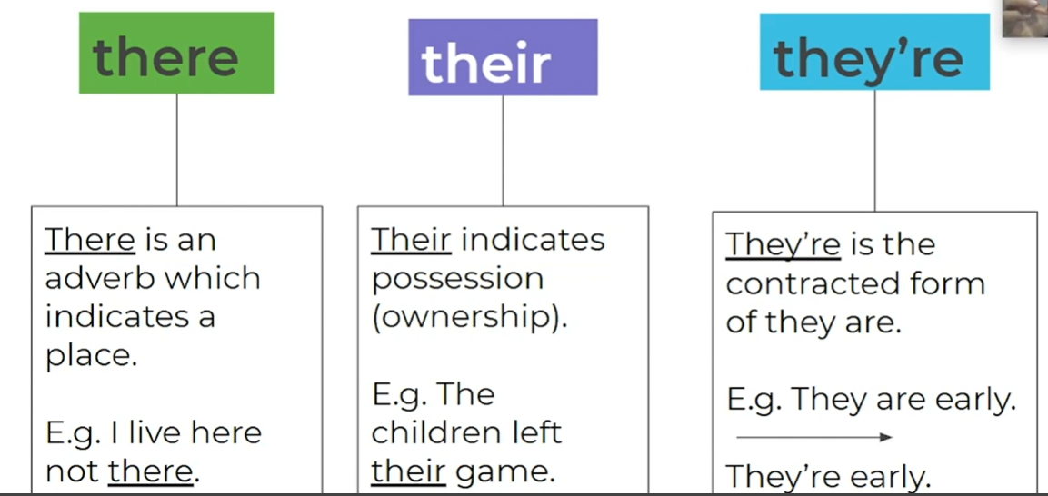

Slide 4
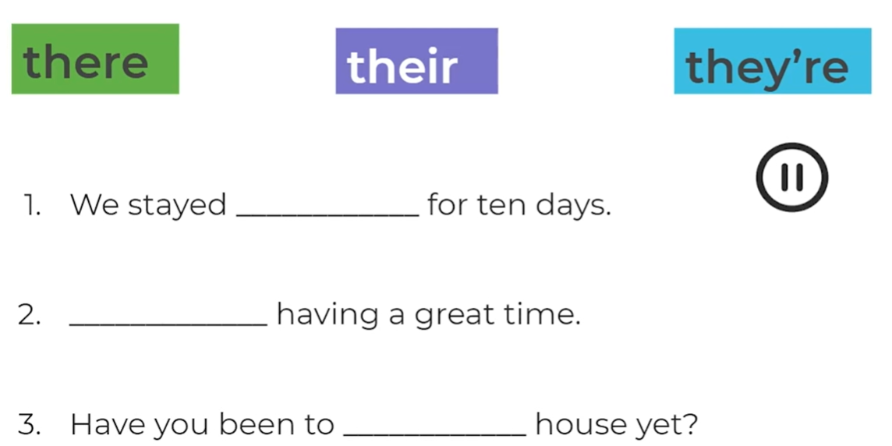

Slide 5
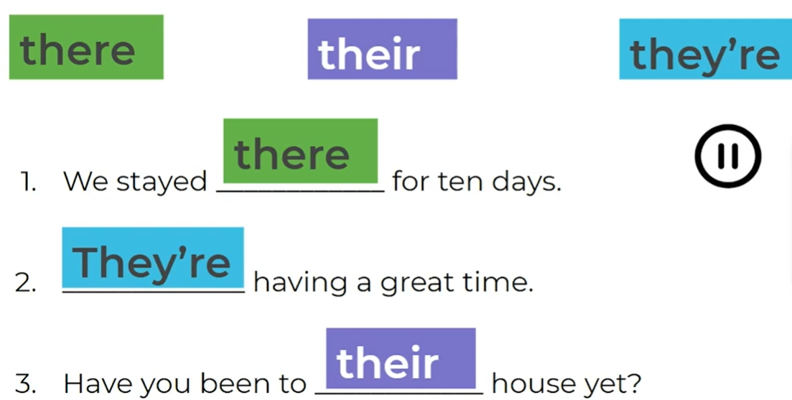

Slide 6
are
our
are is a form of the verb ‘to be’
And it is used in the present tense
our means belonging to us. It is a possessive determiner

Slide 7
are
our
We _______ very happy eating this giant cake.
This is ________ problem that we have to fix.

Slide 8
are
our
are
We _______ very happy eating this giant cake.
This is ________ problem that we have to fix.
our

