Slide 1
LO: to consider how we can support others through charity work.

Slide 2

How much do you like chocolate?
Where does chocolate (cocoa) come from?

Slide 3
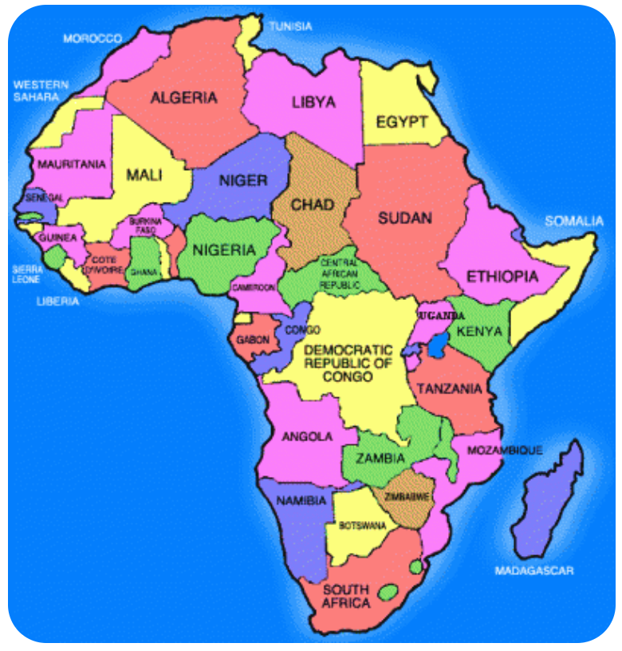
70% of the world cocoa comes from these 4 countries
Ivory Coast
Ghana
Nigeria
Cameroon

Slide 4

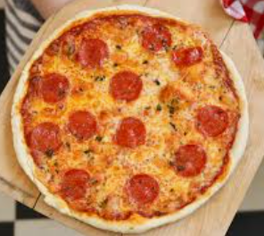
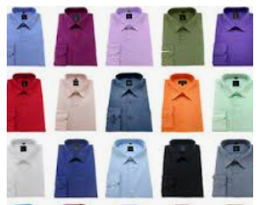


Where might all of these products come from?

Slide 5
We can’t grow tea leaves here in England, so we need the help of other countries to grow them for us.
There are many things that are shared with us from other cultures and countries.
What do you think we in England can offer to other cultures and countries? What is there we can create that other countries can’t?
Could we perhaps offer music, food specific to the UK, medical supplies or aid?

Slide 6
Watch this clip and think about a way we could raise money to help those in need.
http://www.bbc.co.uk/programmes/p00n2ty0

Slide 7
The video clip showed how to raise awareness for supporting people that are in need. By baking cakes you can sell them to raise money in order to give that to a charity that is designed to help those in need.
Think back to Wednesday’s assembly, all of us at Brixington have sponsored a child in Uganda. This money we have raised has given someone the opportunity to get an education; she is now one step closer to fulfilling her dreams.

Slide 8

Independent task
Propose an idea to raise funds for comic relief on the 19th March
Must be covid friendly
Please have a look at the comic relief website linked below to gather thoughts and ideas about an event we could run here at school. (fun run, bake sale, sporting challenges)
https://www.comicrelief.com/rednoseday/schools/primary/
Create a poster outlining your proposal
As an extension task could you design a red
nose mask

