Slide 1
LO: to learn about the Jewish festival Sukkot

Slide 2
Success Criteria
To understand why Jewish people, celebrate Sukkot.
To understand how Jewish people, celebrate Sukkot.

Slide 3




Can you match these pictures to the words.
Jewish day of rest is?
They have a family Shabbat meal on?
They do not what during Shabbat?

Slide 4
What is the festival Sukkot?
Watch this clip to find out more.
https://youtu.be/h_W1pGtlRsY

Slide 5
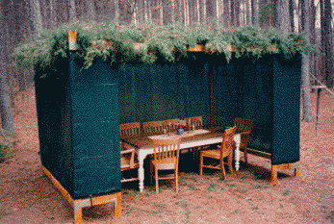
For 7 days, Jewish people live and eat in a Sukkah to remind them of the Israelites who lived in the dessert.

Slide 6

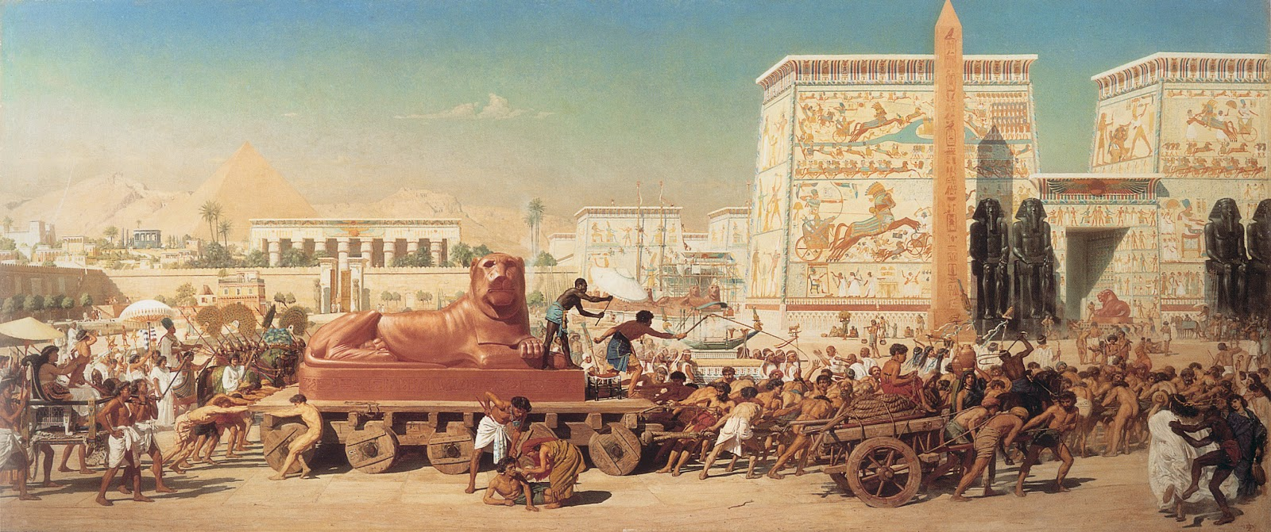
The Israelites escaped the evil Pharoh in Egypt who used them as slaves!

Slide 7
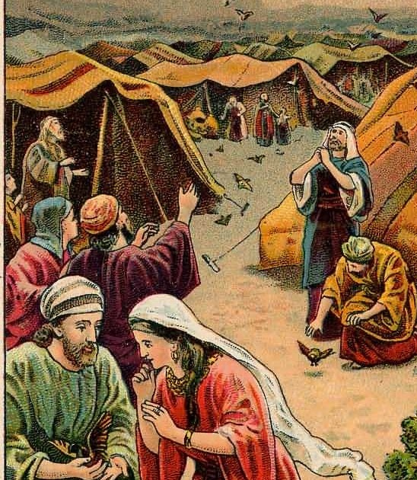
They lived in a Sukkahs (booths/tents) in the dessert for 40 years when they escaped the evil Pharoh.

Slide 8

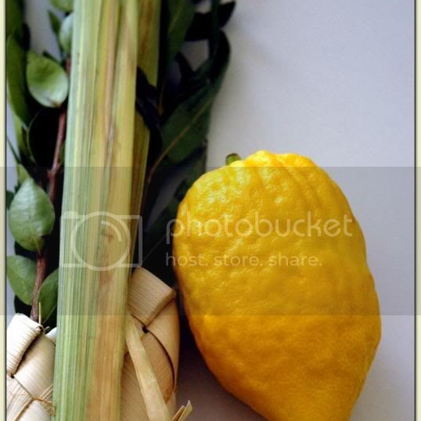
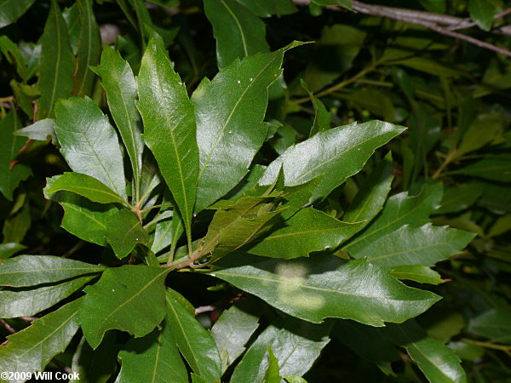
It reminds Jewish people of the sacrifice that was made
They have special items to remind them how lucky they are to have shade from Trees and the fruits that are around them.
Palm leaf
Myrtle Leaf
Etrog (fruit)
CAN YOU MATCH THE WORDS WITH THE PICTURE?

Slide 9
They have special items to remind them how lucky they are to have shade from Trees and the fruits that are around them.
Palm leaf
Myrtle Leaf
Etrog (fruit)
Well done if you matched them correctly.

